Slide 1




Children & Family Hubs – Integrated neighbourhood delivery of early help and support
GP Safeguarding Forum – December 2024
Southwark Family Hubs

Slide 2

LONDON BOROUGH OF SOUTHWARK: FAMILY HUB TRANSFORMATION
WHAT IS A CHILDREN AND FAMILY HUB? – OUR VISION
A single accessible place where families can come to get all the help and support they need to thrive
Hubs will be one-stop-shops where all families with children can get the help they need, quickly, easily, and from the right people.
Professionals from across the council, partners like health and schools, the community and voluntary sectors will work together in one place. They will support families from pregnancy until children reach age 19 (or 25 for young people with special educational needs and disabilities).
We want Hubs to be a place families can trust, feel safe going to, and that de-stigmatises the idea of reaching out for help whenever its needed, especially amongst vulnerable and more disadvantaged groups and communities who are historically less likely to access services until things reach a crisis point.
Hubs will be the local nexus of a seamless ‘relational’ pathway to the right support at the right time, that families will create and maintain a connection to and a place they feel ownership of from conception and throughout their children’s lives.

Slide 3

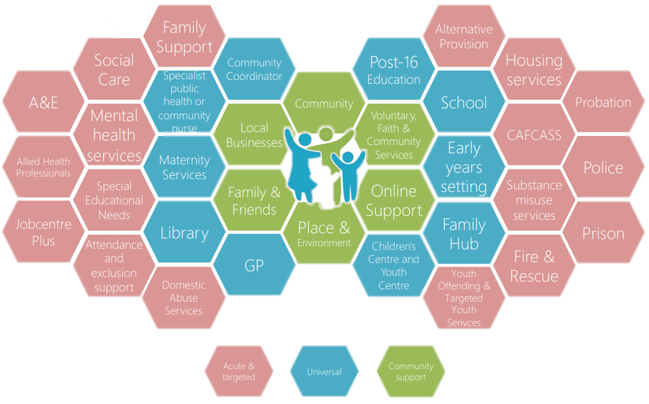
LONDON BOROUGH OF SOUTHWARK: FAMILY HUB TRANSFORMATION
STRATEGIC CONTEXT – THE EARLY HELP SYSTEM
The early help system is the coming together of over 30 categories of services and organisations, all with a key responsibility for providing early help to children and families.
Early help is a complex system of people, services and organisations made stronger with a shared vision and golden thread to bring it together effectively
On average 7% of children receive acute support from partnership services at some point annually.
The early help workforce spans a huge range of professions and disciplines across partnership services and community organisations.
Between the local authority, education and NHS estates we can identify over 430 facilities across the borough that in some part are responsible for the provision of early help, advice and support to our children and families.
Our partnership has set a clear strategic intent to explore opportunities for integration, the development of more evidence-informed and needs led multi-disciplinary interventions and services.
The partnership workforce already champions shared principles of effective practice: strength based working,
      doing with not doing to, and whole family working.
      There is an open door opportunity for stronger integration of place and people to deliver better together.
"Early Help is not a service, it’s a system"
"Early Help is the total support that improves a family’s resilience and outcomes or reduces the chance of a problem getting worse"

Slide 4
LONDON BOROUGH OF SOUTHWARK: FAMILY HUB TRANSFORMATION
CASE FOR CHANGE - ECONOMIC IMPACT OF LATE INTERVENTION
The immediate and short-run fiscal costs of the acute, statutory and essential benefits and services that are required when children, young people their parents and carers experience significant difficulties in life, many of which might have been prevented.
In 2016 the Early Intervention Foundation estimated the annual additional cost in Southwark of potentially avoidable late state intervention as approximately £90 million.
Even discounting the seismic events which have taken place since 2016 and their well evidenced disproportionate impact on our most disadvantaged communities, inflation alone in the 7-year period would bring the estimated opportunity for the partnership to realise benefits by improving outcomes for our children and families to potentially £125,477,148.

Slide 5
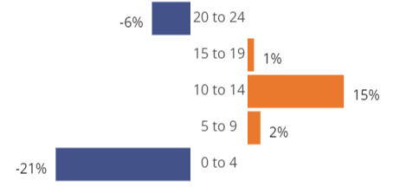
LONDON BOROUGH OF SOUTHWARK: FAMILY HUB TRANSFORMATION
CASE FOR CHANGE – DEMOGRAPHIC CHANGE
The sure start children and family centre offer as required by the Childcare Act 2006 is centred on provision of ‘early childhood services’ with a young child [being] a child beginning with his birth and ending immediately before the 1st September next following the date on which he attains the age of five.
Over the 10 year period between 2011 and 2021 Southwark has seen a 21% decrease in children aged 0-5, and a 15% increase in children aged 10-14. With continuing fall in the younger age group of children the shift towards more comprehensive provision for older children is critical.
Mapped data from the 2021 census (slides below) also shows that the decrease in younger age children has been most marked in those areas where deprivation impacting on children in highest.
Southwark Population Change 2011-2021 by 5- year age band

Slide 6
LONDON BOROUGH OF SOUTHWARK: FAMILY HUB TRANSFORMATION
CASE FOR CHANGE – INSTITUTE of FISCAL STUDIES EVALUATION OF SURE START IMPACT
In 2021 the IFS completed a longitudinal evaluation of Sure Start which showed strong correlation between access to a local centre and positive outcomes for children and their families, including:
Sure Start decisively reduces hospitalisations, with stronger immune systems, better disease management.
Sure Start decisively reduced accident and emergency attendance with safer home environments and fewer behavioural problems all potentially playing a role.
Sure Start’s impacts on child health last well beyond the end of the programme itself. Indeed, some of the biggest impacts are only felt in adolescence, nearly a decade after children have ‘aged out’ of eligibility.
Access to a Sure Start centre between the ages of 0 and 5 significantly improved the educational achievement of children, with benefits lasting at least until GCSEs (age 16).
Access to a Sure Start centre at early ages increased the likelihood of children being recorded as having a special educational need or disability (SEND) at age 5, but significantly decreased the proportion of children recorded as having a SEND at ages 11 and 16 by 3%. By age 16, the probability of having an Education, Health and Care Plan decreased by 9% (or over 1,000 children a year).
Mothers accessing Sure Start reported providing a more cognitively stimulating home learning environment for their children, a less chaotic home environment for their children, greater life satisfaction, and engaging in less harsh discipline.

Slide 7
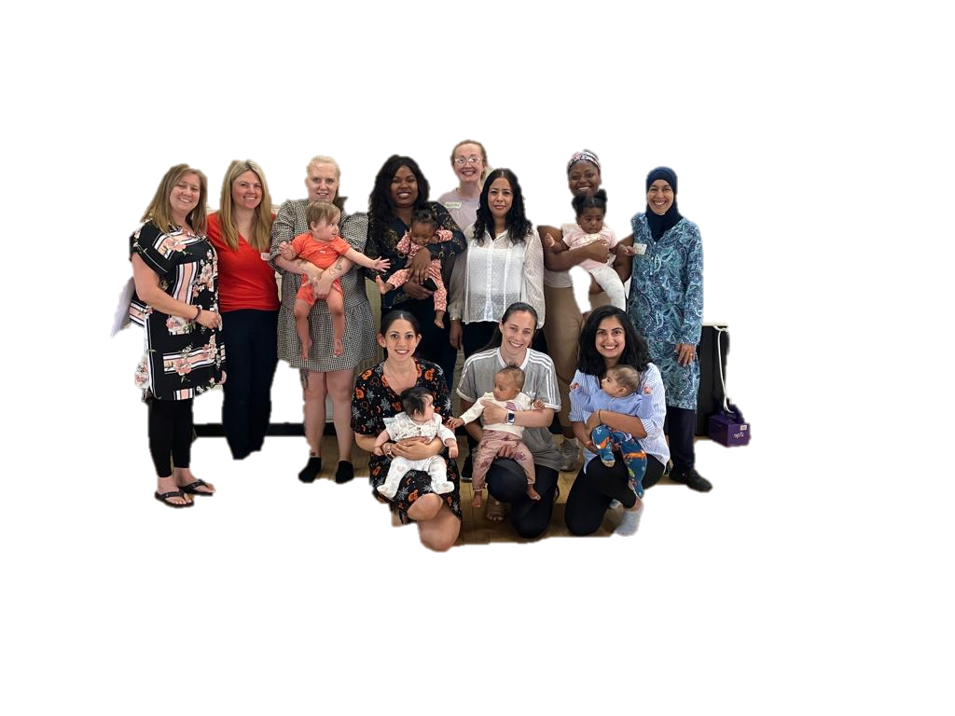
LONDON BOROUGH OF SOUTHWARK: FAMILY HUB TRANSFORMATION
CASE FOR CHANGE – WHAT FAMILIES HAVE TOLD US ABOUT HOW THEY ACCESS HELP
I don’t really know where to go to get the help I need
Getting passed around different people makes it hard to trust any of them
I went round and round the system but still didn’t get the help I needed
I hate having to tell the same story over and over again to different people
If I don’t trust I can get help, I won’t come back when I need it most
I don’t want to feel embarrassed or judged about needing help
When I do ask someone for help they often don’t know where to get it either
Sometimes it feels like all people do is pass you on to someone else instead of helping

Slide 8
LONDON BOROUGH OF SOUTHWARK: FAMILY HUB TRANSFORMATION
CASE FOR CHANGE – WHAT FAMILIES HAVE TOLD US ABOUT HOW THEY SHOULD ACCESS HELP
A consultation on the development of Family Hubs across Southwark was launched in June 2023 and is continuing through to October. The consultation is live on the Council Consultation Hub, is being delivered through a series of local area workshops, and the establishment of an interim Parent Carer Panel. So far we have been told:
89% strongly agreed (64%) or agreed (25%) that they and their families will benefit from integrated place based services.
78% strongly agreed (45%) or agreed (33%) that the development of Family Hubs through existing Children’s Centres is the right approach, 4.9% disagreed with this approach
We can’t afford to lose the locality identity and trust of our CFCs and they should be empowered to lead and direct expansion of locality offers to older age groups.
The most common alternative venue people wanted to see services operating from was Libraries (65%), followed by Education settings (59%) and leisure and health settings (both 55%).
They want arrangements to be clear and simple. Somewhere that families and wider professionals will always understand to be ‘the right’ first place to go, even when parents or professionals might not be sure of the solution they are looking for.
They want the place to be local, a short walk away, or “no more than a couple” of public transport stops away.
They want the place to have a consistent offer that they can become familiar with – both in terms of services and days.
They accept that help is not always easy to give help, but it should be easier to access, and to get clear messages and help you understand ‘where things are up to.’
They want a personalised approach, not one where you ‘call up and spend the first 20 minutes waiting while the person re-reads your records.’
They accept that no one person can do or know everything, but they expect us (the partnership) to make the right connections for them, not relying on them (families) to chase professionals and link services up for us.
They don’t expect to meet the same person every single time they need a service, but they want to see a core group of people, familiar faces, that they can grow to trust as a unit, and most importantly that their children grow and learn to trust from a young age and remember as they grow up.

Slide 9
LONDON BOROUGH OF SOUTHWARK: FAMILY HUB TRANSFORMATION
BACKGROUND – FAMILY HUBS & START FOR LIFE PROGRAMME
The Family Hubs & Start for Life Programme is a DfE grant funded transformation programme intended to deliver wholesale reform of the delivery model for support to families with children from conception to those with children of all ages 0-19 or up to 25 for those with special educational needs and disabilities (SEND).
Southwark is to receive grant funding of £3.8m over the period 2022-2025 to deliver the transformation programme and invest in trialling new innovative and evidence-based models of practice and services for families with children.
The Programme and its funding is delineated across two main areas; Family Hub Transformation, and the Start for Life Funded Workstreams. The Start for Life Funded workstreams are targeted at enhancing the provision of services for families with children aged 0-5, the five workstreams provide ring-fenced funding for;
  Parenting Support - new ways of supporting parents with the skills and knowledge they need,
  Parent–infant relationships and perinatal mental health support,
  Early language support and the home learning environment,
  Infant feeding,
  Parent Carer Panels - New mechanisms for local parents and carers to lead the development of local services.
  The major portion of the funding under the programme is ring-fenced for the system wide transformation of integrated local delivery arrangements – Family Hubs. The Family Hubs Programme is intended to deliver system level change across the whole borough, through new data sharing arrangements, leadership and governance, evaluation and improving the accessibility, integration and connectivity of existing service delivery.
The transformation programme is required to achieve a range of outcomes, some examples of which are:
  more of our vulnerable families are benefiting from easier access and better connection with the right professional and peer support services within their communities,
  where feasible relevant universal and targeted services are co-located, developing local bespoke responses to need, and delivering to a defined community and locality area. Integration of partnership delivery at a neighbourhood level
  families will be able to access all the high-quality support they need in a single place locally and virtually – from breast feeding to benefits advice
  families will be able to go to a refreshed warm, welcoming environment where they will experience one single assessment of need for the whole family, only tell their story once and receive the right support, advice and guidance for every member of the family,
  the complexity of service delivery is reduced through integration, breaking down institutional barriers, empowering disparate professionals to navigate support for families to the full range of services available to them from a single access point
  families receive wraparound support from a skilled and consistent workforce who are able to identify and respond sensitively to a range of need
  Alignment of professional behaviours, culture and values - all families will experience a strengths and relationship-based and ‘whole family’ approach, building on the strengths already inherent while addressing need. Through up of shared practice tools, approaches and interventions
  Moving towards single physical and virtual referral routes into multi-agency support, single shared model’s of assessment, and integrated case management and data systems

Slide 10

LONDON BOROUGH OF SOUTHWARK: FAMILY HUB TRANSFORMATION
CURRENT CHILDREN & FAMILY CENTRE PROVISION
Unlike most other Local Authority areas nationally Southwark has protected investment in Children & Family Centres and the delivery of the Sure Start Core Purpose for children aged 0-5. The core purpose is to:
improve outcomes for young children and their families and reduce inequalities between families in greatest need and their peers in:
child development and school readiness;
parenting aspirations and parenting skills; and
child and family health and life chances.
Southwark’s current Child & Family Centre Provision is delivered from 16 sites by a mix of third sector and educational organisations in 4 clusters covering the whole borough and delivering consistent core services and a range of local interventions and sessions:
Bermondsey and Rotherhithe
Borough, Bankside and Walworth
Camberwell and Dulwich
Peckham, Nunhead and Peckham Rye
Children & Family Centre Locations

Slide 11
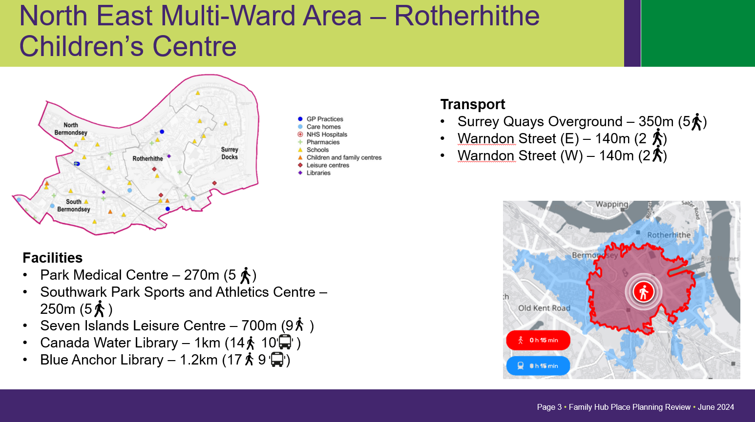
LONDON BOROUGH OF SOUTHWARK: FAMILY HUB TRANSFORMATION
PREMISES REVIEW - CRITERIA
Consultation with families alongside statutory and programme guidance has informed criteria for the evaluation of premises that can support a stronger and more integrated community-based help and support offer.
Must be accessible to those within areas of highest need
Should be within 15-20 minutes walking distance and/or 2-3 bus
stops.
Need to be accessible at times that work for families with children
of various ages – evenings and weekends
Sufficient space for a variety of services to co-locate
Sufficient space for a variety of group sessions to be delivered
Sufficient space for small group/1-1 appointments and
sensitive/private conversations to take place
Appropriate facilities for clinical services to be delivered –
midwifery, sexual health, health visiting
Accessible and inclusive in particular for groups with protected
characteristics
Welcoming, family friendly and comfortable reception area with space to drop-in and get quick advice and support
In proximity to other community locations that can provide wider support particular for older children i.e. libraries, community halls, leisure centres
Can accommodate safe and secure space for breastfeeding and to meet other breastfeeding parents
Established delivery of the 0-5 statutory duty

Slide 12
LONDON BOROUGH OF SOUTHWARK: FAMILY HUB TRANSFORMATION
PROPOSALS FOR A (re)NEW(ed) MODEL APPROACH
Re-energising proven elements of the Sure Start Core Purpose
A number of elements of the original Sure Start model have been lost over the past decade, the programme is seeking to re-energise the:
evidenced successes of co-location of teams and co-located delivery venues
focus on assertive outreach into most in need communities
focus on data driven design of the offer in specific areas
role of Parent Carer Panels in every area
convening role of Hubs to facilitate local area leadership connections
convening role of Hubs to facilitate local area workforce connections
In addition to re-instituting elements of the Sure Start model a number of changes to the core delivery of local Hub provision will include:
expanding opening hours and opening days of Hubs to cover more non-work hours
increasing capacity and skills in Hubs to provide ‘at the point of access’ help support – i.e. Family Navigators, Social Prescribers
further increasing investment in outreach and awareness raising into seldom seen communities
expanding the co-located teams across the whole age range
expanding the broader advice and guidance offer across the whole age range
greater integration with other community assets more likely to support older children, including libraries, leisure centres, youth centres.
Expanding the current core offer

Slide 13




Family Hubs & Start for Life Programme
Briefing – October 2024

Slide 14
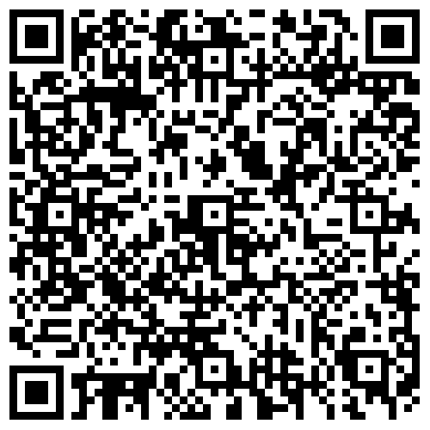
Start for Life Southwark
Access to support
Start for Life Southwark Webpage www.southwark.gov.uk/startforlife
Brings together information in one place that any parent and carers can use to navigate local support and services.
Specifically aimed at support during pregnancy to five years of age
provides helpful advice and support from pregnancy care, infant feeding, through to parenting support and childcare.
Visit Start for Life Southwark webpage
Trained staff in Children & Family Hubs
Information on support is available across Children & Family Hubs network in Southwark
Advice, guidance and signposting available from trained staff

Slide 15
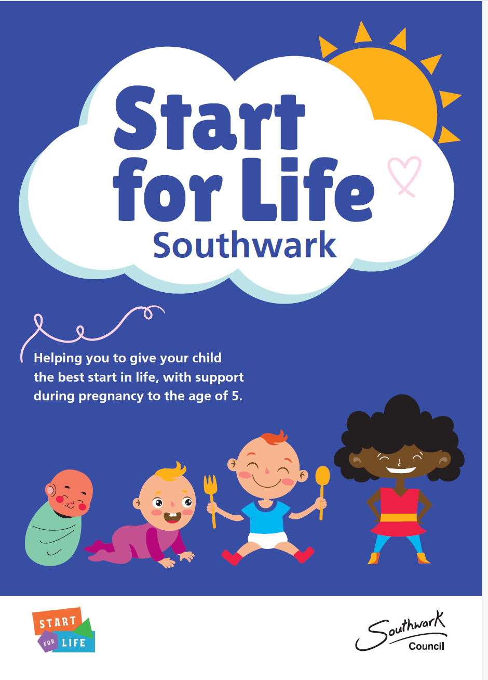
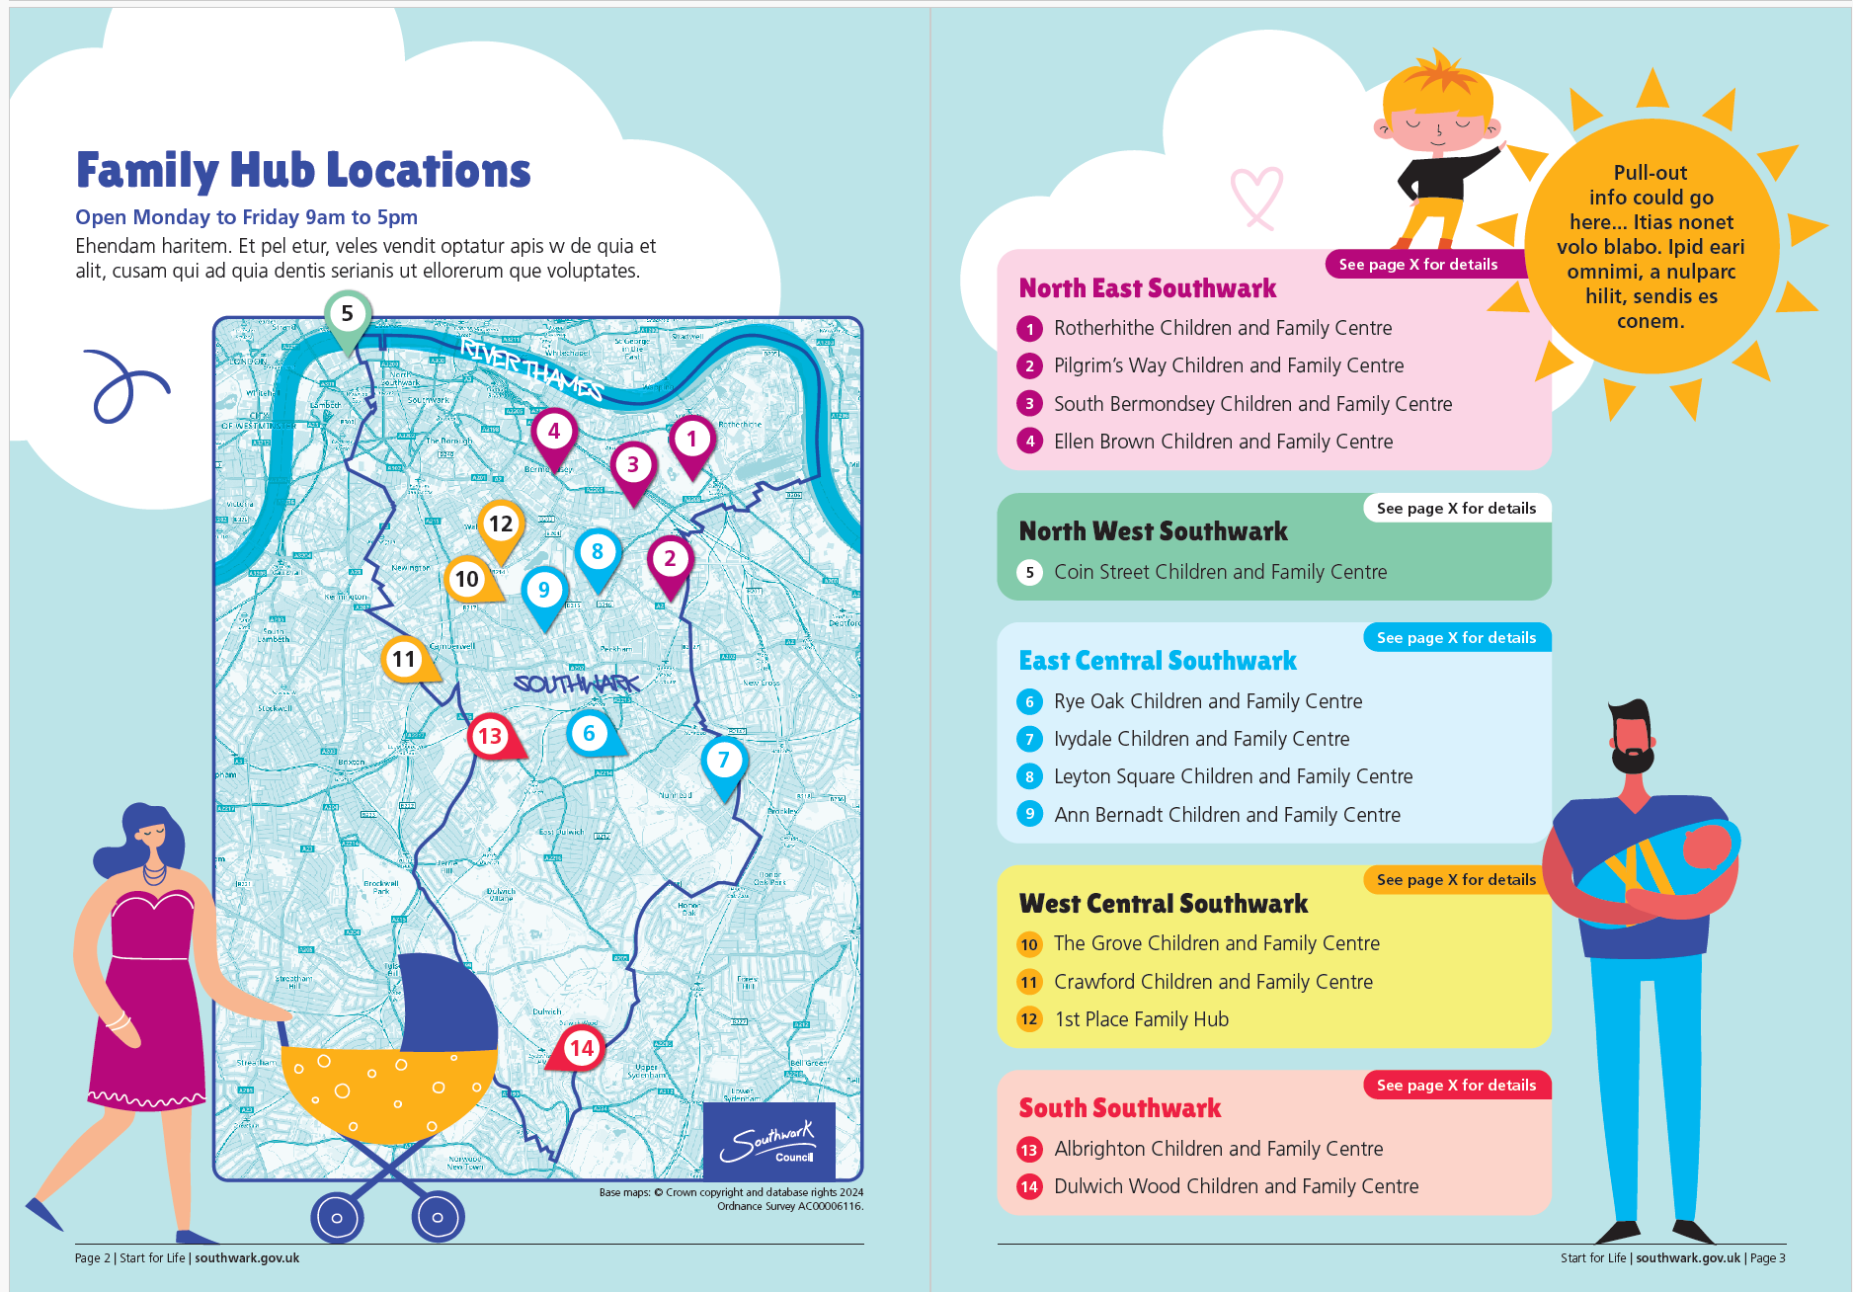
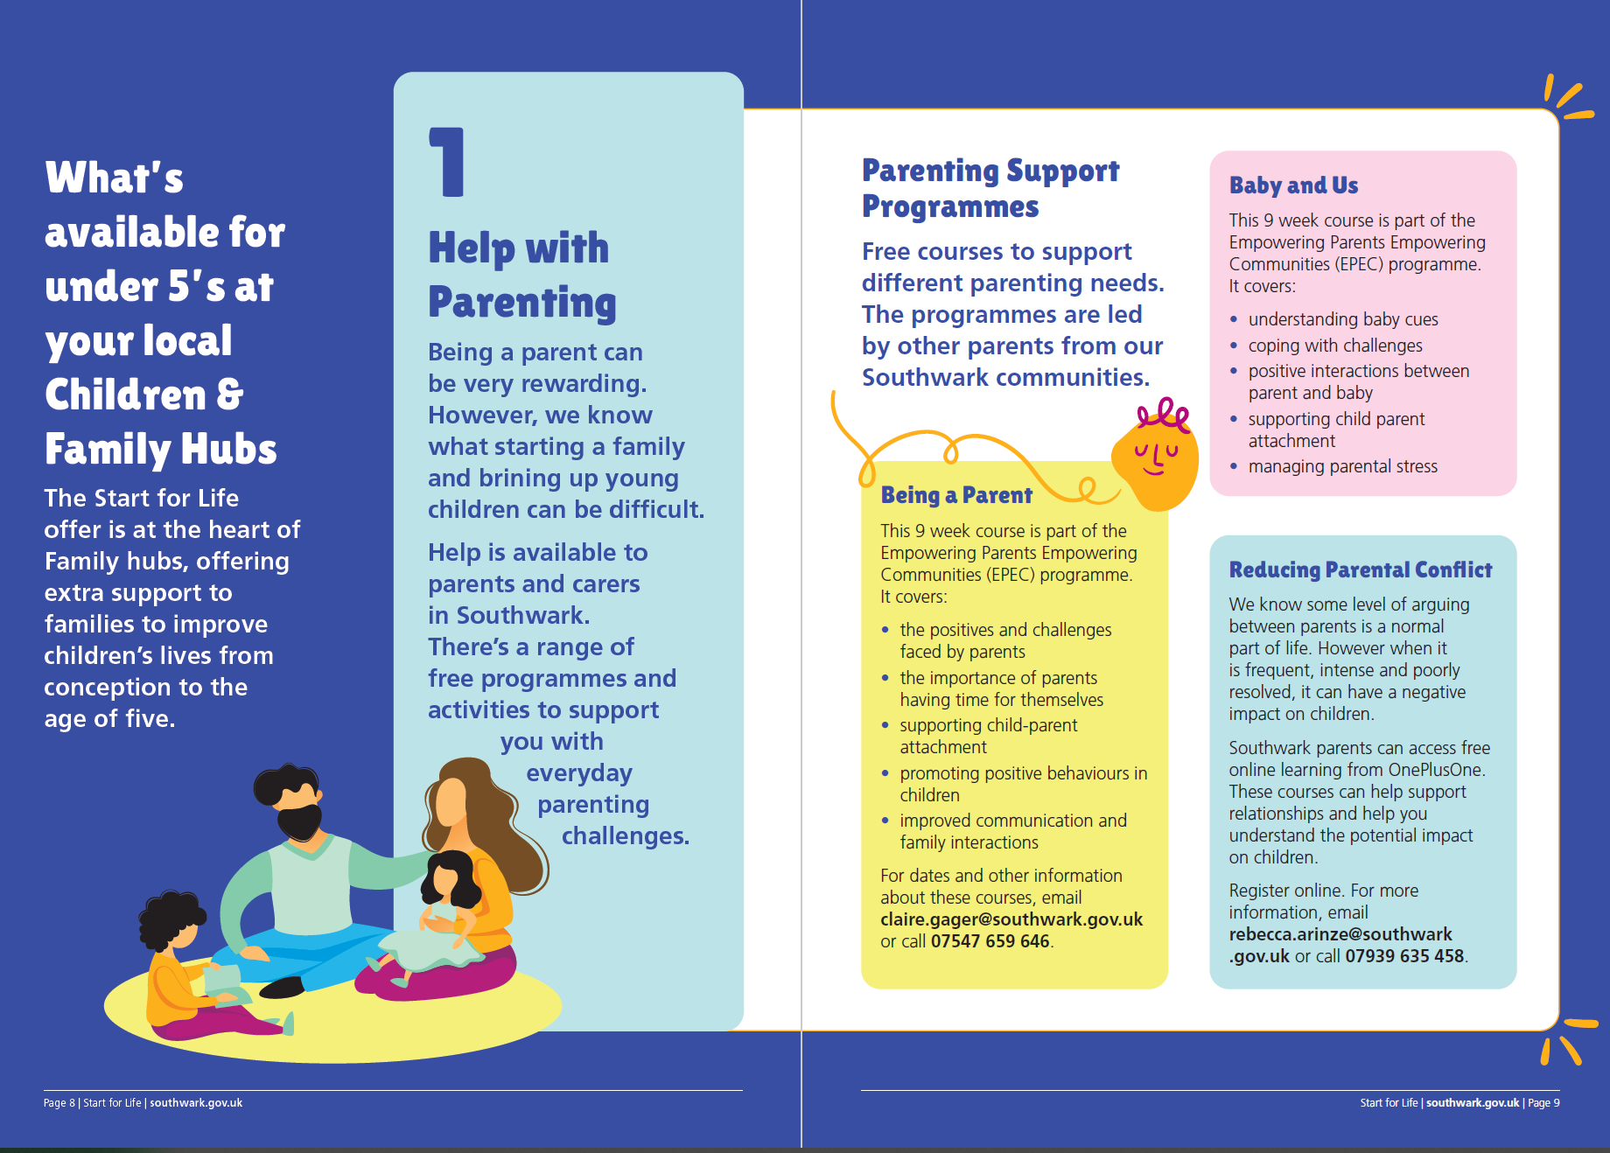
Start for Life Southwark – physical copy
Content Overview
Section1: Introduction
Section 2: About Children & Family Hubs
Section 3: Southwark Map location of Hubs, children centres and key settings (GP, Leisure centres, libraries etc
Section 4: Universal Pathway Diagram – key milestones /points of contact with universal support services
Section 5: Start for Life activities available to families
Section: A directory of universal support services

Slide 16
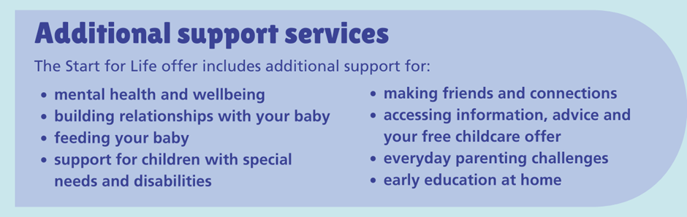
Start for Life Southwark
Southwark Children and Family Hubs Networks
1st Place Children & Family Hub
12 Chumleigh St, London SE5 0RN
Tel: 020 7740 8070
Email: BBWCFC@1stplace.uk.com
Rye Oak Children & Family Hub
Whorlton Road, Peckham, SE15 3PD
Tel: 020 3848 5780
Email: childrenscentre@ivydale.southwark.sch.uk
Dulwich Wood Children & Family Hub
Lyall Ave, London SE21 8QS
Email: cdcfcoffices@dulwichwood.com
Tel: 020 7525 2017
South Bermondsey Children & Family Hub
Tenda Road, SE16 3PN
Email: ccadmin@pilgrimsway.southwark.sch.uk
Tel: 0207 358 2878

Slide 17
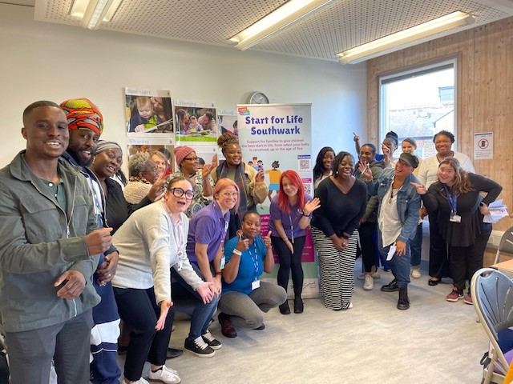
Start for Life Southwark
Collaborative working
Start for life: Community Help & Support Networking Events
  open invite breakfast sessions for services, partners, voluntary and community organisations
  building stronger local relationships
  learn about what each other is doing to help in the community.
  share any issues and ideas
  renew and create new relationships
Dates for next events
Tuesday 19th November 2024 – South Bermondsey Children & Family Hub
Friday 22nd November 2024 at Rye Oak Children & Family Hub (Peckham Rye)
Wednesday 4th December 2024 at 1st Place Children & Family Hub (Burgess Park)
Friday 31st January 2025 at Dulwich Wood Children & Family Hub
Click link here to register your interest to attend the sessions:

Slide 18
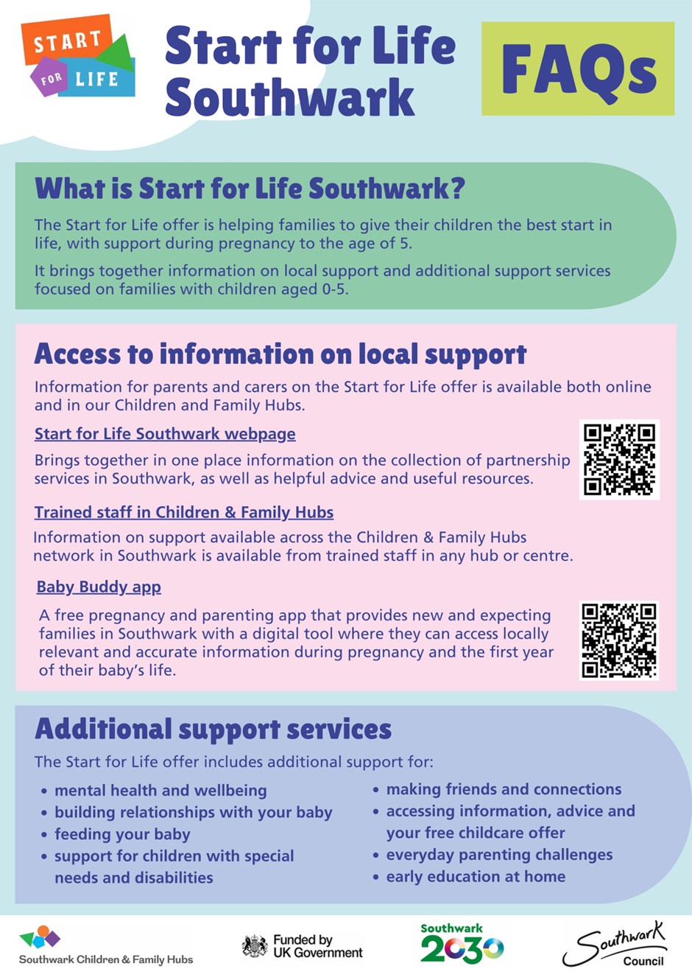
Start for Life Southwark
What are we asking from you?
Raising awareness across your services to enable frontline staff to
  signpost to Start for Life webpage
  signpost to Children and Family Hub network for information, advice and support services
  Inform families on the range of support services available
Opportunities to meet with and share our Start for Life FAQ document with frontline staff
Display Start for Life promotional material in settings
Encourage attendance at the Community Help & Support Networking Events

Slide 19

LONDON BOROUGH OF SOUTHWARK: FAMILY HUB TRANSFORMATION
DELIVERING THE SOUTHWARK 2030 GOALS & PRINCIPLES
Children & Family Hubs have a significant role to play in delivering against our Southwark 2030 goals and principles, including:
to reduce inequality – ensuring a Hub is accessible to our most in need and deprived communities. Prioritising outreach and community engagement and awareness raising into our most seldom seen communities
empower people – establishing representative locality-based Parent Carer Panels to co-design the local offer and hold services to account
invest in prevention – repurposing resources towards earlier and earlier intervention and a better connected universal and targeted offer
support the best start in early years – retaining a strong universal early years offer, and supplementing by strengthening the connection across the health, wellbeing and support landscape for children in the early years
improve outcomes for those facing disadvantage – empowering local leaders across the wider help and support system with stronger place-based analysis to strengthen the local offer for all ages of children

