Slide 1
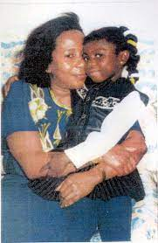
Private Fostering

Slide 2
Learning objectives
Understanding private fostering
legal responsibilities
safeguarding implications
and role clarity for professionals and agencies.

Slide 3

What is Private Fostering ?
Private fostering is a private arrangement between a parent and a carer, to look after a child/children under the age of 16 (18 if disabled).
The carer would not be a blood relative, therefore : a cousin, great aunt/uncle, neighbour, friend as well as boarding schools
This arrangement would have to be more than 28 days, before being considered as PF arrangement.
Private Foster Carers do not have PR but can make day to day decisions for the child.
Notes:
Private fostering arrangements are usually hidden, and rarely brought to the attention of the local authority, even though it is an offence not inform them.

Slide 4
Private Fostering Situations
Local children living apart from their families
Children from overseas
Child care arrangements
Asylum seekers and refugees
Parents who may be unwell
Children who may be staying with friends for a short time due to family difficulties
Children attending language schools
Children at independent boarding schools who do not return home for holidays
Children living with another family for a variety of reasons
Children brought into the UK for adoption
Notes:
There are different types of private fostering situations
Sometimes families breakdown, and it is best for a child to be privately fostered until the family can sort their issues out.
A very popular form of PF, are children from overseas whose parents want them to have a better life or education , and send them to the UK to be looked after by a friend of the family. Within the borough of Southwark this is usually seen within the Asian and Afro-Caribbean community.
Children who attend language school from abroad on a educational programme, will usually stay with a host family, whilst in the UK.
Children who attend boarding schools, if they do not return home during the summer holidays, that would be deemed as a PF arrangement

Slide 5
What is my role
I oversee all children in Southwark in private fostering arrangements.
When a referral comes in from MASH, an initial visit occurs to see the child and carer within 7 days.
I complete a private fostering assessment to ascertain the suitability of the arrangement.
I present all my cases at the Private Fostering panel every 8 weeks
I supervise carers and visit children every 6 to 12 weeks
I offer advice on benefits and parenting support
I spread awareness of what Private Fostering is to both the community and other professionals.

Slide 6
What the Law says about Private fostering
The law requires that both the parents and carer must notify the local authority about the proposed arrangement before it takes place; failure to give notification is an offence.
The local authority is required to assess and say whether or not they agree and accept the private fostering arrangement in regard to a particular child.
Notes:
The Private Fostering Regulations 2005, stipulates that any person who is involved (whether involved directly or not) in arranging for a child to be fostered privately must notify the appropriate local authority of the arrangement as soon as possible before as well as after the arrangement has been made.

Slide 7
Case study
Tiangy – A Young Person in a Private Fostering Arrangement
Background: Tiangy, a 14-year-old girl from Sierra Leone, came to the UK to live with a family friend, Martha, after the death of her grandmother who had been her main carer. Tiangy’s mother remains in Sierra Leone. Martha agreed to care for Tiangy on an informal basis.
Identification:
Tiangy was brought to a GP appointment for a routine vaccination. During the health check, it became apparent that Martha was not Tiangy’s biological relative and had been caring for her for over two months. The GP correctly identified this as a private fostering arrangement and made a referral to children’s services.
Intervention:
Children’s services conducted a private fostering assessment to ensure Tiangy was safe and well cared for. The home was deemed suitable, and Tiangy presented as happy and settled. However, some gaps were identified—such as the need for a DBS check for another adult living in the household, and a lack of clarity around Martha’s legal status as a carer.
Outcome:
Children’s services worked with Martha to formalise the arrangement, ensure all safeguarding checks were completed, and advised her to seek legal advice regarding long-term guardianship. Regular visits were scheduled to monitor Tiangy’s well-being. Martha was also supported in understanding her responsibilities, and the school nurse was informed to ensure continuity of care.
Notes:
Discussion points: Legal implications, necessary steps (e.g., notifying local authorities, ensuring the carer's suitability), and potential risks (e.g., exploitation, neglect).
Key Messages for Health Professionals:
• Private fostering occurs when a child under 16 (or 18 if disabled) lives with someone who is not a close relative for more than 28 days.
• Health professionals are in a key position to identify these arrangements—especially during routine health checks or vaccinations.
• Referral to children’s services is a legal requirement when private fostering is suspected.
• Early identification and support ensures that the child’s health, education, and emotional needs are properly met.

Slide 8
Case study 2
Case Study 2 (15 minutes)
Scenario: An 8-year-old child is sent by their parents, who are facing temporary financial hardship, to live with a neighbour for more than 28 days. The parents haven't informed the local authority.
  Explore safeguarding concerns (emotional well-being, school attendance, etc.).
  Discussion points: The role of professionals in encouraging parents to report the situation, possible outcomes, and how to monitor the child's welfare.

Slide 9
What your responsibilities are ?
It is also imperative that all agencies are aware of the relationship between private fostering and safeguarding activities. Some children who are privately fostered may also have been trafficked, be at risk of exploitation, domestic servitude and abuse.
If you are aware that a child is being privately fostered, encourage the parents or private foster carer to notify us about their arrangements, explaining that it is the legal duty of both parents and carers to do this. **
All key professionals and agencies who are involved with children/young people are able to access advice from MASH in the Assessment and Intervention Service on 020 7525 1921 or email MASH@southwark.gov.uk.
Notes:
**Many parents and private foster carers are not aware they have to notify local authorities of the arrangements they make and some people may be wary of notifying us. Reassure families and private foster carers that we are here to help them and may be able to offer them support and advice on how to access benefits.

Slide 10
People who can help
You can speak to or email or invite us to your team meetings…
Rachael Omotayo, Specialist PF Senior Social Worker: 07395882517 Rachael.Omotayo@southwark.gov.uk
Aine Lavin Team Manager : Aine.Lavin@southwark.gov.uk
Joyce Patton, Service Manager, SFS A Joyce.Patton@southwark.gov.uk

Slide 11
Summary: Private Fostering Annual Report 2022/2023
In 2022/23 (April 2022 to March 2023) we received 13 new notifications of privately fostered children in Southwark. The largest referral source were from schools accounting for 3 of the 13 referrals and an internal source – social worker within the Local Authority, which accounted for 3 referrals. Of the remaining 7 referrals, 2 were from other Local Authorities, 1 from an individual family member, 1 from the Education Service, 1 from the Home Office, 1 from a legal agency (Court) and 1 from the Housing service. This showed a wide variation in referral source, although compared to the previous year, no referrals were received from the Police or Health services.**
Of the 13 new notifications we received in 2022/23, 7 children were in the 12+ age range, 5 children in the 6-11year age range and 1 child was in the 3-5 year age range. **
Of the 13 new notifications received, the largest ethnic group was Black/Black British (African) at 76.92% (10 children), followed by other ethnic group (Spanish) at 15.38% (2 children) and White British at 7.69% (1 child.) Within the cohort of children from Black - African backgrounds, 6 children were from Nigeria, 1 from Sierra Leone, 1 from the Congo, 1 from Ghana and 1 from Cameroon. **

Slide 12
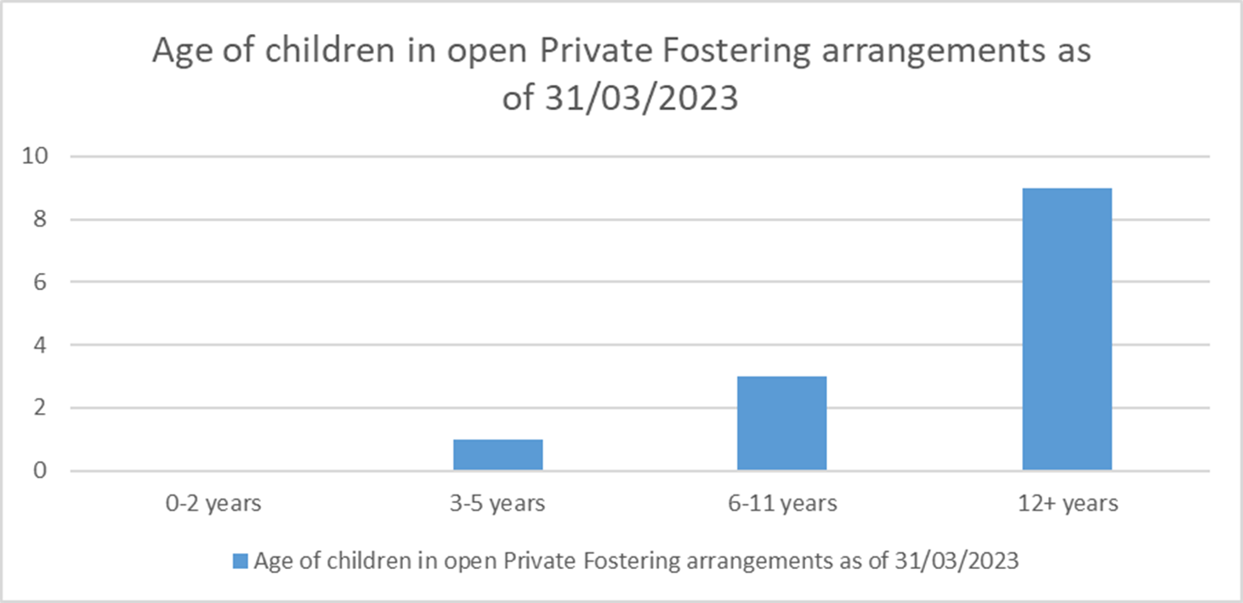

Slide 13
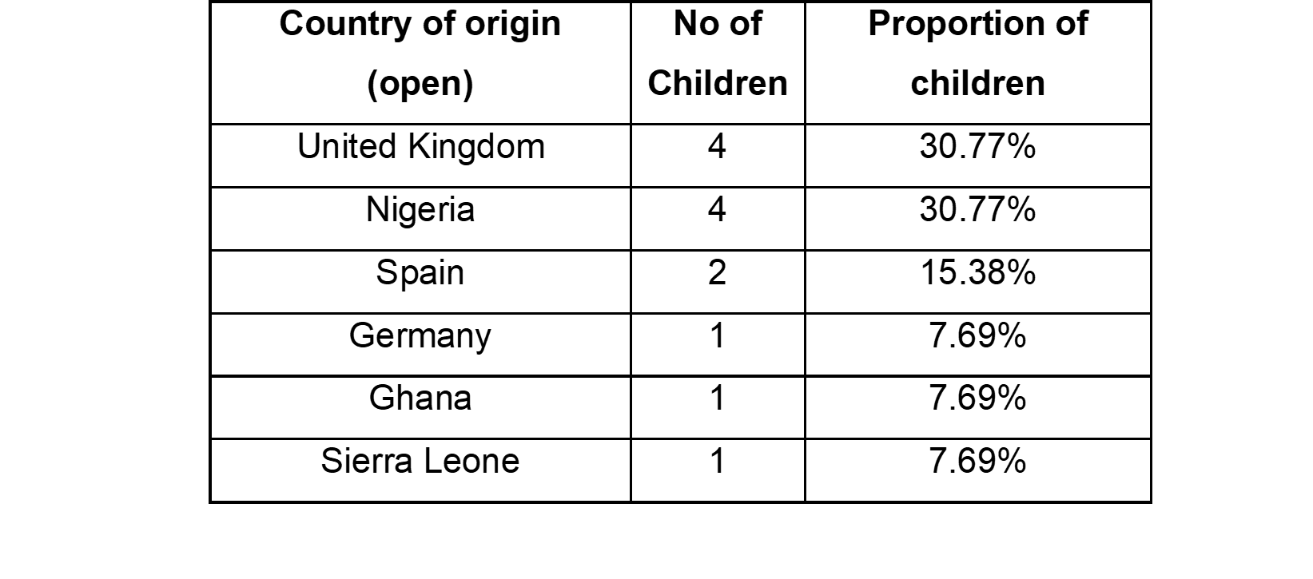

Slide 14
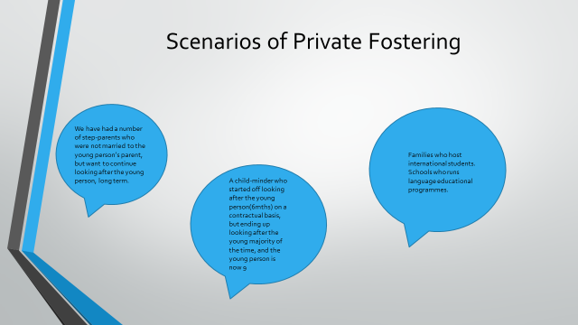

Slide 15
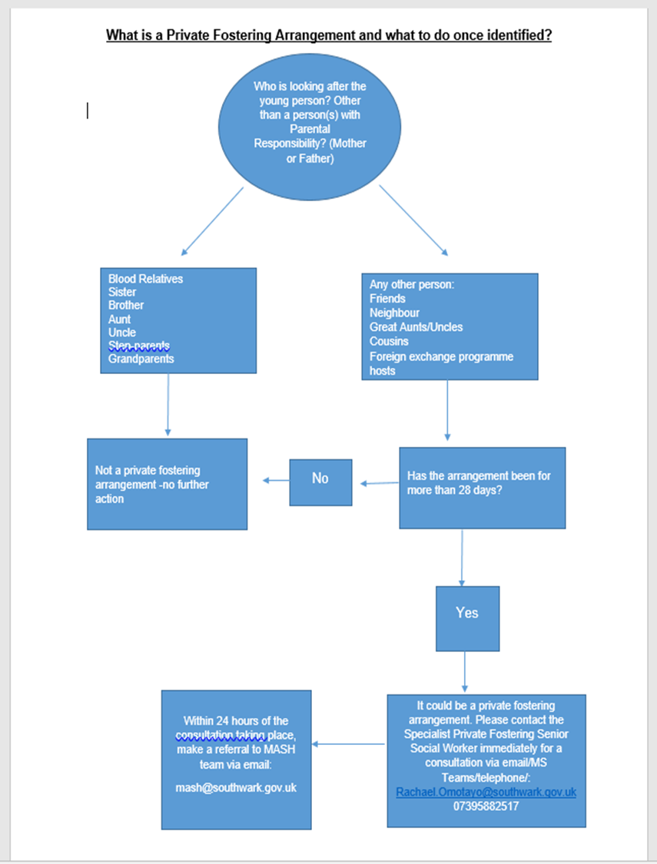
Private Fostering flow Chart

Slide 16

Quiz!!!

Slide 17

Question 1: Private fostering is an arrangement where a child under the age of 16 (or 18 if disabled) lives with someone who is:
a. Their parent
b. A relative as defined by the Children Act 1989
c. A person with parental responsibility
d. None of the above

Slide 18

Question 2: Which of the following relatives is not considered a 'relative' under the Children Act 1989 for private fostering purposes?
a. Grandparent
b. Great aunt
c. Uncle by marriage
d. Step-parent

Slide 19
Question 3: In private fostering, the local authority must be notified if the arrangement lasts for more than:
a. 14 days
b. 21 days
c. 28 days
d. 35 days

Slide 20

Question 4: Which of the following situations might involve private fostering?
a. A child living with their step-parent
b. A child living with their grandparent
c. A child living with a family friend for 30 days
d. A child living with their sibling

Slide 21
Question 5: What must a local authority do within seven days of being notified about a private fostering arrangement?
a. Find alternative accommodation for the child
b. Visit the home and speak to the carer and child
c. Arrange a court hearing
d. Enrol the child in a new school

Slide 22

Question 6: Which piece of legislation replaced the Children (Private Arrangements for Fostering) Regulations 1991? a. Children Act 1989
b. Children (Private Arrangements for Fostering) Regulations 2005
c. Children Act 2004
d. Adoption and Children Act 2002

Slide 23

Question 7: If a private fostering arrangement ends, the private foster carer must notify the local authority within: a. 24 hours
b. 48 hours
c. One week
d. One month

Slide 24
Question 8: A private foster carer:
a. Has full parental responsibility
b. Can make day-to-day decisions for the child
c. Must adopt the child within a year
d. Is not allowed to make any decisions for the child

Slide 25

Question 9: What kind of support can a private foster carer receive from the local authority?
a. Financial support equivalent to child benefit
b. Advice on benefits and parenting support
c. Full parental rights and responsibilities
d. Free accommodation

Slide 26

Question 10: True or False: Private fostering arrangements need to be continuous and cannot include brief breaks.
a. True b. False

Slide 27
Questions ???

