Slide 1
Primary Care Safeguarding Forum
Wednesday 17th December 2025
megan.morris@selondonics.nhs.uk
s.gayle@nhs.net
This forum can form part of your Safeguarding Adults/Children Level 3 Training

Slide 2
Agenda
Topic | Speaker
Brief updates from the Safeguarding Leads | Shimona Gayle/Megan Morris
New VAWG service starting February, and Safe Havens Scheme in Southwark | CANCELLED due to illness
Supporting people with No Recourse to Public Funds who are victims of Domestic Abuse | Daisey Hussain, our current Health IGVA, Refuge (Southwark Domestic Abuse Services)
Southwark Council Hoarding Panel | Laurna Huggins and Yinka Olubajo, Resident Services/Area Manager, Southwark Council Housing Department
An approach to identifying and supporting patients who hoard in Southwark | Megan Morris

Slide 3
Updates from the Named GPs
Domestic Abuse Service going through changes
New service will be launched in February 2026 to incorporate support in Domestic Abuse but also other offences of Violence Against Women and Girls (VAWG) – you will be kept updated of any changes to referral processes etc.
Use current form, email, phone number until further notice:
  sdas@refuge.org.uk phone 01182147150
Our current “Health IGVA” is Daisey Hussain. She is assigned to manage all referrals sent to SDAS by us from general practice, or other health settings.
She is able to see patients at your surgery, by prior arrangement with you, the referrer (or your admin team) if this is the patient’s preference.
There will continue to be a Health IGVA in post after the change to the structure of the service.

Slide 4
Adult Safeguarding Referrals Web Portal now live
www.southwark.gov.uk/adult-social-care/report-abuse-or-neglect
You can still currently use the mergeable form on DXS and email this but this will not be for very much longer.
YOU WILL BE INFORMED WHEN THIS CHANGES

Slide 5
Primary Care Safeguarding Audit Launching Today
All Practice Safeguarding Leads will receive an invite to complete an online questionnaire for their practice, which will also be sent to the practice generic email inbox (only one response needed per practice)
Questionnaire designed by your Named GPs (us!)
Results help to inform us of areas we need to support practices with more
We will aim to present the data at the next Primary Care Safeguarding Forum

Slide 6
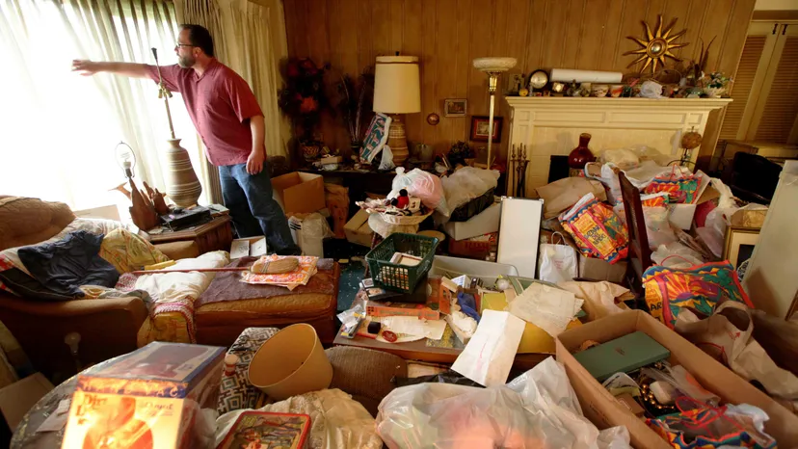
Supporting patients that
Hoard and Self-neglect
Understand that hoarding and self-neglect often stem from previous trauma
build trust and approach the issue sensitively and compassionately
A slowly-slowly approach – go at the patient’s own pace and with their collaboration
Keith's story: a personal and touching film about hoarding - YouTube

Slide 7
Affects 2-5% of the population
However
Just 5% of those with hoarding issues come to the attention of statutory agencies (Nottinghamshire Multi-Agency Hoarding Framework)
  May often be used as a protective response to hide from outside world
  It may not be obvious who may have this condition – often may lead a “double life” keeping up appearances when outside the home
  May be particularly reluctant to accept visitors to their home
  Shame/an element of DSH
  Underlying depression, anxiety, PTSD, and other addictions common
  Consider asking patients about their home environment when seeing
  them at the surgery as many may have undiscovered hoarding issues
  complicating ther health /putting them at risk

Slide 8
Risks:
  Can find it difficult to get to bathroom or kitchen due to build-up of clutter
    Poor nutrition
    Poor hygiene
  Can stop individuals from seeking help for home maintenance etc due to the shame of having people into the home
    Gas safety
    Heating/electricity may be lacking
  Fire hazard
    1/3 of all people who die in house fires are
    hoarders
    Impact on physcial and mental health

Slide 9
Action Plan
1. Safeguarding Adults Concern referral if significant risks
2. Discuss with patient about addressing underlying issues
  Southwark Talking Therapies for CBT
  PCN Mental Health Nurse
  Assessment and Liaison Consultant advice/referral to potentially access more specialised therapy
    Through SLAM secondary care patients can be referred on to a service within CADAT:
    “Centre for Anxiety Disorders and Trauma”, based in Denmark Hill
3. Consider presenting at the Hoarding Panel to have a multi-agency approach – esp helpful if a tenant of Southwark Council
4. Discuss with patient referral to ASC/Social Prescribers

Slide 10
CADAT service for hoarders
Limited capacity
Needs tertiary panel approval and funding (no direct GP referrals)
20hrs of treatment
  2x 2hr home visits
  16-18 sessions in total

Slide 11
Service Criteria to bear in mind for your patients
Hoarding is the primary difficulty
Hoarding is not the result of a different problem i.e. mobility difficulties, primarily self-neglect related to depression (or other MH Difficulty) or physical health difficulties.
Patients live within 30mins of CADAT (main Maudsley site)
The client is willing and on board with the referral and are ready and motivated to engage in de-cluttering
The client can attend the majority of sessions at the clinic
They would allow home visits, and these would be safe for CADAT staff to attend
CADAT would also review which referrals might meaningfully be treated within 18-20 outpatient sessions, and which may require alternative services or approaches: e.g., hoarding as secondary to complex PTSD (which they don’t treat at CADAT), or cases needing a MDT approach due to e.g. severity and chronicity
They meet the general pre-existing CADAT criteria around risk, alcohol/substance misuse etc.

Slide 12
              Patience
              Kindness
              Respect
Allow patients to feel heard
Review regularly, but don’t push too hard
Build patient’s trust before suggesting potential referrals/solutions
Be realistic about what services are available to them
Remember that the process of decluttering can be extremely traumatic for the individual if not approached with sensitivity

