Slide 1
Child J
Michele Sault
Designate Nurse Safeguarding Children
J was a 16-year-old born male and was currently waiting GIDs service following being referred there in 2020.
Mother also had serious mental health issues and was often hospitalised, she was an inpatient leading up to and on the day of J’s death.
Was known to CAMHS from 2017 – 2023 for emotional regulation difficulties, anxiety, depression and gender dysphoria.
Mother and father split up when she was 10 years old and J struggled with this, early learning showed she experienced fractured family relationships and rejections.
History of domestic abuse with mothers' partners of which J would have witnessed.
Paternal family did not support her with gender identity issues.

Slide 2
J became a victim of hate crime in the community and stopped attending school due to transphobic bullying.
Concerns around possible sexual exploitation and an older boyfriend and being coerced into taking large amounts of drugs.
Several episodes of missing episodes whilst staying with maternal grandmother.
J become a looked after child in Feb 2023 and had 4 placements moves. Professional concerns missing episodes from placements and semi-independent accommodation were an ongoing concern.
J took her own life in 2024

Slide 3
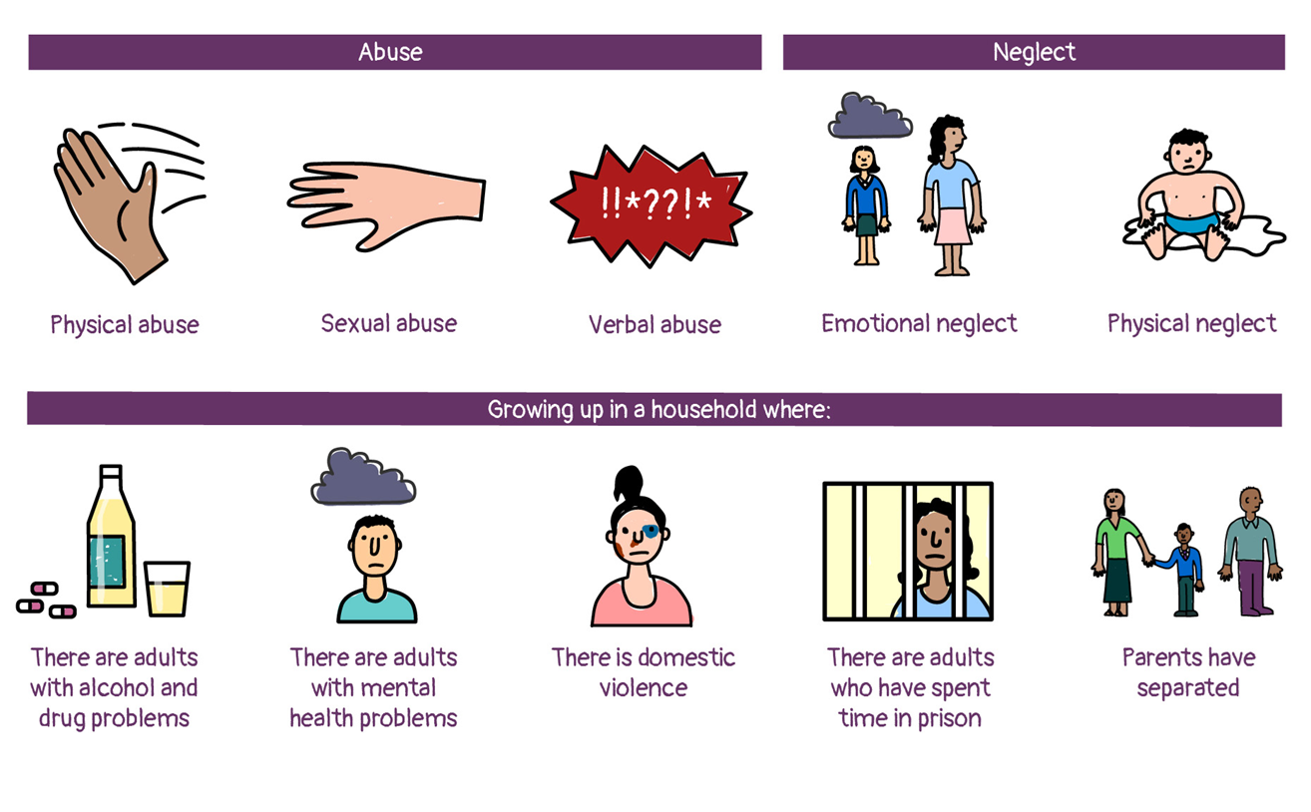
Early Learning & Emerging Themes
Adverse Childhood Experiences (ACE’s)
Out of 10 widely recognised ACEs J would have experienced 9

Slide 4

Gender Identity and multiagency understanding of this.
The Child’s Voice especially around exploitation and trauma, “was it heard”
Professional understanding of both negative and positive issues around online use,(especially that the young person’s phone was so important to her and one of the indicators of her stress just before the incident happened because her “boyfriend” had taken it from her).
This Photo by Unknown Author is licensed under CC BY-NC-ND

