Slide 1

Connected:
How does your service support seamless and successful patient journeys?

Slide 2
Aim of this session
Our health system is very complex – it can be difficult to navigate for both staff and service users.
For this system to work together everyone in it (patients and staff in different services) need to know:
  What is happening now (i.e. how far through a process are they, when will the next activity happen)
  What they need to do
  What others can do, and what they will do
  How to contact the right person to resolve any questions or issues
As our system is made up of lots of small teams delivering different parts of an individual’s care (e.g. staff at GP practice, in A&E, or in an outpatient clinic) it is difficult to ensure these four things are consistently known by all – and this causes problems and errors which effect the experience of care of our patients and the daily working life of our staff.
Healthcare professionals working across south east London, with the input of service users, have worked together to create a number of resources to help teams improve how they work with others. Many are mentioned in this session.
This session is designed for teams to use to examine how their service currently functions as part of the system – where things are working well, and where they could be improved. It will point to resources that may help, and ask teams to consider a few simple actions they can take which will improve the experience for all patients and staff in our healthcare system.
This session is designed to be self-delivered by teams and should take approximately 1 hour, if you would like some advice on how to run the session please contact: [email address]

Slide 3
What problems occur when services aren’t connected?
(10 mins)

Slide 4
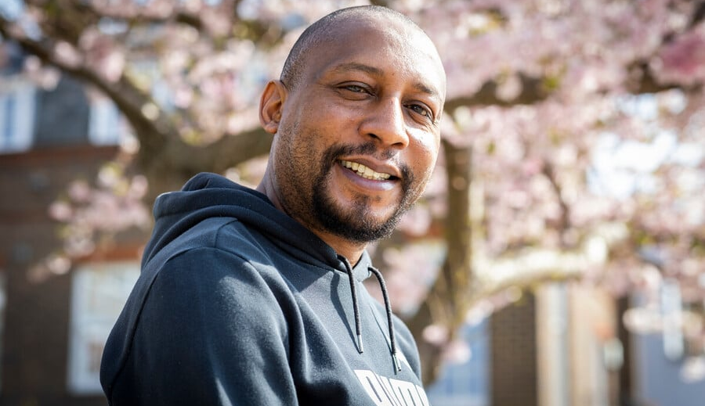
Video: experiences of service users and carers
Patient quote:
I’ve got 5 different doctors. It’s mind boggling. It’s confusing.
Carer quote:
All the time I should be resting and recovering, I spend chasing up NHS admin for me and my dad. It’s so frustrating feeling like the system is working against you.
Patient quote:
I think it took me about a year to finally get on my medication, on repeat and coming regularly

Slide 5

1. Stuart’s Story
When care transitions don’t run smoothly, patients are often forced to become their own champions, finding workarounds when processes don’t work as they should. Over time, some patients have come to expect that there will be problems at the interface, leading to anxiety and confusion. Stuart’s story gives an example of this.

Slide 6

2. Rita’s Story
Breakdowns in communication between primary and secondary care services can lead to improper condition management, which can have extremely negative impacts on patients. Listen to Rita’s account to hear an example.

Slide 7
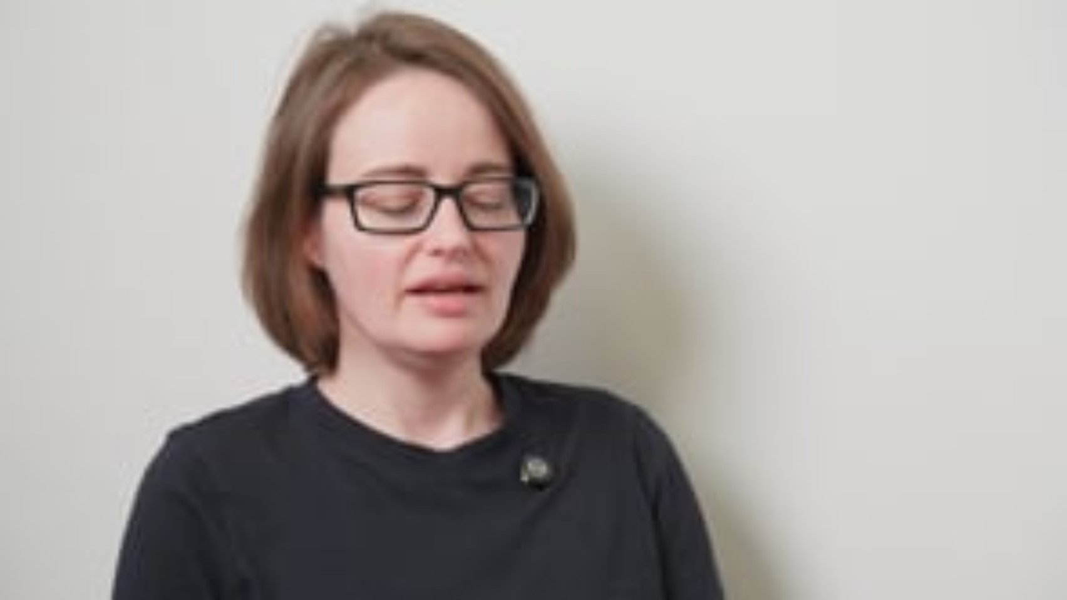
2. Victoria’s Story
Keeping the patient informed about next steps, how long interface processes (such as acquiring discharge medications) will likely take, and who to contact if expected timelines elapse, prevents confusion and anxiety. Listen to Victoria’s story to hear more.

Slide 8
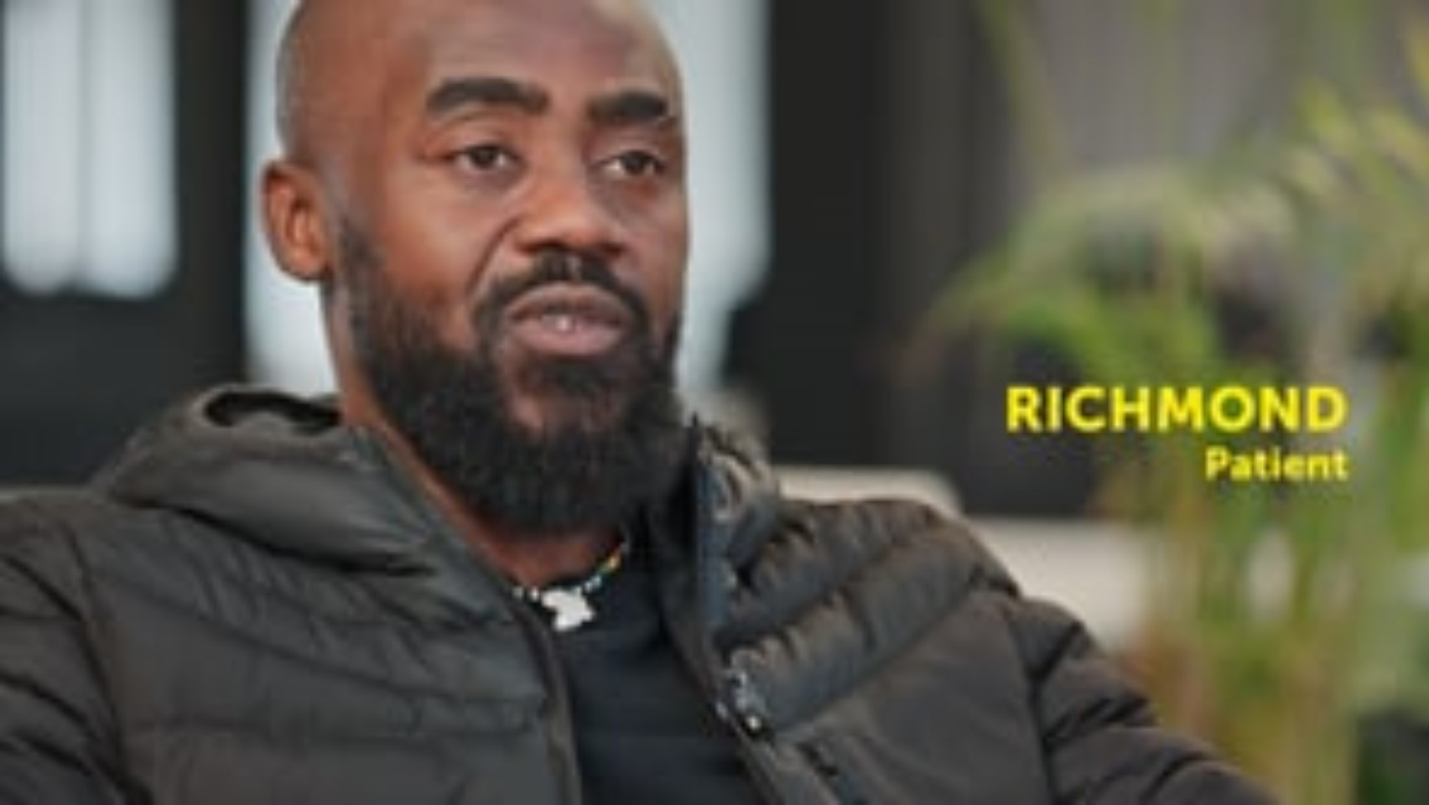
2. Richmond’s Story
Patients highly value building relationships with the staff involved in their care. Having a single point of contact who understands their condition(s) and case, and who they can contact during their treatment, can help patients feel understood, motivated and in control. Listen to Richmond’s story to hear more.

Slide 9

Video: experiences of primary care professionals
GP quote:
The way we work with secondary care feels so uncoordinated. I’ll get patients who have got potentially life-changing test results come back without any context or information about what happens next, leaving us to pick up the pieces.
Receptionist quote:
Every single day I deal with angry patients who don’t know what is going on with their care. I’ve had so many shifts where I go home and cry.

Slide 10

2. GP Story - Riaz
Dr Riaz gives a primary care perspective on the importance of good interface working and the ways in which interface challenges can impact their capacity, ability to provide high quality, timely care, and their relationships with patients.

Slide 11

2. Primary Care Administration Story - Cristian
Administrative staff, such as GP receptionists, can inadvertently become the ‘face’ of interface problems as they are the first people patients interact with when accessing clinical services. The burden of poor interface working can fall on administrative and operational staff as much as on clinicians. Listen to Cristian’s story to hear more.

Slide 12

Challenges for hospital services
Case studies: examples of good interface working
List of top challenges or examples of where interface causes issues for secondary care services
Placeholder:
Placeholder copy

Slide 13
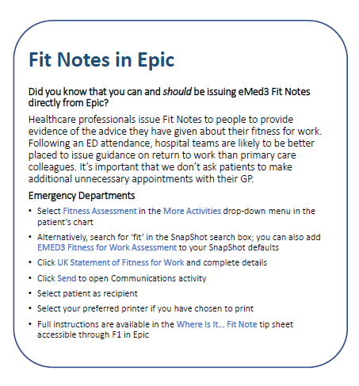
Examples of Quality Improvement Work
There is a range of ongoing work focused on improving interface working in south east London. This work is being led by Trusts and GP practices themselves, as well as borough based interface groups, neighbourhood teams and the ICB.
Example of QI work in Lambeth and Southwark
FIT NOTES
GSTT and King’s collaborated on developing fit note and onward referral guides and flyers for ED, inpatients and outpatients.

Slide 14
Examples of Quality Improvement Work
Example of QI work in Bromley
Bromley / PRUH Maternity Service
What was the problem?
What did they do and who did they involve?
Inappropriate requests from the maternity department to GPs
Engagement between ICB lead, Bromley PCSC GP leads and PRUH Gynae leads to outline problem and discuss resolution. An email inbox was created for midwife prescription requests accessible by consultants - to reduce requests going to GP.
What were the outcomes and learnings?
Reduction in inappropriate requests. Learning point: correctly identify and convene the appropriate leads with authority and understanding to make responsive and proactive decisions on changes needed.
How was progress measured and monitored?
Number of inappropriate request Quality Alerts submitted.

Slide 15
Challenges for mental health services
Complexity of consent, capacity and risk.
Mental health care must navigate fluctuating capacity and patient engagement with care, compulsory treatment, and complex risk environments. Some standard principles (e.g. DNA policies) cannot be applied without adaptation for mental health services, where harm reduction and safety can outweigh patient preferences.
Blurred roles, responsibilities and accountability across services.
Mental health teams, primary care and community services often hold overlapping but unclear responsibilities, especially around medications, physical health tests and management, and follow-up.
Non-linear pathways and multi-service involvement
Many mental health pathways are non-linear and involve multiple services (not all of them healthcare) simultaneously, making principles designed for acute/ consultant-care feel out of synch with the realities of care.
“There are grey areas… often linked with social issues which one person cannot resolve… [it’s] not a linear system”

Slide 16
Key Connected principles for all teams
“We’re all working towards a more connected primary and secondary care interface in south east London, for the benefit of patients and staff. There are three things every clinician can do which will add up to make a big difference:
Make sure your patients have the information they need to remain connected to their care. Do they know who is responsible for the next stage of their care, when their next appointment is, and how to contact someone if they need to?
Connecting with clinical colleagues directly. Think about conversations or communication to help find real-time solutions instead of referrals where possible.
Make the most of your connection to the patient – are there clinically-appropriate actions that you can take right now based on your understanding of the patient’s needs, rather than waiting for others to examine or intervene?"

Slide 17


Reflections
Take a moment to reflect on the challenges and key principles you have just heard about.
Do these sound familiar?
Which bits do you think are most relevant to your service?
Do you have any of your own experiences of poor connection between health services to share?

Slide 18
Activity 1
How does your service interact with others?
What do you think works well and what could be improved?
(25 mins)

Slide 19
Activity 1: Reviewing how well Connected your service is?
As a team, discuss how your service connects currently with other services in doing the things below – think of what you do well and where things could be improved. Consider how these principles work for both service users and other health services your team interacts with.
Key activity | What works well? | What doesn’t work well? | Notes
Sharing information that is not visible to others (e.g. waiting list information)
Passing on actions to other health services (e.g. starting or continuing new medications)
Providing advice or guidance to other services or to service users
Requesting information or advice from another service

Slide 20
Resources available to help
Healthcare professionals working across south east London, with the input of service users, have created these resources to help teams improve how they work with others. These include standards, templates, and guidance to tackle some of the key issues that have been identified in the connection between services. You may wish to consider them as you think about your actions in the second activity.
Title | Description | Links
Consensus Document | This document highlights roles and responsibilities for all organisatons in SEL delivering health services
Advice and Guidance resources | This set of resources provides guidance on best practice for services requesting or providing Advice and Guidance
Discharge summary standards
Etc
Etc

Slide 21

Activity 2
What can you do about this issues we have discussed in this session?
Our complex system is made up of lots of small teams delivering exceptional services to our population, but none of them can do that in isolation.
All of these teams can make a difference to the patient experience by working to ensure they are thinking about how they support a seamless experience with other services.
What can your team do differently?
(20 mins)

Slide 22
Activity 2A – Action setting vs key principles:
Thinking about the discussion you had in the first activity, what do you think your team could do to improve on any of the areas you identified where things don’t always work well currently.
Try to set a SMART goal for each of the relevant areas using the table below [see next slide for explanation of SMART goal]
Key activity | Problem we identified: | What we can do & by when: | What change we expect to see: | How we will know it has improved:
Sharing information that is not visible to others (e.g. waiting list information)
Passing on actions to other health services (e.g. starting or continuing new medications)
Providing advice or guidance to other services or to service users
Requesting information or advice from another service

Slide 24

Activity 2B: 15% Solutions
“You cannot cross the sea merely by standing and staring at the water.”
R. Tagore
Making big changes a large and complex system like a health system is very difficult – but there is another way…
Everyone is empowered to make small changes to how they work that they could implement immediately and lots of small changes could make a BIG difference.
You can call these small changes “15% solutions” – there is always 15% of capacity that is there for the taking – for example:
  “I can take the extra time to ensure the actions in my discharge letter are clear”
  “I can make sure our department has up-to-date contact details on our website.”
Spend 10 minutes thinking about your own 15% solutions and sharing with your team.
  What are you able to do on your own that can make a difference to how well connected our services are?
  What can you do without more resources or authority that will make a difference to patients’ experience?
Think about documenting these so you can check back to see if they have made a difference later.

