Slide 1
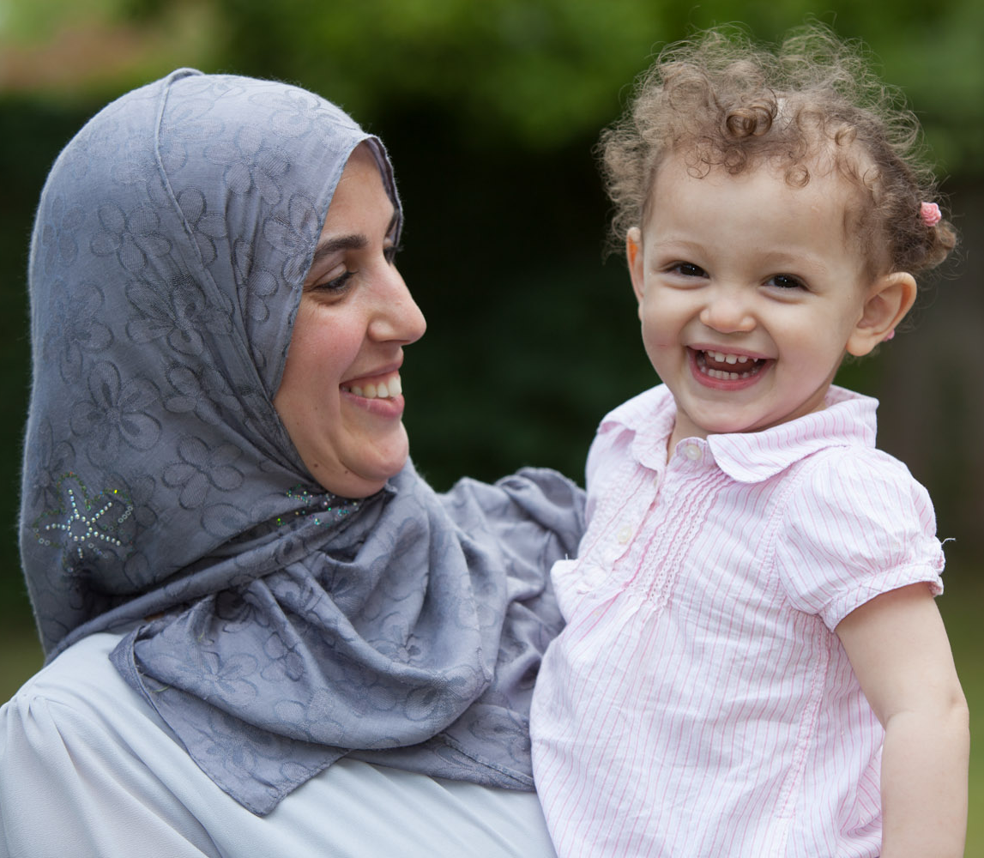

Providing domestic and sexual violence services in Southwark
Notes:
Refuge is the largest specialist domestic abuse organisation in the UK. On any given day our services support thousands of survivors, helping them to overcome the physical, emotional, financial, and logistical impacts of abuse and rebuild their lives — free from fear.

Slide 2
Key elements of the service
Survivor advocacy and support service
Group work programme
Sanctuary scheme
IRIS
Perpetrator casework
Training and awareness raising
Counselling
Children’s therapeutic support
Homelessness IDVA
Notes:
For all levels of risk; easy and quick to access; supports survivors and their children to become safer; co-locates with statutory services to offer wrap around support to survivors
Own my life is an established group work programme that can be run face to face or online and is designed to: build self efficacy, increase safety; increase understanding that abuse is rooted in ownership and entitlement, and the power and control dynamic, reduce isolation and increase space for action
To increase the safety of survivors, allowing them to remain living in their own home – providing a range of target hardening measures, such as lock changes, installation of security features, such as door chains, Ring-type doorbells, working with partners such as the Fire Service (arson-proof letterboxes)
IRIS- identification and referral to improve safety- offering training and casework support to 25 GP practices in Southwark
Homelessness IDVA – will co-locate in Southwark Housing Solutions offering support and safety planning, plus liaising with housing advisers on PHPs (personal housing plans)
Independent Gender-Based Violence Advocates (IGVAs) –work with people who are resident in Southwark from the age of 16. The IGVAs will support all levels of risk; high, medium, standard and provide information advice and guidance, effective case management and intensive advocacy for survivors of gender-based violence and abuse.
Housing IDVA Specialist support for survivors of domestic abuse with complex housing issues. Co-located within Southwark Housing Solutions service, and referrals directly received from housing teams.
Sanctuary Scheme aims to minimise the number of households, families and individuals who must leave their own home because of domestic abuse by exploring safe alternatives where appropriate such as implementing safety measures in victim’s homes.
IRIS Advocate Educator specialist advocacy and support to clients with referrals received specifically from GP surgeries.
Perpetrators Service The overarching goal of the service is to increase the safety and wellbeing of domestic abuse survivors and any children involved by intervening with perpetrators to hold them accountable and provide them with opportunities to change through 1-to-1 intensive case management sessions. To do this the survivor also needs to be referred to the IGVA service so we can offer them support and assess any ongoing risks to them.
Survivor group work programme 12-week group which supports women to regain ownership of their lives when they have been subjected to abuse or violence.
In Partnership with Bede House, we will also be delivering:
Counselling 16-week 1-2-1 counselling programme for survivors of domestic and/or sexual abuse. The service is for women and men who are 18 years and over who are resident in Southwark and have experienced domestic and/or sexual abuse.
Children’s Therapeutic Support Qualified Children’s Therapist to provide a 1-2-1 12 week play and arts based therapeutic intervention to children and young people.

Slide 3
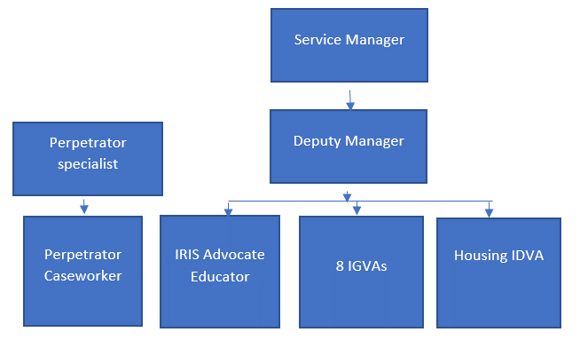
Staffing Structure for Southwark (Refuge)
Notes:
Why IGVAs? Based on our experience risk is a very fluid concept – low risk score doesn’t necessarily equate to not in danger – this approach also allows us to develop relational support with survivors, within the appropriate barriers
IGVAs will support survivors at all levels of risk. They will take part in a duty rota (2 workers on duty) and provide casework to allocated clients
Service manager and service team will provide awareness raising training within the community – working towards a ‘no wrong front door’ approach: embedding pathways to the service from across the community

Slide 4
Casework management policy and procedure
Referral | First contact attempted within 24 hours, case created on IMPACT
First contact | Assessment of immediate danger, safety planning and appropriate service
Referral outcome | Decision made on service requirement, client informed
Risk assessment | Full SafeLives DASH-RIC within 24 hours of referral
Intake form | Details taken on history of abuse, psychological and behavioural questionnaires
Needs assessment | Completed and led by client and worker within 5 working days.
Support plan | All risks identified to be incorporated into co-created plan. Short and long term goals identified. Supporting client to cope and recover.
Exit | Assessment for appropriate services. Final SafeLives DASH-RIC and exit interviews conducted.

Slide 5
Refuge Southwark Domestic Abuse Referrals Q4
Notes:
Period cover 6th Feb to 31st March 2023
Some elements we did not start in Q1 as were mobilising, so we did not run any groupwork programmes or deliver any training to partner agencies
Out of the 332 referral 69 were transferred from Solace Women's Aid

Slide 6
Notes:
In Regards to referrals for Q4
Domestic Violence was the highest abuse form
Followed by psychological, physical abuse

Slide 7
IRIS
(Identification & Referral to Improve Safety)
IRIS Programme
A study of 1,000 women in GP waiting rooms found that 41% of women had experienced physical violence from partner/ex-partner and 74% had experienced controlling behaviour by their partner.
In-house specialist domestic violence training sessions to become better equipped to respond to concerns and disclosures of DVA from all patients, including perpetrators.
  Clinical staff: Two, 2 hour training sessions. Content focuses on how to recognise and respond to DVA, as well as record disclosures.
  Reception and administration teams : one, 1 hour training session. Content focuses on understanding DVA, responding to patients, resource provision, confidentiality and safety.
  A 1 hour Refresher training.
Ongoing support and DVA consultancy from a named Advocate Educator.
Literature for your practice recognising you as a DVA aware practice.
Developed and enhanced safeguarding responses to both children and vulnerable adults
A simple referral pathway for your patients to a named Advocate Educator, reducing time required from GPs and practices to respond to disclosures and related issues.
A certificate for each clinician who attends training, counting towards their CPD points.

Slide 8
The Benefits of IRIS
Improves safety, quality of life and wellbeing for your patients and their children.
Provides access to advocacy which benefits victims and survivors of DVA.
Develops DVA aware practices with fully informed resources and equipped practice teams.
Saved general practices and the wider NHS time and resources.
  - 70% of service users report visiting their GP less after being referred to an advocate educator
Provides holistic care and thus achieving better outcomes in terms of improved quality of life, physical and mental health well-being.

Slide 9
Contact Details
IRIS Advocate Educator
Southwark Domestic Abuse Service
If you wish to express, you’re practices interest in receiving the IRIS training please use the contact information below:
Name: Ellie Quick
Mobile Number: 07436 897 136
Email: iris.southwark@nhs.net
For support from the SDAS team please use the contact details below:
Email: sdas@refuge.org.uk
Phone Number: 0118 214 7150

Slide 10

Questions

