Slide 1
Mental Capacity Act and Deprivation of Liberty for Primary Care
^{David Rowley}
Designated Lead for the Mental Capacity Act and Liberty Protection Safeguards, SEL ICB
david.rowley@selondonics.nhs.uk

Slide 2
What is the Mental Capacity Act?
The Mental Capacity Act (MCA) is designed to protect and empower people who may lack the mental capacity to make their own decisions about their care and treatment - NHS website
Framework on decision making for people who may be unable to do so
Article 8 HRA - Right to a Private and Family Life
Underpinned by 5 principles
Decisions are time and situation specific

Slide 3
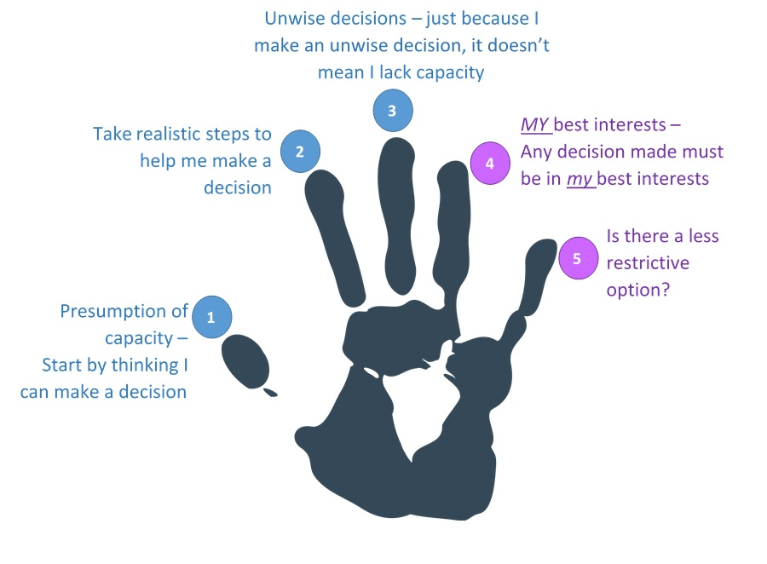
Five Principles of the Mental Capacity Act

Slide 4
Capacity Assessments and Best Interests decisions -Top Tips
Identify the decision.
Who is the decision maker?
Is the decision simple or more complex?
Prepare! Give relevant information to the person.
Assess capacity = have a structured conversation!
If person lacks capacity, make a best interests decision
Follow Best Interests checklist (key elements)
Present wishes and feelings
Previous wishes (an advance statement?)
Views of others (family, professionals)
Less restrictive option
8. Record
What is the Mental Capacity Act | Lambeth Safeguarding Adults Board (lambethsab.org.uk

Slide 5
What is a Deprivation of Liberty?
Article 5 of the Human Rights Act - Right to Liberty
Right to Liberty is a qualified right
A deprivation of liberty occurs when
Person lacks capacity (subjective element)
The person is under ‘continuous supervision and control & not free to leave’ because of their care (objective element)
The state has involvement in/ is aware of the care (imputable to the state)
A deprivation of liberty can only be authorised by due legal process

Slide 6
The Bournewood case
49 year old autistic man, HL
HL lived with Mr and Mrs E, under resettlement scheme from Bournewood Hospital
Re-admitted to hospital in ‘best interests’ under common law doctrine of necessity
MHA not appropriate, HL lacked capacity
No right of challenge to the clinician
Following various court hearings ECHR decided HL Deprived of his Liberty.

Slide 7
Deprivation of Liberty Safeguards, COPDOL 11
DoLS is the ‘due process’ to authorise a DoL
DoLS is administered by local authorities only
DoLS covers registered care homes and hospitals only
Consists of three main assessments
Mental Disorder
Mental Capacity
Best Interests
Deprivation of liberty can also apply in other settings
In these cases, Court of Protection authorises directly
An applicant would need to complete a COPDOL11

Slide 8
Issues and criticisms of the current system
Process led rather than person centred – rubber stamping exercise
Doesn’t meet the needs of the person
New case law broadened definition of a DoL and therefore number of cases dramatically increased
Local authorities unable to process applications
Vulnerable people without appropriate protections
In 2014, recognised that system ‘not fit for purpose’
In 2015 Law Commission set about change

Slide 9
Liberty Protection Safeguards – process overview
3 Responsible Bodies , not just local authority
CCG, Hospital Trusts, Local Authority (share the load!)
3 main assessments
Mental Disorder,
Mental Capacity and
Necessary and Proportionate (replaces best interests assessment)
Duty to consult family
New role of Approved Mental Capacity Professional
Extends to 16-17 year olds
IMCA ‘if relevant’
Reviews – more focused. After year 1, year 2 and three yearly thereafter’

Slide 10
Liberty Protection Safeguards – ethos overview
Ethos of LPS – aims to incorporate consideration of liberty into mainstream care planning.
Aims to discourage creation of separate processes/teams as per the current DoLS system
How? By integrating assessments where possible into everyday practice/ transferability of assessments

Slide 11
Liberty Protection Safeguards – an overview
LPS was due to come into force October 2020
Delayed due to Covid-19
Next date was set for April 2022
Further delay in 2021 as Code of Practice (CoP) was not finalised. No new date set at this stage
Draft CoP has now been published and consulted upon (July 2022)
We await final version of the CoP and implementation date. Likely to be in 2024
On commencement - there will be a 12 month transition period

Slide 12
Liberty Protection Safeguards – SEL progress
Key challenges with implementation
Collaborative working
Integrating new responsibilities to front-line practice
Developing skills in the new Responsible Bodies
Training
Developing IT
Embedding a culture which protects liberty

Slide 13
Liberty Protection Safeguards – SEL progress
What are SEL Responsible Bodies doing now to prepare for LPS?
SEL ICS LPS Steering Group
Borough LPS Groups
BIA Training
LPS Implementation Plan
LPS Process Maps
LPS Scoping

Slide 14
Liberty Protection Safeguards – Protecting Liberty
What can practitioners do now to prepare for LPS?
The process has been delayed, but the ethos is relevant now!
Effective MCA practice,
support a person to make their own decisions.
Effective care planning
Adopt a strengths based approach,
Promote conversations with the person
Consider risks – what level of intrusion is necessary?
What is a proportionate level of support for the persons needs?

Slide 15
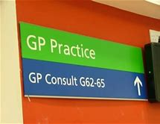
Liberty Protection Safeguards – GP implications
Likely ask for GP’s
Providing evidence of diagnosis of Mental Disorder
Training needs: recognition of a DoL, action
Capacity Assessments (possible but unlikely)
Necessary and Proportionate Assessments (unlikely)
No funds currently earmarked for this
However, GP’s have role (along with all of health staff) to support the ethos of LPS.
Knowing and following the MCA principles
Supporting rights and strengths based practice

