Slide 1

SEL Neighbourhood Health Service Implementation Update
SEL Integrated Care Board June 2025

Slide 2
Background
All Places in SEL have been working for a number of years to increase levels of collaboration and integrated working between health, social care and the VCSE through community-based care.
In May 2022, the Fuller Report was published and outlined the need to develop pro-active care at a neighbourhood level. In 2025, the Government published their Neighbourhood Health Service guidelines which built on the need to develop integrated and collaborative neighbourhood-based services and set out 6 key components required for a Neighbourhood Health Service (including developing Integrated Neighbourhood Teams).
The 6 Places, who are accountable for the development community-based care, have worked through the Neighbourhood Based Care Board (NBCB) to bring together the 6 Places and key partners from across the ICS to shape implementing a SEL Neighbourhood Health Service.
In January 2025, the ICB Board approved the overarching SEL Integrated Neighbourhood Team (INT) framework which guides the development of neighbourhood ways of working and INTs in each place with a consistent narrative and a clear articulation of the common end point all Places are working towards, noting that starting points are different for each Place. Implementation of INTs within each place has been ongoing since this point, with the Neighbourhood Based Care Board providing collaborative oversight of the design and delivery of all 6 core components of a Neighbourhood Health Service and supporting enabler plans.
In May 2025, the London region published their Case for Change and Target Operating Model for a Neighbourhood Health Service which aligns closely to the work already underway across South East London. As part of this Target Operating Model, an integrator role is proposed for each place to ensure effective delivery of INT working.
South East London ICB is expected to confirm its integrator arrangements for most places in June 2025.
This paper provides an update on:
  The implementation of Integrated Neighbourhood Teams in South East London
  The London Target Operating Model and Case for Change
  The South East London approach to integrator arrangements
We are collaborative | We are caring | We are inclusive | We are innovative
2

Slide 3

Integrated Neighbourhood Teams

Slide 4
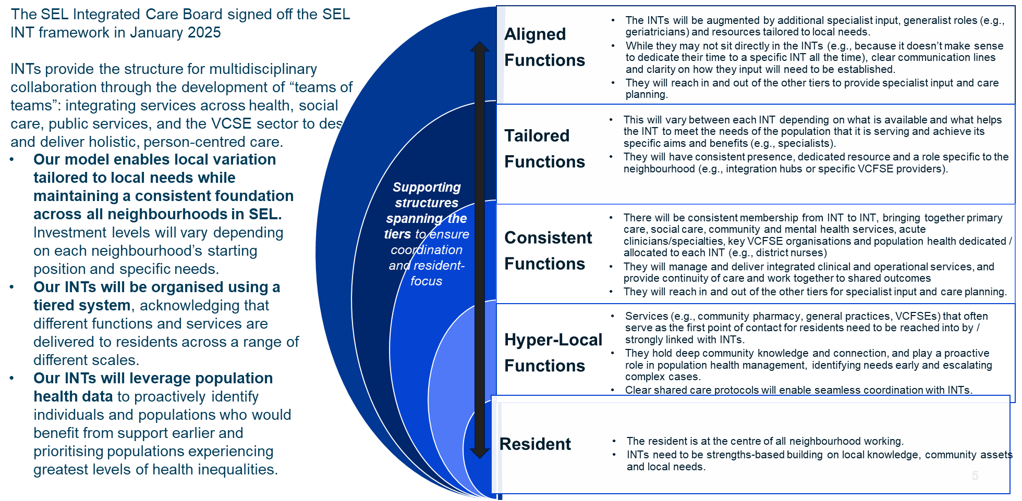
SEL Integrated Neighbourhood Team Framework
We are collaborative | We are caring | We are inclusive | We are innovative

Slide 5
SEL Integrated Neighbourhood Team Priority Populations
As part of SEL’s ‘test and learn’ approach, it was agreed that there needed to be a level of consistency across INTs in terms of what they focus on to be able to compare success measures and demonstrate the impact of this new way of working, ensure the work aligns with SEL’s strategic priorities and enable shared learning across Places about what is working and not working to facilitate continuous improvement.
SEL identified three initial population groups for INTs to focus on where the opportunity for improvement is greatest, including addressing health inequalities and improving health and care outcomes for our population. This will also enable a genuine and sustainable shift in investment across the system.
3+ Long-Term Conditions
There are currently pilots in each place, and there is a current cost of £18m, £16 Non-Elective (NEL) admissions per year,
£3-6m outpatient opportunities for diabetes alone.
Frailty and those approaching end of life
There are examples of best practice already and a current cost of £244m* per year on NEL admissions. This also aligns with how many Places are prioritising Ageing well as a strategic goal over the next six years. This might mean pivoting virtual wards and other admission avoidance initiatives into maximising independence outside of the hospital.
Children and Complex Needs
There is an existing model which has demonstrated reductions in GP and outpatient appointments, Accident and Emergency (A&E) attendances and NEL admissions.
Initial INT rollouts in each place have focussed on these three population groups. However, there is an expectation that as INTs develop, they may identify additional specific priorities based on their local population needs.
We are collaborative | We are caring | We are inclusive | We are innovative

Slide 6
INT Design and Implementation Progress
Population | Design | Implementation
Children and Young People | Child Health Integrated Learning and Delivery System (CHILDs) began development in 2013 and is central to plans to implement Integrated Neighbourhood Teams for Children. Initial evaluation has demonstrated reductions in planning and unplanned activity via the model Further work will be done in 2025 to further develop the neighbourhood model for CYP further. | Southwark, Lambeth and Bromley have implemented the CHILDs model and are developing their work into a broader neighbourhood model. Implementation planning underway for the remaining boroughs
Multiple (3+) Long Term Conditions | The SEL framework for multiple Long Term Conditions was developed in 2023. This has been the key design block for our multiple (3+) LTC Integrated Neighbourhood Team model signed off by the Neighbourhood Based Care Board in 2024. Initial evaluation of 7 test bed sites has demonstrated improvements in the detection and management of disease, reductions in unplanned activity and strong patient and staff experience | Model has been tested via 7 primary care networks with evidence of improvements to detection and management of disease and reductions in unplanned activity. All 6 boroughs are planning to go live with multiple LTC Integrated Neighbourhood Teams in 2025/26 (starting from July in a phased approach)
Frailty | The SEL Ageing Well Framework for Integrated Neighbourhood Teams was developed in early 2025 and signed off by the Neighbourhood Based Care Board and Local Care Partnerships in April 2025. | Implementation planning is underway in all places. Bexley and Southwark are early adopters of the frailty framework with the remainder of places following via a phased implementation approach..
We are collaborative | We are caring | We are inclusive | We are innovative

Slide 7
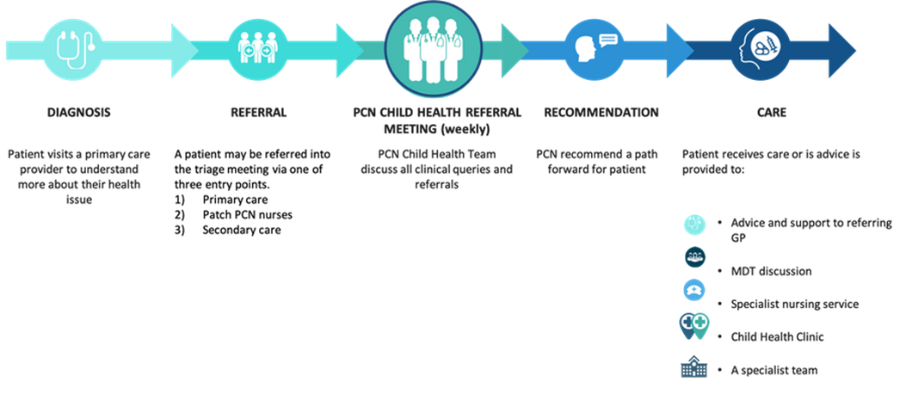
Children and Young People Neighbourhood Model
The child health model offers personalised, integrated care pathways for children with general child health conditions and targeted early intervention care for children with long-term conditions. The model of care has changed the ways of working between hospitals, primary care, and child health specialists.
We are collaborative | We are caring | We are inclusive | We are innovative

Slide 8
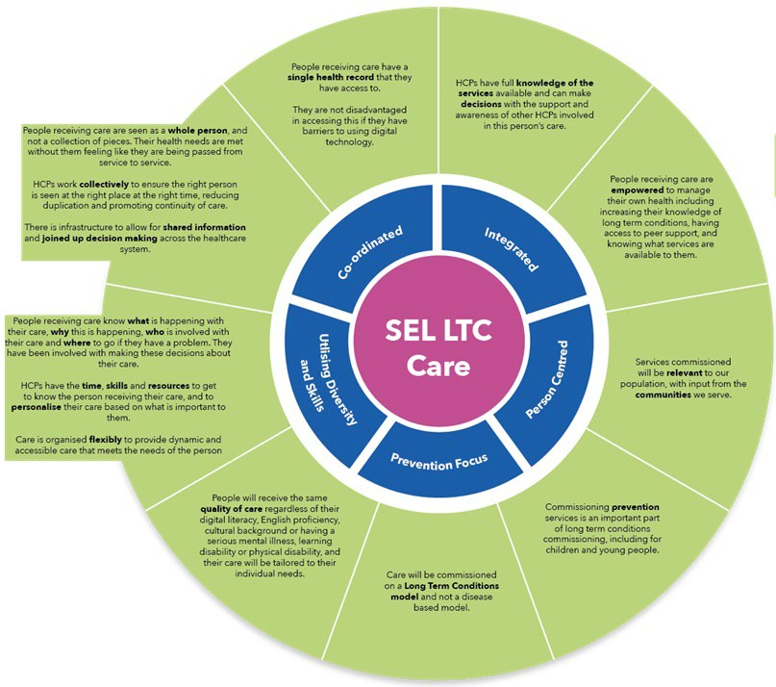
Multiple (3+) LTC Neighbourhood Model
Proactive case finding and targeted outreach into neighbourhoods including point of care testing to find and quickly respond to unmet need
Holistic and Personalised Care Planning through a single and shared care plan -
Coordinated Case Management approach aligned to different levels of risk
Shared approach and management of clinical risk across the team-
Streamlined pathways for escalation and de- escalation, with additional support able to be quickly drawn down to support people with escalating needs
Quick and reliable access to specialist input
Embedded care and wellbeing support meeting the needs of the person not the disease
Easy access to personalised self- care and self- management advice and support
A test, learn and evolve approach to the team using impact data and experiential learning.
We are collaborative | We are caring | We are inclusive | We are innovative

Slide 9
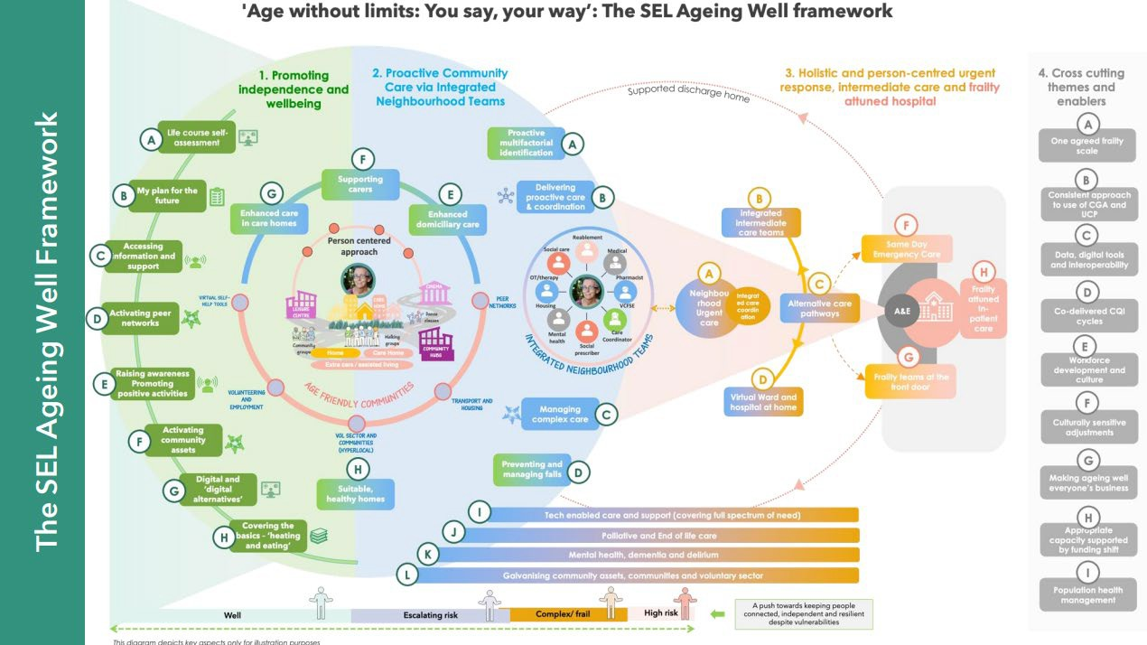
Ageing Well (Frailty) Neighbourhood Model
We are collaborative | We are caring | We are inclusive | We are innovative

Slide 10
Place Implementation of INTs (1 of 4)
There are 25 Neighbourhoods across the 6 SEL Places
The starting point for each Place has been different with some places having well established neighbourhood footprints, whilst others have had to go through a process to agree these footprints over the last few months
The Neighbourhood Based Care Board TORs have recently been amended to increase the focus on understanding progress on delivery and any challenges in the individual Places
A simple highlight reporting process has been agreed and will commence from July. This will support consistency in reporting, highlight good practice that should be shared and common areas of challenge where a shared approach may help
Each Place monitors delivery locally as part of their partnership arrangements
All Places are focusing INT delivery on the three priority population groups (3+LTCs, frailty and CYP with complex needs)
The following slides set out at a high level what Places have achieved thus far and next steps, noting the points above about differential starting points and a consistent reporting mechanism from July
We are collaborative | We are caring | We are inclusive | We are innovative

Slide 11
Place Implementation of INTs (2 of 4)
Place | Current position | Next steps
Bexley | Agreed 3 neighbourhoods and 3 INT priority areas aligned to Joint Forward Plan (CYP, Ageing Well/Frailty and 3+ LTCs). Agreed which neighbourhoods would test which INT model Approved LTCs and ICHT business cases. 3+LTCs INT teams being formed through a mixture of recruitment and realignment of staff across local partners and model live in one neighbourhood. ICHT model developed and ready to mobilise in North Bexley LCN; INT team will be formed drawing on existing staff. Ageing Well/Frailty engagement event held with partners and residents on 4th June to develop Bexley end-to-end model of care and agree core components of INT for Frognal LCN pilot – aligned to SEL framework. | June: Confirm recruitment of Health and Wellbeing coaches and alignment to practices providing holistic assessments and ongoing support to LTC pilot in Clocktower. June: Finalise ICHT implementation plan and confirm go live date in North Bexley. July: Design Frailty INT with focus on moderately frail in Frognal LCN; develop implementation plan. August/September: Frailty INT pilot go live in Frognal. January 2026: Commence scaling INT models.
Bromley | Agreed 4 geographic footprints of Bromley INTs Sub-group of One Bromley Executive now drives and governs neighbourhood development in Bromley Developed initial demographic, needs and assets insights for each neighbourhood Focus on residents with 3+ long term conditions, residents living with frailty, those 18 or under with health and social needs and people discharged from hospital admission. Intervention models being aligned to INT footprints and expanded: integrated care network (ICN), children health partnership (B-CHIP), hospital discharge pathway New intervention model: multiple long term conditions (mLTC) pathway based on CKD pilot Firm focus in all models on re-alignment of existing resource to secure best value for the Bromley pound Agreed phased roll out plan of INT geographies | Q1-2: SW INT mLTC model localisation and go-live workshops following a QI approach, including resident engagement Socialisation and pre-work within other three INT footprints Review of ICN, B-CHIP and discharge models to align to INT footprints and expand in scope Q3: NE INT mLTC model localisation and go-live workshops following a QI approach, including resident engagement Initial localisation of ICN, B-CHIP and discharge models to INT footprints with expanded scope Q4: SE and NE INT mlTC model localisation and go-live workshops following a QI approach, including resident engagement Finalisation of implementation of ICN, B-CHIP and discharge models to INT footprints with expanded scope
We are collaborative | We are caring | We are inclusive | We are innovative

Slide 12
Place Implementation of INTs (3 of 4)
Place | Current position | Next steps
Greenwich | Workstreams established to progress INTs x3 – Care model design, Workforce, Population Health – each with a senior lead and each having now completed a commencement workshop with local system partners, and each with steering groups now established Enablers now have local leads – Estates, Comms, Digital – to support INTs. Estates is the most progressed, having worked up Neighbourhood Hub options for each area, and incorporating INTs into our emerging Estates strategy HGP workshop was held on 22nd May for bring all partners up to speed with current thinking and influencing next steps on INTs; and Greenwich Neighbourhood Care Board now set up/meeting. | Engagement, socialisation and ideally codesign with all general practices – beyond just a small number of representatives, is now needed. Primary Care engagement and OD plan is being worked up collaboratively to support this. Scaling up the existing frailty pathway using PHM data and principles is in discussion and will form the basis for community, acute, vol sec and PMS Premium resource distribution toward the Frailty and LTCs priority pathway: a Proactive Care INT INT design resource has been appointed, to focus on how workforce and vol sector are being deployed and best utilised Neighbourhood Hub locations x4 to be agreed and strategic plans for establishing these to be developed
Lambeth | Agreed 5 neighbourhoods and 4 INTs to focus on (CYP, frailty, MLTCs and MH) Developed initial insights for each care pathway Identified named neighbourhood leads from each partner Agreed which INT will be tested in each neighbourhood, along with a high level approach Drafted a high level delivery plan with resources identified (aligned to integrator conversations) – due to be signed off 17th June at INT Working Group and then at 3rd July Lambeth Together Care Partnership Board | July to December (led by integrator): Each neighbourhood will undertake detailed design for the INT models, using data insights and existing work to ensure there is a model for each care pathway January 2026: review draft models for INTs and sign off at Lambeth Together Care Partnership Board April: all INT models are up and running
We are collaborative | We are caring | We are inclusive | We are innovative

Slide 13
Place Implementation of INTs (4 of 4)
Place | Current position | Next steps
Lewisham | First focus in 3+ LTCs Completed the collaboration with people with lived experience to shape the Integrated Neighbourhood Team (INT) Model. Memorandum of Understanding (MOU) with PCNs has been signed. Job descriptions for all new roles in the Integrated Neighbour Hood Teams (INTs) agreed and advertised from 16th May until 30th May INT teams being formed through a mixture of recruitment and realignment of staff across by local partners and expected to be operational from July Digital pathway is in place. The DPIA has been developed, and we’re now working to secure full EMIS access for prescriber roles. (working with SEL digital for better solution to support integration). Health Equity Fellows have been successfully recruited and have started engaging with the 6 VCSE groups to support the project. Business case is being finalised and should be completed | Population health reporting is being tested for use in Multi- Disciplinary Meetings (MDMs). Going live with new way of July INT dashboard is currently being built within HealtheIntent – this will be ready in time for team mobilisation. July Wider GP engagement event to support the development of the GP voice within the integrator/ partnership governance June Finalise the Integrator arrangement/governance – July – Aug Detailed design of the Children with Complex Care INT – July- Sep Proactive Ageing Well Service live. Further work via the Lewisham Older People Board to expand this to mobilise the Frailty Framework recently agreed for SEL
Southwark | Agreed 5 neighbourhood INTs to focus on 3 cohorts initially (CYP, frailty and 3+ LTCs). Drafted high level implementation plan and set up corresponding implementation programme governance. Gathered initial population health insights and asset mapping for each neighbourhood. Established a Primary Care Task & Finish Group to support primary care with the challenges raised around transitioning to new neighbourhood footprints. | Design resource structure for implementation programme and operational delivery and identify and deploy resource against this (aligned to Integrator conversation). Refine INT model using learning from existing work together with further insights and mapping across each neighbourhood. October: first INTs launch under a programme of iterative testing and learning.
We are collaborative | We are caring | We are inclusive | We are innovative

Slide 14
London Neighbourhood Health Service Target Operating Model and Case for Change

Slide 15
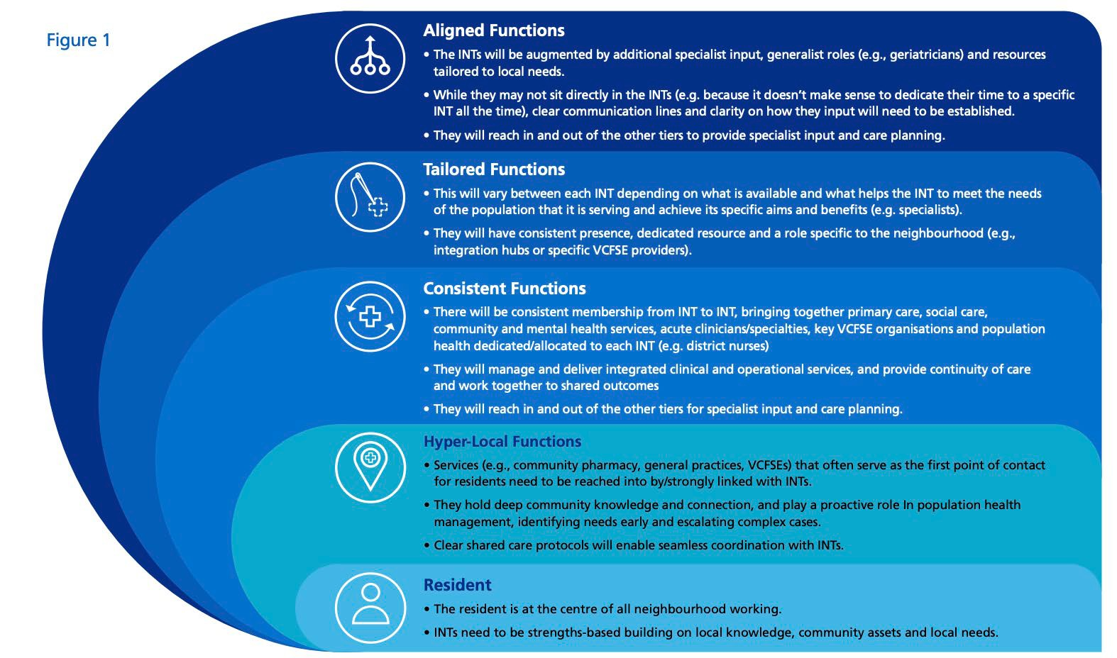
London Target Operating Model and Case for Change (1/2)
The London Target Operating Model (TOM) and Case for Change, published in May 2025, outlines the next steps for Neighbourhood Health in London. They have been developed in partnership between London’s five integrated care boards, NHS England London Region, and the wider London Health and Care Partnership (London Councils, Greater London Authority, UK Health Security Agency, and the Office for Health Improvement and Disparities in London), with support from Londonwide Local Medical Committees. What is outlined in these documents aligns with the work we have been doing in South East London as part of our work to implement a Neighbourhood Health Service, with clear alignment to the Integrated Neighbourhood Team framework that this Board endorsed in January 2025.
What do we mean by a neighbourhood health service for London?
A neighbourhood health service means a service that provides high quality, coordinated, accessible care in every neighbourhood; for all ages, from babies, children and young people to working age adults and older people; for all levels of need, from those at risk of ill-health but not yet unwell to those already in receipt of long-term, complex health and care; in a way which works sustainably for the wellbeing of all our communities and the professionals who support them.
Neighbourhood care in London will be delivered by a Team of Teams:
We are collaborative | We are caring | We are inclusive | We are innovative

Slide 16
London Target Operating Model and Case for Change (2/2)
The TOM outlines 10 key functions (plus an eleventh around the management of the transition) to enable a neighbourhood health service and its constituent INTs across all parts of London. These are designed to support place partnerships and individual partner organisations to determine the necessary functions, where they are already well established and where development is needed to deliver within a future neighbourhood health model.
10 key functions to enable a neighbourhood health service and its constituent INTs
Geography: defining our neighbourhoods
Workforce: developing our teams
Relationships and interfaces: enabling joint working
Participation: working with communities
Population health management: addressing inequalities
Information sharing: building our shared view
Access and technology: making interaction easier
Governance: working together safely and efficiently
Metrics: evidencing success
and Managing the transition: from national to neighbourhood, which will require
Clear leadership, support and accountability at all levels
Development of infrastructure within each of our places to build neighbourhood operational capacity and enable local delivery.
Collaborative structures for shared learning and adaptation.
10. Resource allocation: powering the change
The London Target Operating Model also sets out a set of key priorities for systems. The SEL Neighbourhood Based Care Board has reviewed those key priorities against is current programme of work to ensure that we are able to respond to those priorities.
We are collaborative | We are caring | We are inclusive | We are innovative

Slide 17
London TOM key priorities – SEL progress
Priority identified in the London Target Operating Model | Current Progress | Next steps
Agreeing who will host integration functions locally | Underway | Integrator arrangements broadly confirmed end of June
Finalising the footprints of London’s neighbourhoods based on local evidence and data | Completed
Developing an identified set of priority cohorts | Underway | Further work being undertaken to define the population for the frailty and CYP segments
Developing localised, contextualised messaging describing “what the neighbourhood health service means for you” within each borough. | Underway | Review of plan due at June NBCB.
Ensuring effective community representation and leadership in decision-making around neighbourhood care. | Underway | On all structures, but ongoing review required.
Developing options around co-location where it makes sense | Planned | Estates workstream plan being developed
Ensuring key partners including domiciliary and residential care providers are part of the process of co-designing and INTs. | Underway | Engagement in INT design at place
Bringing together population health management insights, assets and resource to identify gaps and overlaps in current neighbourhood provision | Underway | Being taken forward by PHM group
Incorporate lived experience and qualitative feedback into planning processes | Underway | Ensure consistent use of current mechanisms
Developing consistent neighbourhood governance structures | Completed | Place and SEL level
Clear signposting systems to reduce confusion and improve access to services. | Planned | Existing systems in place, work is needed to ensure comprehensive whole-system access
Mapping data associated with each population segment at a granular geographical level (eg within individual lower super output areas (LSOAs) | Underway | Further work around Frailty and CYP cohorts.
Understanding geographic trends, variation, and drivers including measures of engagement/disengagement with health and care services | Underway | Development of theory of change and accompanying outcomes framework in June/July
We are collaborative | We are caring | We are inclusive | We are innovative

Slide 18
London TOM – Role of the Integrator
The role of the Integrator
The London Target Operating Model sets out the role of an integrator to ensure the effective delivery of INTs working within place partnerships, operating at a level of scale to allow sufficient organisational resources, capacity and capabilities to be available across all associated neighbourhood teams
This role cannot operate in isolation or remove individual responsibility and accountability from partnering local organisations.
In some places, these functions will be hosted within a single organisation. In others, integrators may work with one or more local partners to provide the range of required support. In this case, it will remain important that there is a clear line of organisational accountability to the place partnership
The integrator will help with:
Bridging fragmentation
Flexing to local needs
Promoting consistency
Facilitating population health improvements at local and hyper-local level
Enabling shared learning
Mediating challenges and ensuring inclusive decision-making
Providing essential infrastructure:
Improving sustainability
This role will require an organisational host that is:
drawn from existing institutions within the place partnership.
organisationally mature and able to operate at a scale sufficient to manage related budgets and provide required infrastructure
senior and experienced enough to be credible and influential across the partnership, to build trust amongst partners whilst recognising that this role is about hosting and facilitating, not leading
able to operate in alignment with the geographical footprints of the INTs it supports.
part of the landscape across those INTs – an organisation with “skin in the game” but which is prepared, where appropriate, to ignore short-term self-interest for the interests of the partnership and population as a whole.
The integrator will NOT:
duplicate or introduce extra layers of senior leadership, management, or assurance.
Take away from individual roles and responsibilities within integrated neighbourhood working, including existing contract holders.
Just focus on integration around “just the top of the pyramid”, it is a whole population approach which focuses on improving the lives of all Londoners.
We are collaborative | We are caring | We are inclusive | We are innovative

Slide 19

SEL Integrator Function Arrangements

Slide 20
Current Position
On 3rd June 2025, Andrew Bland wrote to Local Care Partnerships and systems to set out the next steps for delivering a Neighbourhood Health Service in South East London. This included the function of a system ‘Integrator’ to support and drive forward neighbourhood working. Place Executive Leads, on behalf of their borough partnership, have been asked to confirm by the end of June 2025:
Their Integrator arrangements and their adherence to those elements outlined in the case of Bexley, Lambeth, Lewisham and Southwark
Their plan and timetable to achieve these same milestones in quarter three in the case of Greenwich and Bromley (who may wish to act faster if locally agreed).
Sent alongside the letter, was a high-level set of principles as to the function and form of an integrator (included in the two slides overleaf)
A further communication was then shared on 12th June setting out how the ICB, and LCPs will gain assurance on adherence to these function and form principles through the proposed integrator arrangements, ensuring a proportionate approach.
This set out an initial set of questions to be answered as part of the initial confirmation process, as well as an outline
approach to measuring baseline maturity of arrangements and their development over time.
We are collaborative | We are caring | We are inclusive | We are innovative

Slide 21
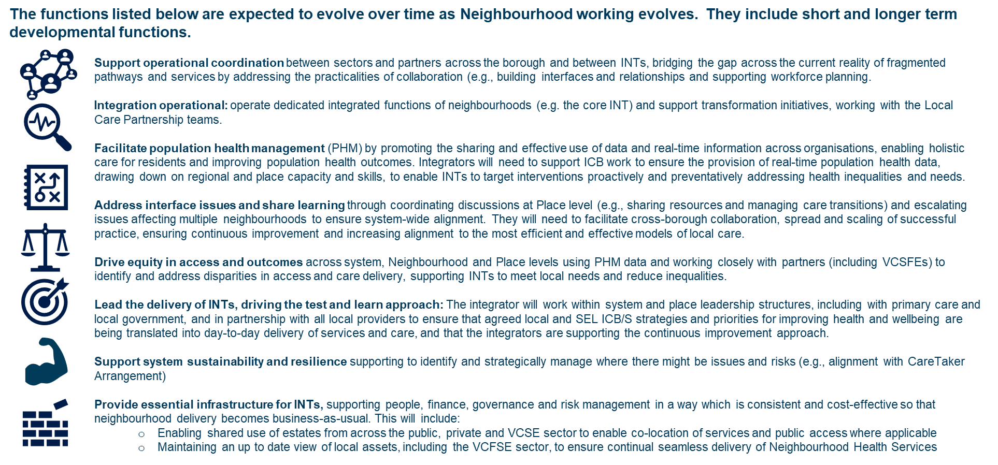
SEL Integrated Principles: Function
We are collaborative | We are caring | We are inclusive | We are innovative

Slide 22
SEL Integrator Principles: Form
The integrator will be performed by one place-based organisation or partnership, drawn from within the system.
Integrators may work with other local partners / as a partnership, to provide the range of required support, however it is important that there is clear organisational accountability (e.g., a single lead within the partnership) to the Place Partnership for ensuring the neighbourhood health service can function effectively, efficiently and sustainably in each place.
This role cannot operate in isolation or replace individual responsibility and accountability from partnering local organisations.
In SEL, we recognise that it does not matter who performs the role and there is no requirement for a certain type of integrator, as long as they can perform the functions of the integrator vehicle. This is particularly pertinent given the level of variation across SEL. However, the integrator is likely to be:
Organisationally mature and able to operate at scale: The integrator should be able to manage related budgets and provide required infrastructure, including around data sharing, workforce, estates and digital. They will need to be operating at an organisational scale and maturity that will allow sufficient organisational resources, capacity and capabilities to be available across all associated neighbourhood teams; whilst drawing on the local knowledge, experience and relationships from local professionals and communities. They will also need to be able to offer additional support to any part of the partnership, including at an individual practice level to ensure the sustainability of INTs across the Place.
Part of the existing landscape: The integrator should already function operationally within the INT footprints and be able to align with the agreed neighbourhood footprints, to be able to provide operational support to all INTs. They should have the existing networks and relationships across Place that can be drawn upon and utilised to support the functional delivery of INTs.
Recognised as a partner and collaborator: The integrator will work within system and place leadership structures, including with primary care and local government, and in partnership with all local providers to ensure that agreed local strategies and priorities for improving health and wellbeing are being translated into day-to-day delivery of services and care.
Credible and trusted: The integrator and indeed wider INT model requires trust and confidence between organisations and different staff groups. The integrator needs to be sufficiently experienced to be credible and influential across the Place to deliver the integration functions and support the INTs to operate effectively.
We are collaborative | We are caring | We are inclusive | We are innovative

Slide 23
Confirming the Integrators in SEL: First Steps
The lead statutory organisations and the broader partnership underpinning integrator arrangements are asked to write to their Place Executive Lead and the ICB Chief Executive Office outlining their response to the following four questions:
  Which statutory bodies and partners are included within the integrator arrangement being proposed. If the arrangement is a partnership arrangement, which organisation would be acting as the lead organisation (as set out within the principles related to form)
  What shared decision-making structures are planned to be put in place to support the integrator arrangements, and how is parity of voice being considered to enable effective neighbourhood working?
  How will the integrator arrangement ensure that resources and leadership are in place to deliver the integrator function and the development of integrated neighbourhood care either through the lead organisation, or via a broader partnership approach? It is recognised that the function will grow over time.
  What will be the first priorities for the integrator arrangements to support effective neighbourhood working, considering the South East London focus on delivery of integrated neighbourhood teams for our three priority populations?
This should be done in-line with the original timeframes set out in the letter.
The proposed integrator arrangements will be reviewed by the Place Executive Lead and ICB Chief Executive Officer, before being agreed at Local Care Partnership Boards and then approved by the Integrated Care Board
Over the summer, Local Care Partnerships will then work together with their local integrator arrangements to assess the initial maturity of the arrangements using a system-wide maturity matrix. Through this process, they will jointly agree key developmental priorities to strengthen the maturity of the arrangement.
To support early development and implementation of the Integrators the ICB will make available non recurrent funding of £250k per Place. The proposed utilisation of this funding should be agreed at Place with the Integrator (including any partners in the Integrator arrangements) and Place team, with a recommendation then made to the ICB Neighbourhood Board, with final sign off by the ICB Executive. It should demonstrably support establishment of the Integrator and implementation of neighbourhood ways of working, having reference to the maturity process outlined above.
It is anticipated that at future stages of development of neighbourhood working, more formal assurance requirements may need to be put into place proportionate to the scale of the function being undertaken.
We are collaborative | We are caring | We are inclusive | We are innovative

Slide 24


SEL Integrator Maturity Matrix
A maturity matrix is a commonly used approach to support the development of new functions particularly where they rely on strong collaboration and where requirements are likely to develop over time in relation to local need and developing policy.
The maturity matrix provides a description of how the attributes of an integrator function may develop in maturity over a core set of functional and relational domains
The approach is intended to be supportive. Enabling integrators and systems to reach a common view as to the current level of maturity of the integrator function and more easily identify developmental priorities.
Thriving
Able to demonstrate delivery of the full integrator function , supported through an embedded improvement culture and underpinned by a robust partnership that transcends individual organisation objectives
Maturing
Able to demonstrate delivery of most functional requirements through a maturing partnership with impact measured
The lead organisation(s) within the integrator function will be required to complete the maturity matrix assessment for their current integrator arrangements, working within their partnership arrangements.
Developing
Able to demonstrate developing relationships with a shared set of priorities and
Local Care Partnerships will then review the assessment working with both the lead organisation(s) within the integrator function and a cross-section of place leadership, subject matter experts and public/patient representatives.
Emerging
Key developmental priorities for the integrator function will be agreed on the basis of the maturity assessment and supported through the £250k non- recurrent development funding provided. This will also be reported into the ICB Board for their continued oversight
Is exploring ways of plans to
working and is identifying and defining how to deliver some elements of the function
expanding delivery of the integrator function
The maturity matrix tool will be used to monitor and track the development of the integrator function over time.
We are collaborative | We are caring | We are inclusive | We are innovative

Slide 25
SEL Integrator Functional Domains
Functional Domain | Sub domains (initial priorities) | Sub-domains (future priorities)
Operational Coordination | Building relationships and trust | Integrated and shared workforce planning
 | Shared clinical risk | Operating integrated functions (e.g the Core INT)
Facilitating population health management | Facilitating data sharing | Supporting segmentation and stratification (inline with SEL wide approaches)
 | Promoting use of data | Reducing unwarranted variation
Improving the interface | Process and pathway mapping | Reducing transfers of care
 | Scaling best practice | Cross boundary collaboration
Driving Equity | Understanding variation | Building structures that tackle variation
Leading delivery | Integrated Neighbourhood Teams | Integrated intermediate care with a ‘Home First’ approach
 |  | Urgent neighbourhood services
 |  | Prevention
Supporting system sustainability | Encouraging mutual support | Sustainability offer
 |  | Driving efficiency
Essential Infrastructure | Digital optimisation | Integrated estates optimisation
 |  | Education, training and workforce development
We are collaborative | We are caring | We are inclusive | We are innovative

Slide 26
SEL Integrator Relational Domains
Relational Domains | Sub-Domains (initial priorities) | Sub-domains (future priorities)
Organisation development and culture | Sharing risk | “One team” approach
 | Embedding holistic and personalised care
Building partnerships | Co-design of ways of working | Shared Accountability
 | Parity of voice | Aligned resources
Resident and neighbourhoods | Aligned communication and engagement around INTs | Integrated patient communication and engagement
 | Supporting neighbourhood infrastructure | Co-production and participative models
People, staff and teams | Integrated staff communication and engagement | Collaborative leadership development
 | Staff activation | Wellbeing
We are collaborative | We are caring | We are inclusive | We are innovative

Slide 27
SEL Integrator Timescales
June 2025
ICB outlines the role of the integrator and asks LCP to confirm its integrator arrangements
End of June 2025
LCPs confirm their integrator arrangements or forward timeline where this is not possible
July 2025
End of September 2025
Integrator arrangements complete the Integrator Maturity Matrix Assessment
End of November 2025
Review Integrator Maturity Matrix Assessments and agree developmental priorities
December 2025
ICB Board reviews current maturity position and assures arrangements
LCP and ICB Boards confirm preferred integrator arrangements and sign-off the ICB Integrator Maturity Matrix
End of July 2025
ICB publishes the Integrated Maturity Matrix
We are collaborative | We are caring | We are inclusive | We are innovative

