Slide 1
Bromley Health and Wellbeing Centre – Project Update
Tom Downard – on behalf of NHS South East London Integrated Care Board
December 2023

Slide 2
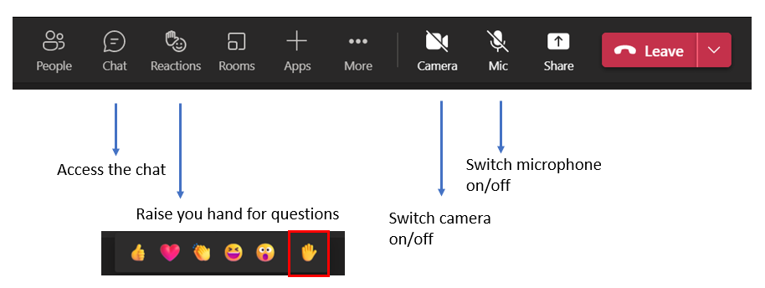
Welcome and introduction
Thank you for joining our online public event.
The event will be recorded. Please keep you microphone off, and if you prefer, switch off your camera.
You can share your questions in the chat or by raising your hand, we will cover as many questions as we can during the Q&A session.

Slide 3
Agenda
What we are aiming to achieve
Choosing the site
Site photos
Benefits to patients and the local community
Developing our plans
Designs
Timelines
How you can find out more and get involved
Next steps
Questions

Slide 4
What are we aiming to achieve?
A Health and Wellbeing Centre in Bromley Town will help us to:
Provide fit for purpose buildings for current and future primary care services
Ensure that there is sufficient capacity for primary care to meet future demand
Enable the rollout of more health and wellbeing services in the local community
Support Bromley health and care organisations to deliver services closer to the communities they serve
Provide a sustainable estates solution for the long term

Slide 5
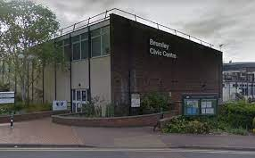
Choosing the site
In 2017, a property search was undertaken which concluded that there were 12 potentially suitable sites
6 of the 12 were discounted as not meeting the required criteria (around location, disability access, access to public transport etc)
The remaining 6 were appraised and the most credible and financially viable option was the Adventure Kingdom site, located adjacent to the Bromley Civic Centre in the town centre.

Slide 6
The preferred site
As the project progressed, it became apparent that the option wasn’t a viable one. There were issues with the configuration of the current building and some significant restrictions imposed on the design which wouldn’t support the provision of a hiqh quality environment for patients and staff.
The ICB together with the Council, managed to identify an alternative option, Churchill Court (previously Direct Line Insurance) on Westmoreland Road/High St South. Bromley Council’s Civic Centre will be moving into Phases 1 – 3 of Churchill Court and the Health and Wellbeing Centre will be on the 1st floor of Phase 4.

Slide 7
Developing our plans
Working with the Council, we are developing the designs for the Health & Wellbeing centre which will be on the first floor of Phase 4.
An ambulance parking/drop of bay will be created on High St South, close to the path leading to the building entrance.
Disabled bays are already in place on High St South and within the nearby St Marks Square car park.
Patients driving to the practice will be able to park in nearby public car parks. St Marks Square is the closest.
The entrance for patients will be via the building entrance which accessed from the walkway linking High St South with St Marks Square.

Slide 8
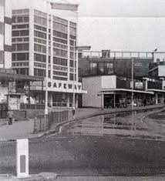
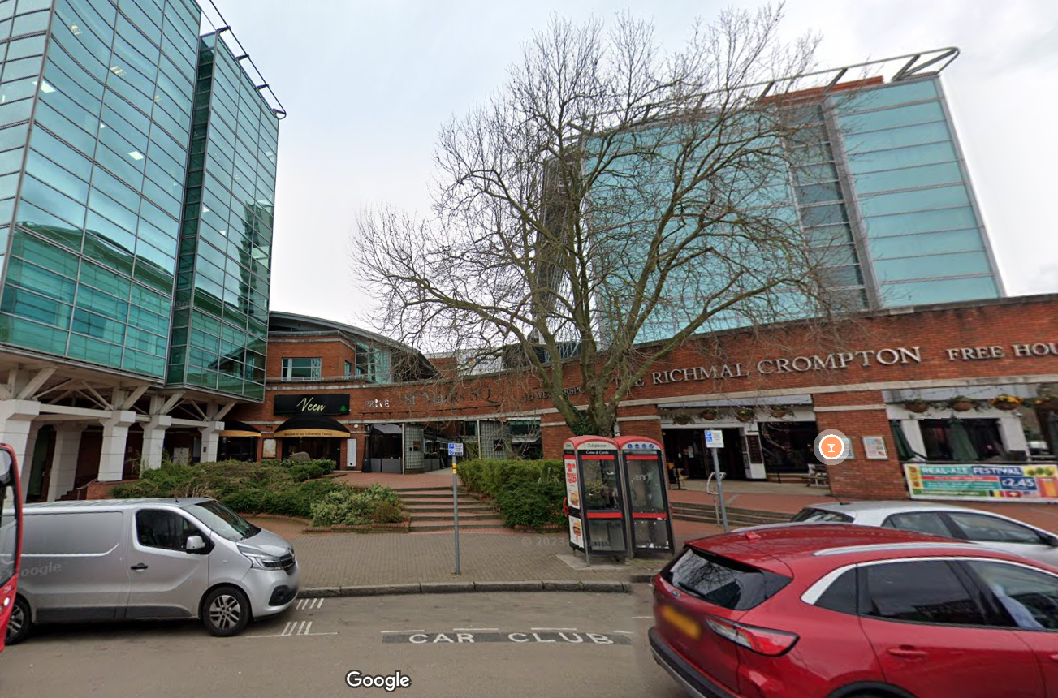
Churchill Court
Churchill Court was originally built as a supermarket and was subsequently converted into office accommodation for use by Direct Line Group.
Junction of Westmoreland Road, looking North, 1976.
High St South (view from Bromley South), looking West, 2023.

Slide 9
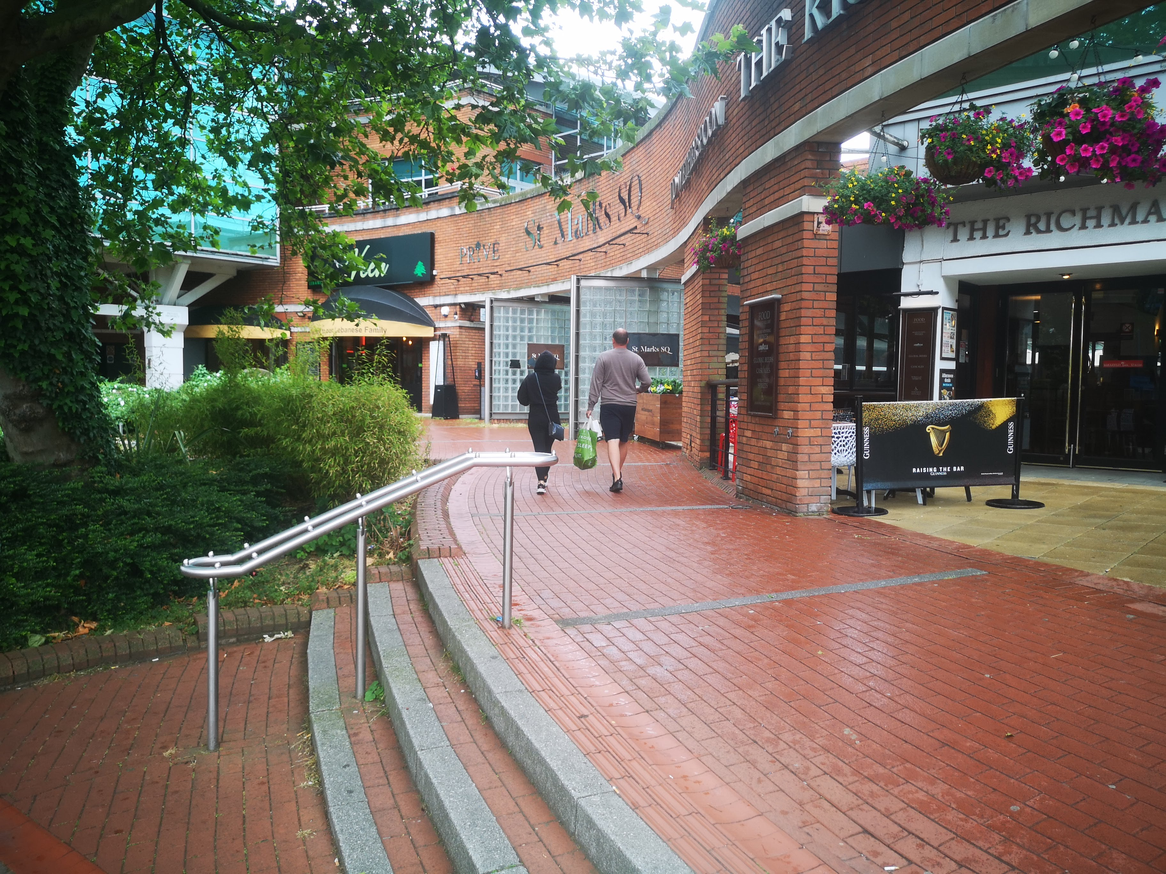
Photos
Way to Health and Wellbeing Centre
Ramped access to street (and ambulance/drop off bay)
Proposed ambulance/drop off space

Slide 10
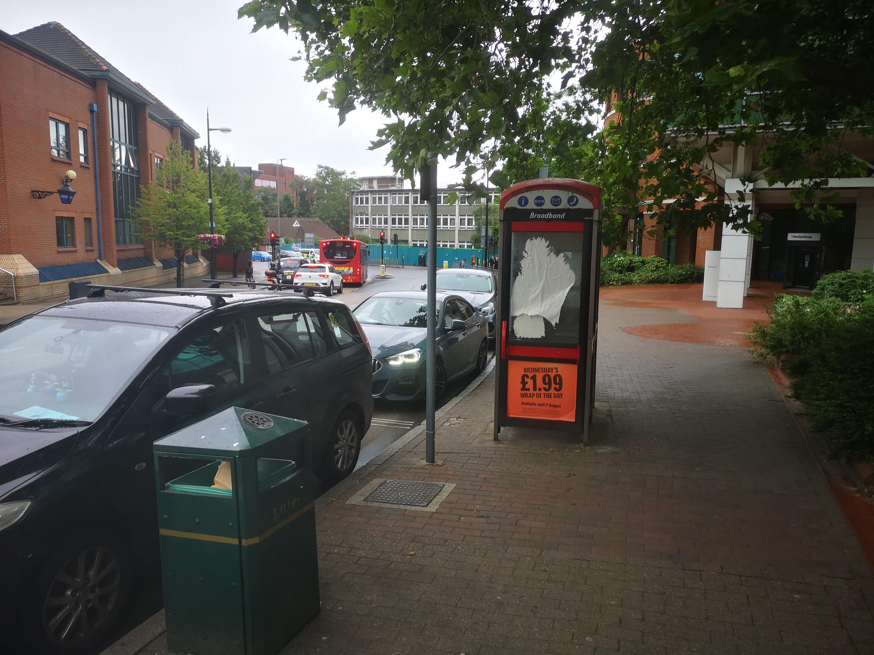
Photos
Police Station
Council main entrance
Way to Health and Wellbeing Centre
Proposed ambulance/drop off space
Ramped access to street (and ambulance/drop off bay)
Proposed ambulance/drop off space

Slide 11
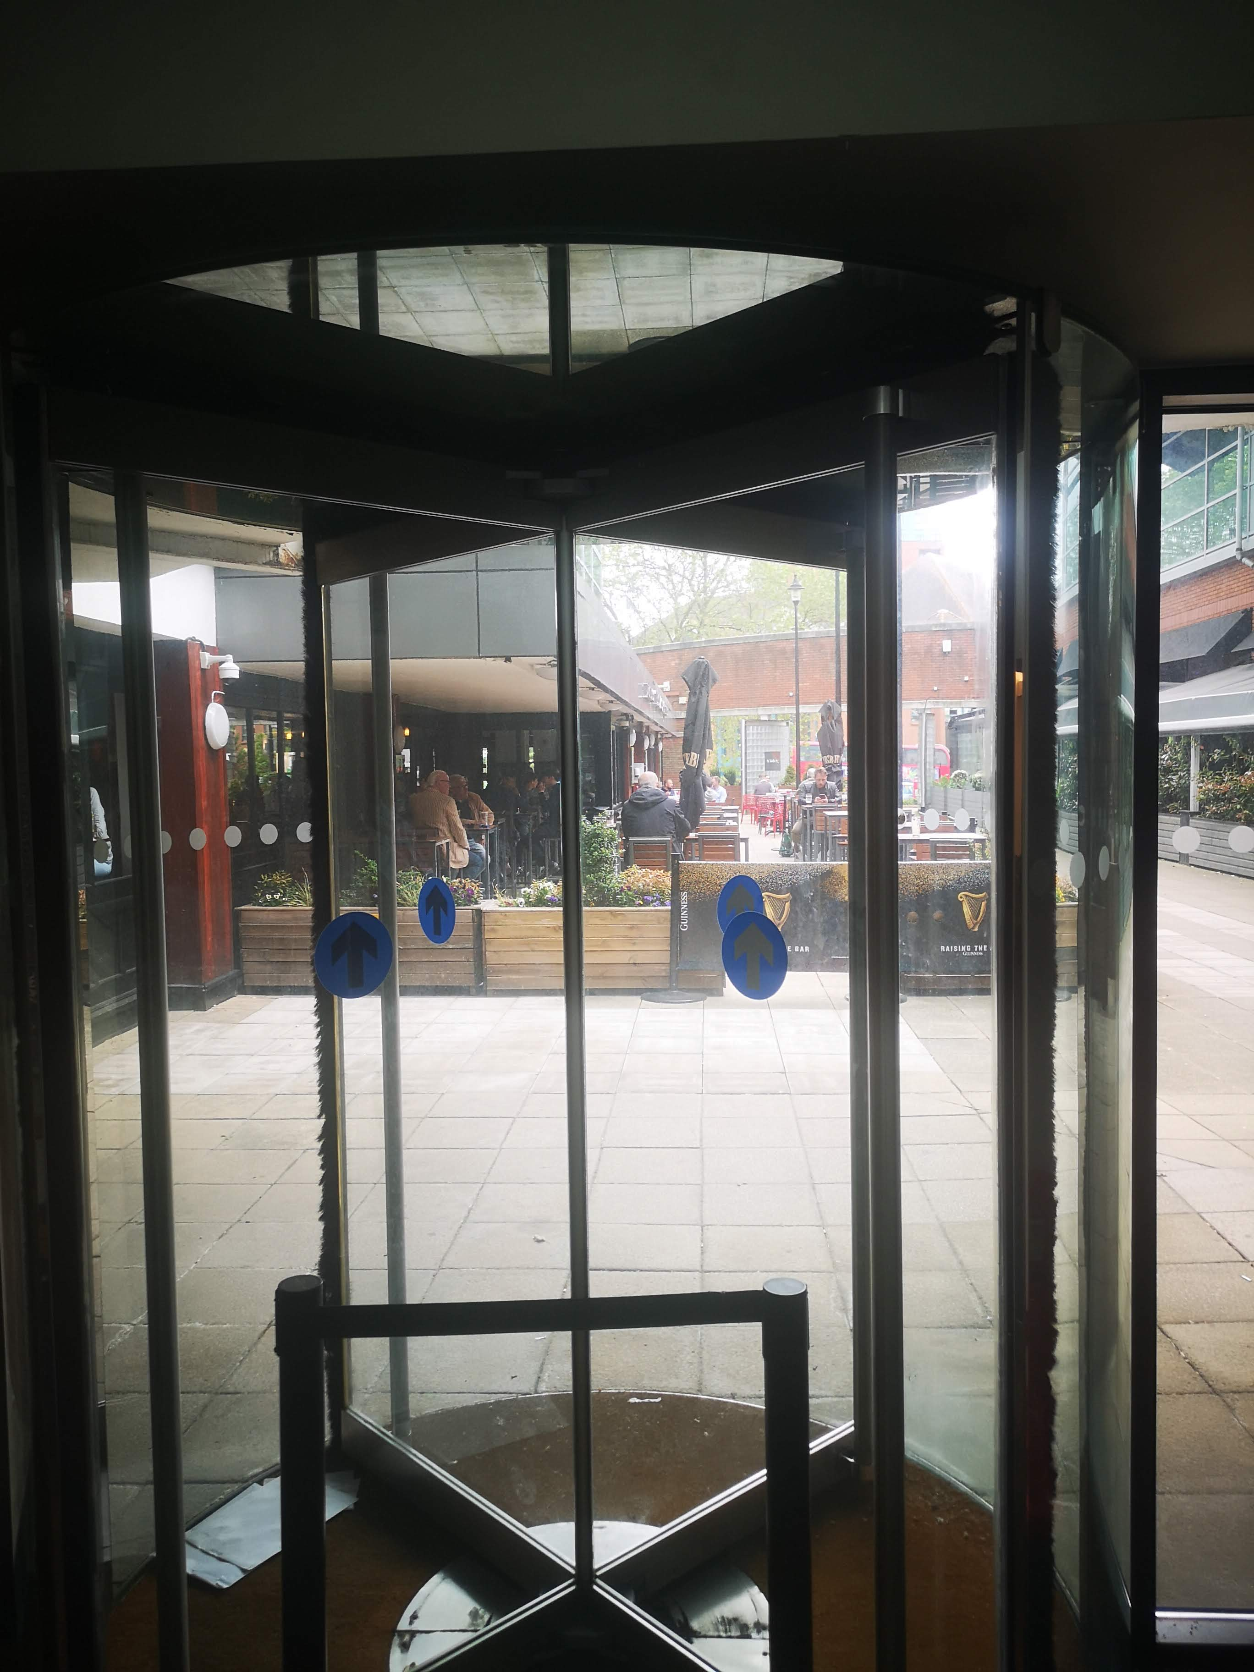
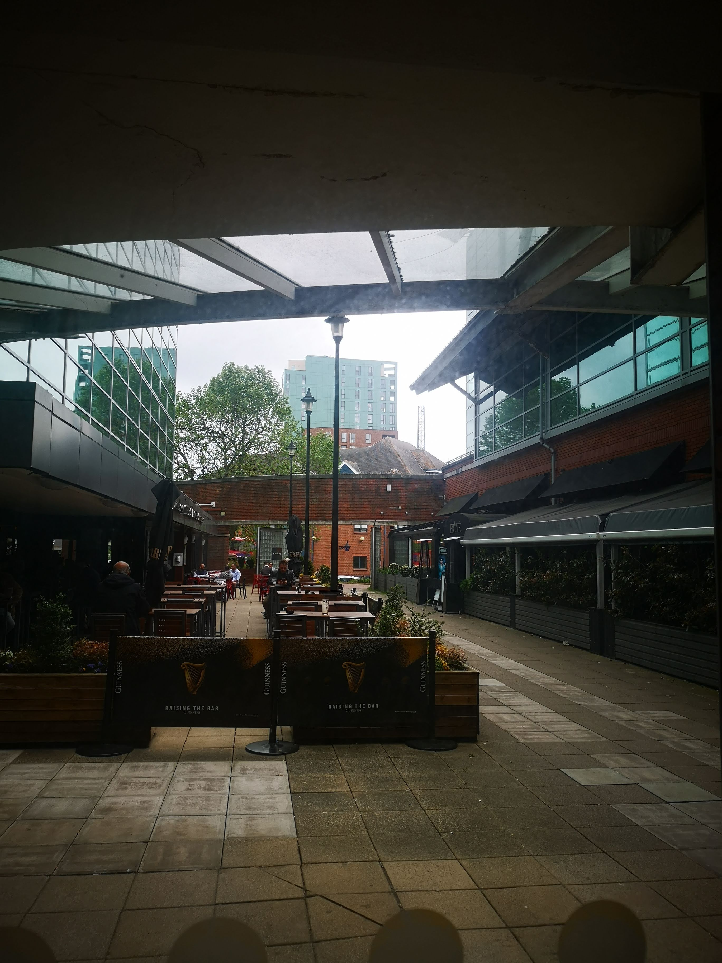
Photos
Looking out from phase 4 entrance towards High St South
Looking out from phase 4 entrance towards High St South
Way to Health and Wellbeing Centre
Pub
Restaurant
Ramped access to street (and ambulance/drop off bay)
Proposed ambulance/drop off space
St Marks Sq

Slide 12
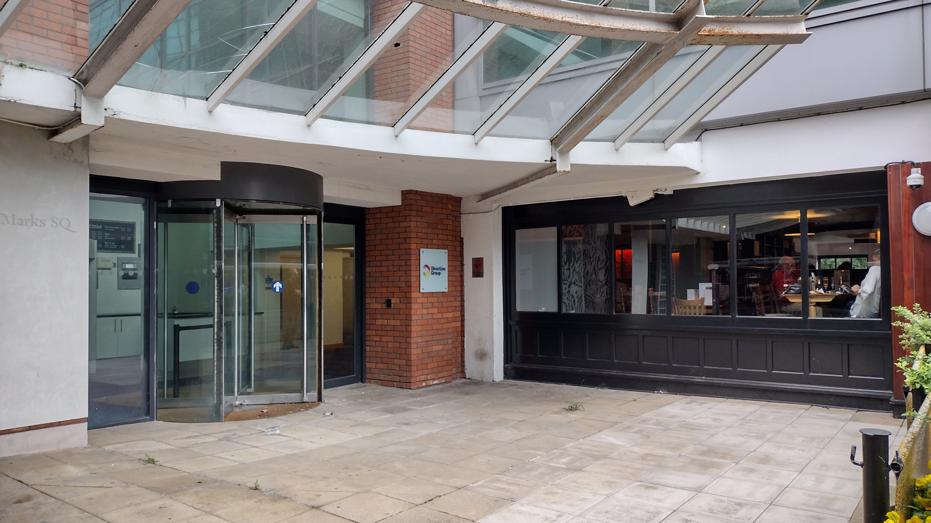
Photos
Council main entrance
Proposed ambulance/drop off space
Ground floor entrance – external view
Ramped access to street (and ambulance/drop off bay)
Proposed ambulance/drop off space

Slide 13
Photos
1st Floor – Proposed floor for Health and Wellbeing Centre
Council main entrance
Ground floor entrance – external view
Ramped access to street (and ambulance/drop off bay)

Slide 14
Benefits to patients and the local community
Introduction of new health and wellbeing services
More staff will make it easier and quicker for people to be able to see a health professional
Excellent public transport links (8 bus routes stop at Bromley South)
Reduced need to attend hospital for outpatient appointments
Improved access ensuring the building is accessible by those with mobility issues and by central location in Bromley
Close to leisure facilities at St Marks Sq and close to the High St
New staff for patients to see as an alternative to a GP (paramedics, physiotherapists, pharmacists etc)
Excellent car parking facilities in close proximity (St Marks Square)
Improved patient experience by providing a high quality environment

Slide 15
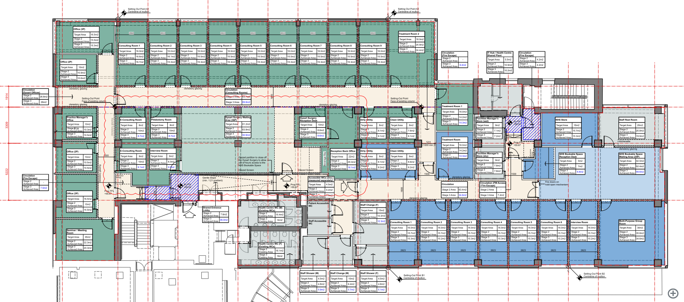
Designs
Designs as of 4/12/23
Still in development

Slide 16
Timelines
Planning permission has been submitted
Planning decision expected January 24
The business case setting out the commercial arrangements, the final designs and the tendered construction costs will be completed at the end of March 24. We plan to issue a draft with information available at the time to give the approvers time to review.
Construction works will go out to tender in January 23 and tender returns will be received in April 24.
Works will start June 24 and will be complete in December 24.

Slide 17
How you can find out more and get involved
We want to hear from you and others about what you think.
We are planning more opportunities for the public and stakeholders to hear about the new centre and share their views, both online and in person.
This will include a face-to-face event in Spring 24 at a local and accessible venue where we will share plans and answer questions.
Please share any feedback by emailing bromley.contactus@selondonics.nhs.uk
Our website will be updated regularly as the project progresses www.selondonics.org/OneBromleyHWBC

Slide 18
Next Steps
We are awaiting the planning decision
In the meantime, we will continue to develop the design and to produce the tender packages and documentation
The business case once submitted at the beginning of April will need to be approved by the NHS South East London Integrated Care Board and then by NHS England.

Slide 19
Any questions?

