Slide 1
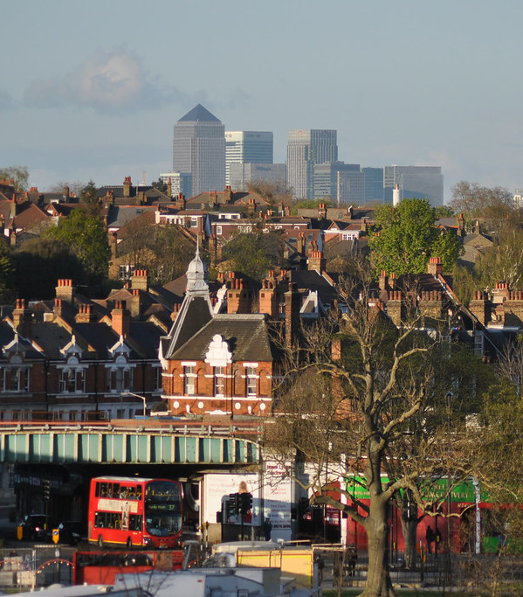

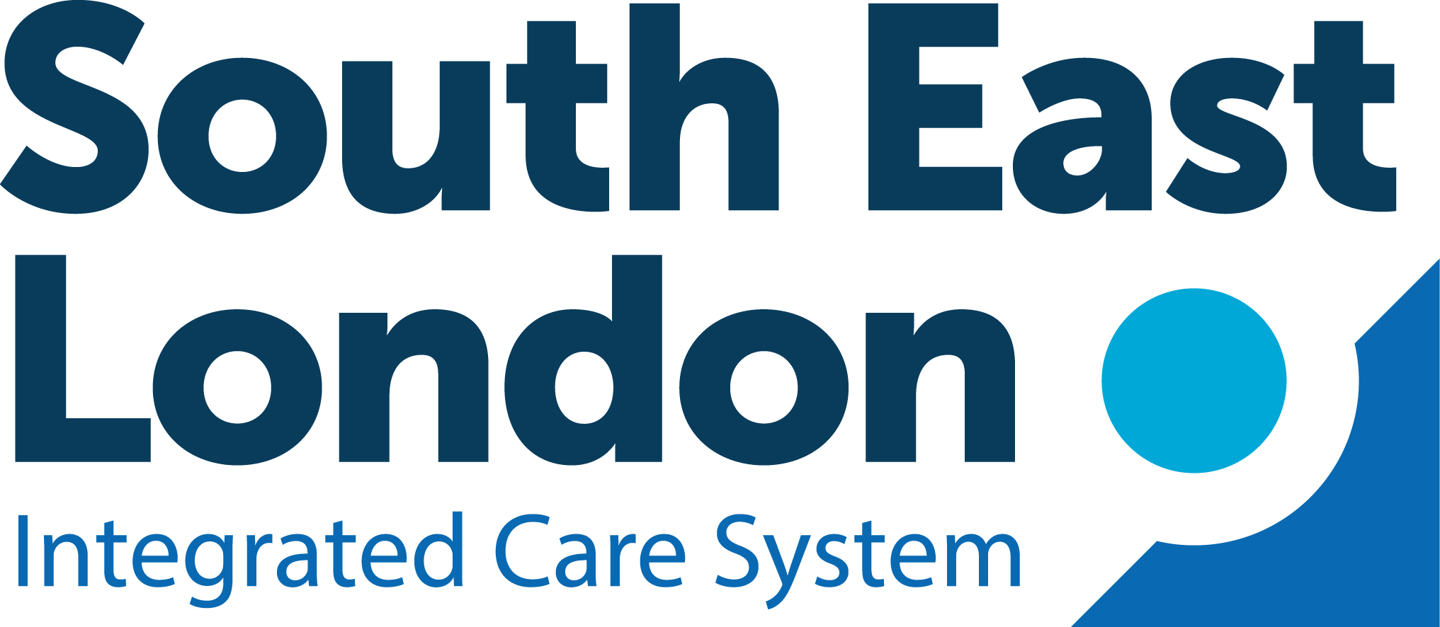
Tackling alcohol harm in South East London
Toolkit to support the introduction of evidence based high impact policies
Prepared for the Vital 5 initiative by the Institute of Alcohol Studies
May 2024
This Photo by Unknown Author is licensed under CC BY-NC

Slide 2
Situational analysis
Alcohol harm places significant strain on families, communities and public services
The COVID-19 pandemic has exacerbated existing trends: Alcohol-specific deaths in England increased by 35.9% between 2019-2022
1,525 people die each year in London due to alcohol, and there are 77,499 alcohol-attributable hospital admissions
Each year there are 347,293 alcohol-attributable crimes in London, costing society over £1.7bn
Alcohol is a major driver of health and social inequalities: In London 74% of alcohol-attributable deaths and 60% of hospital admissions are from the most deprived 40% of the population
Estimated costs of alcohol harm in South East London are £902.5 million per year (2021/22), equivalent to £504 per head

Slide 3
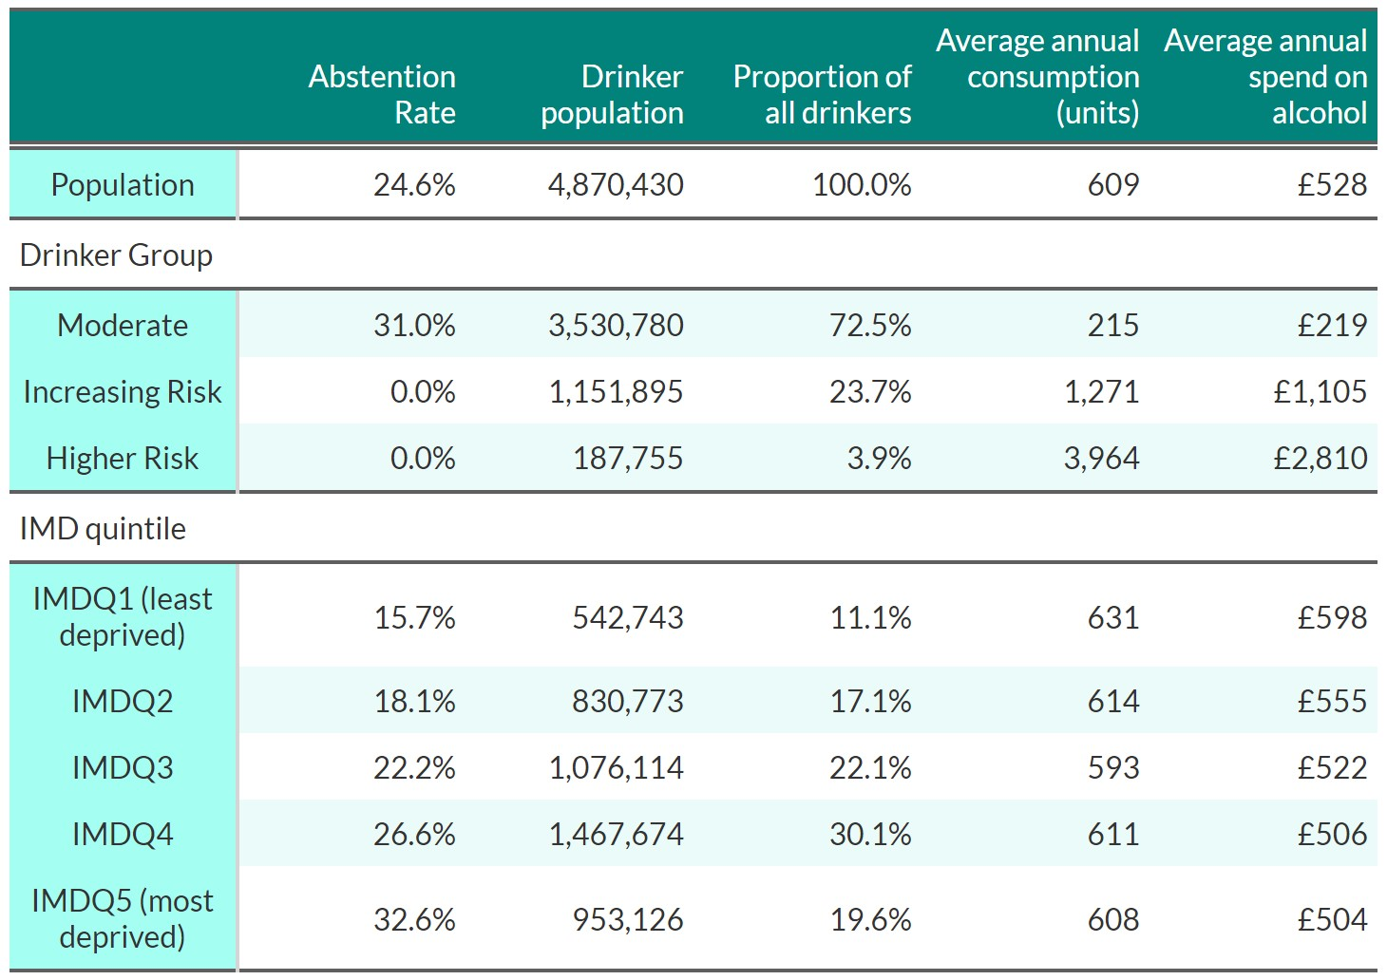
Patterns of alcohol consumption and spending
75% adults (aged 18+) in London drink alcohol
  72.5% drink at moderate levels of no more than 14 units per week.
  23.7% drink at increasing risk levels (14-35 units per week for women, 14-50 units per week for men)
  3.9% drink at higher risk levels (above 35 units for women, 50 units for men).
Significant socioeconomic variation exists in drinking patterns:
  People from the most deprived 20% of areas are more than twice as likely to abstain from alcohol than those from the least deprived 20% of areas (32.6% vs. 15.7%).
  Drinkers in less deprived areas spend more on alcohol: £598 per year in the least deprived quintile compared to £504 in the most deprived and drink slightly more on average: 631 units per year compared to 608 units per year.

Slide 4
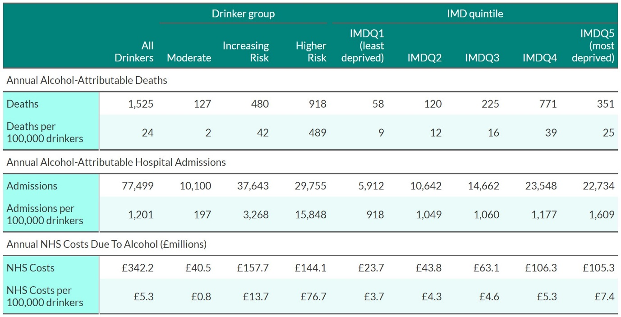
Harms are concentrated amongst heaviest drinkers
60% of all alcohol-attributable deaths and 38% of alcohol-attributable hospital admissions are from the 3% of adults drinking at higher risk levels.
These higher risk drinkers consume an average of 3,964 units a year, equivalent to:
  1744 pints of beer,
  440 bottles of wine, or
  151 bottles of vodka,
  spending an average of £2,810.

Slide 5
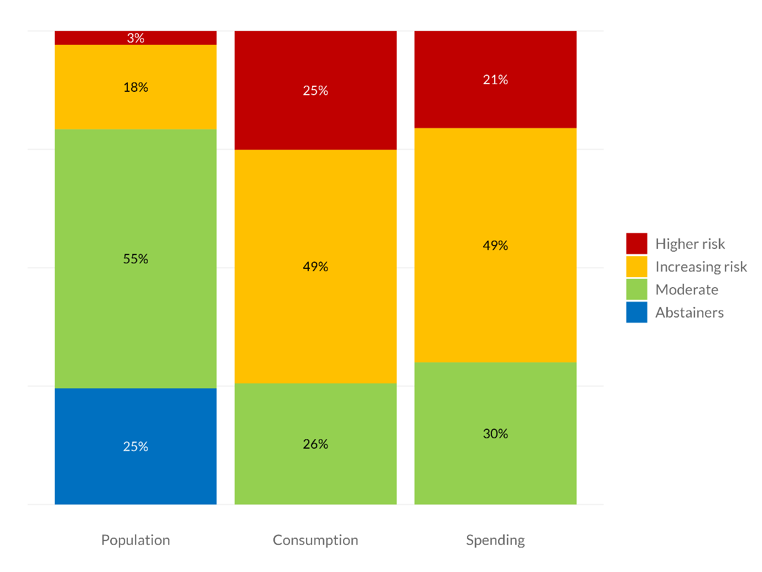
Alcohol sales are dependent on risky drinking
70% of all money spent on alcohol in London comes from the 21% of adults drinking more than 14 units per week.

Slide 6
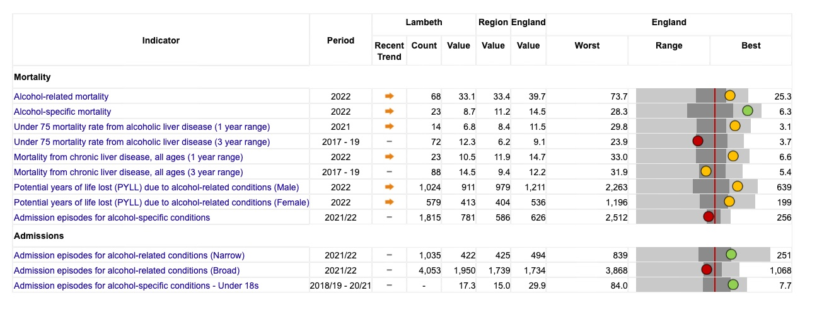
Finding local health data: OHID alcohol profile
OHID* provides data on local alcohol health harms, available at https://fingertips.phe.org.uk/profile/local-alcohol-profiles
Allows local authorities to compare their indicators with other LAs and benchmark against the England or regional average
Data provided on:
  mortality (alcohol-specific and alcohol-related),
  hospital admissions (narrow and broad measures) by age and sex,
  incidence of alcohol-related conditions
  percentage of dependent drinkers in a chosen area.
*OHID: The Office for Health Improvement and Disparities (formerly Public Health England)

Slide 7
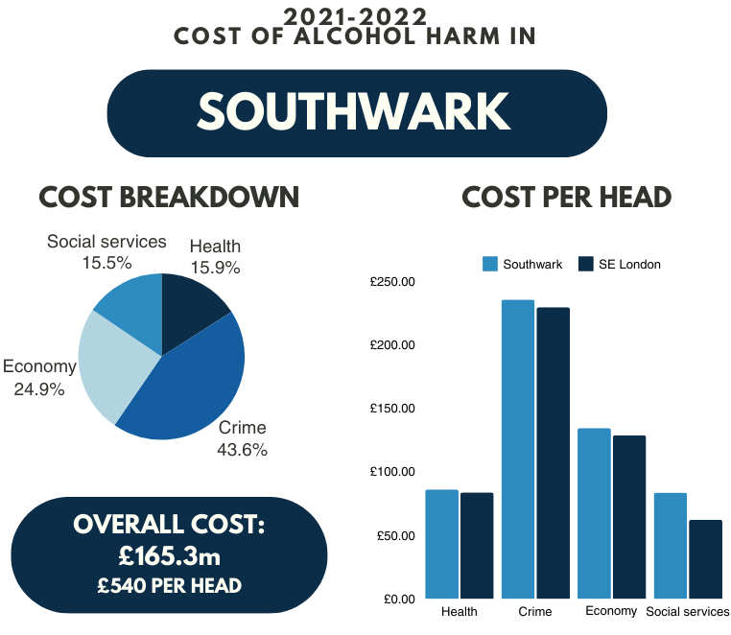
Local data on costs of alcohol harm
The Institute of Alcohol Studies provides data on societal costs of alcohol harm (2021/2022) by Local Authority in England at https://www.ias.org.uk/factsheet/economy/
Data provided on cost of:
  NHS & healthcare
  Crime and disorder
  Wider economy and productivity
  Social services
Methods for calculating costs available at https://www.ias.org.uk/wp-content/uploads/2024/05/Cost-of-Alcohol-in-England-Methodology.pdf

Slide 8
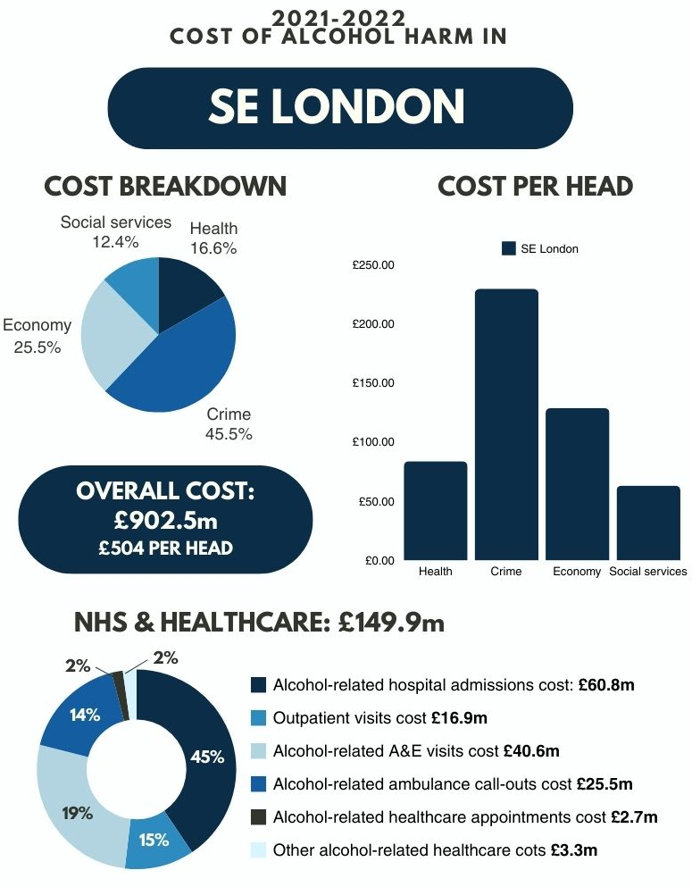
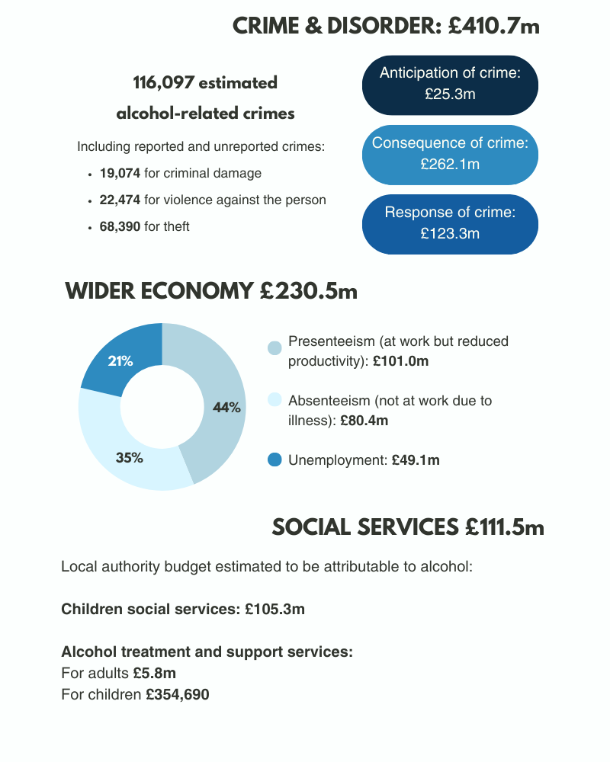


Slide 9
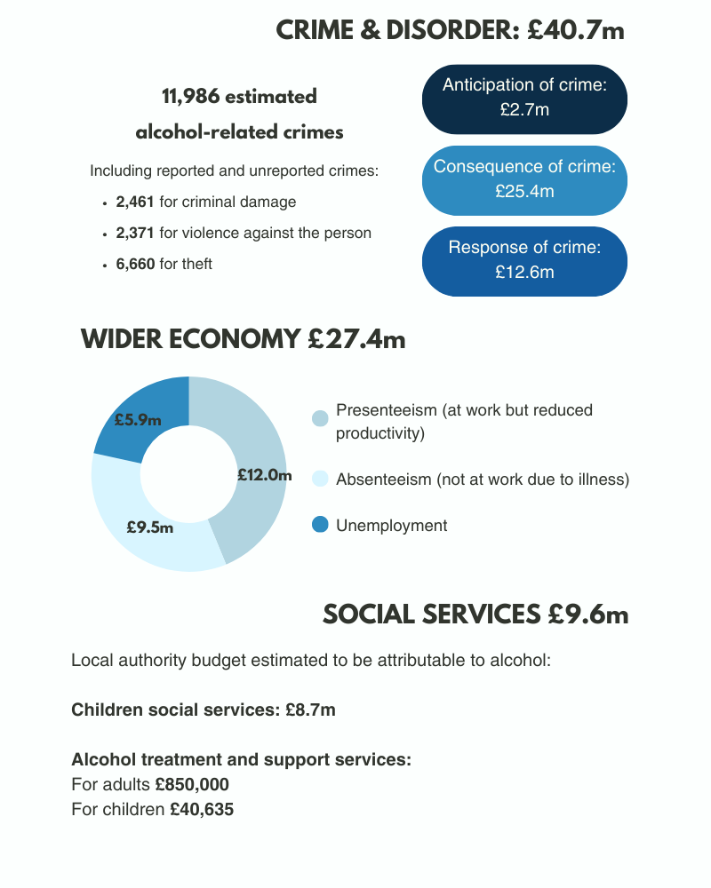

Slide 10
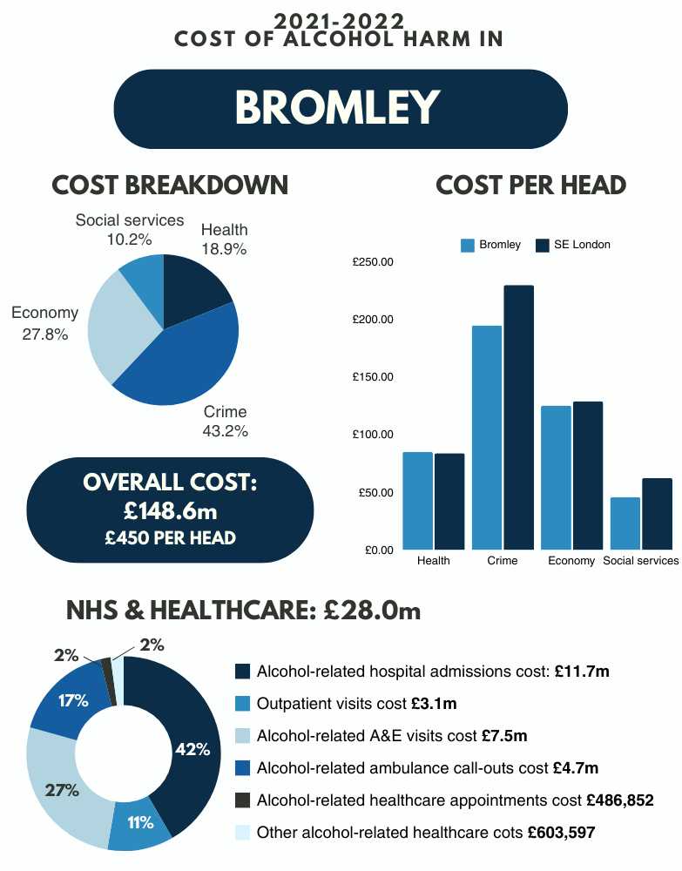
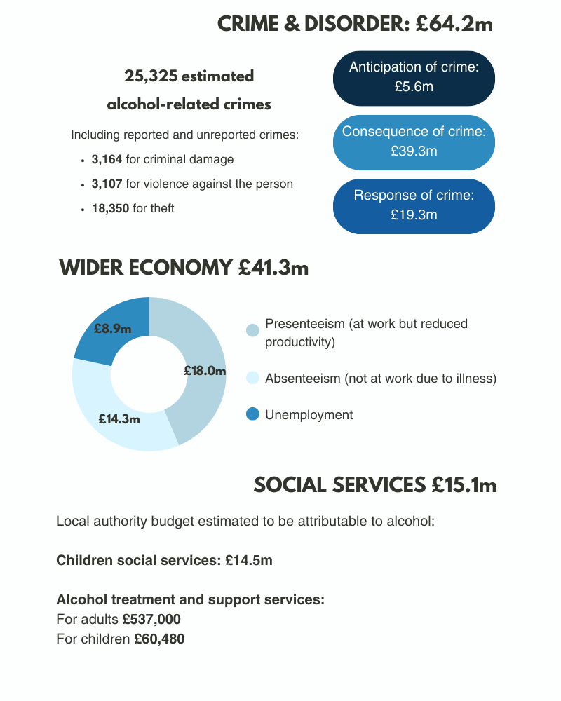

Slide 11
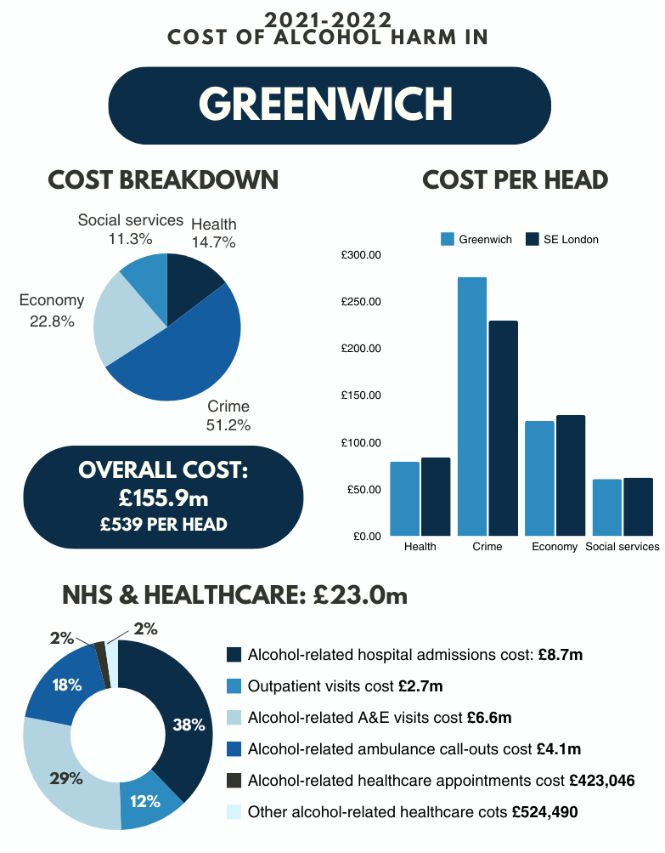
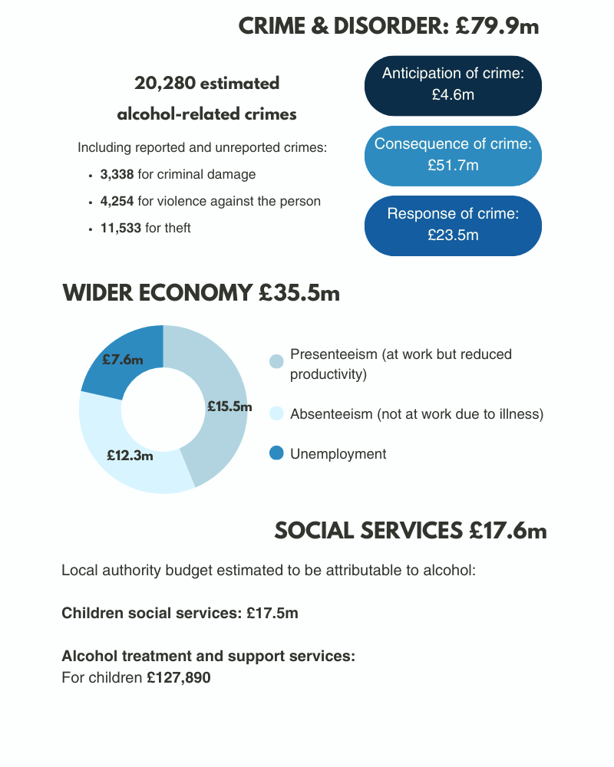

Slide 12
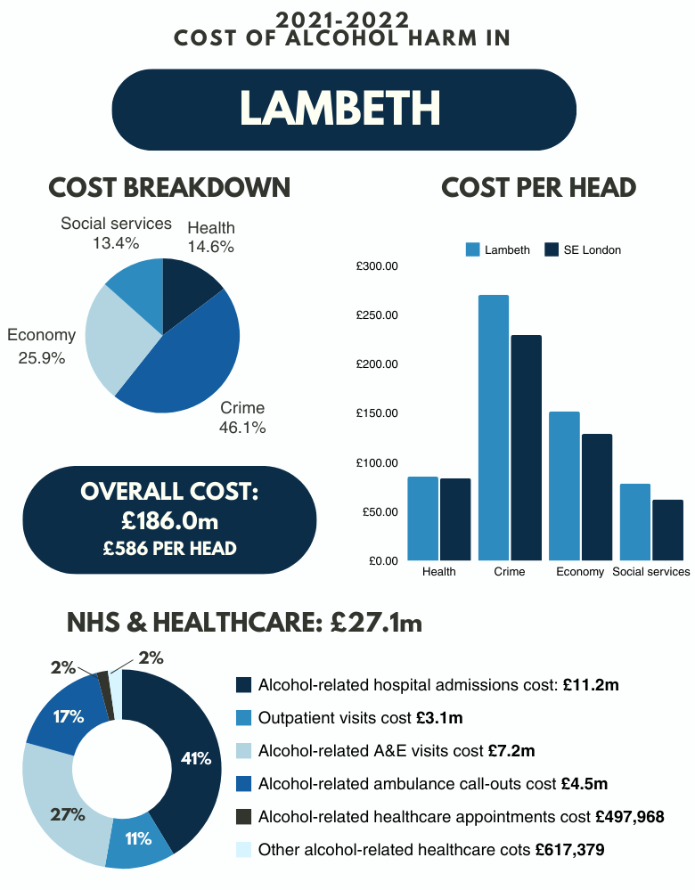
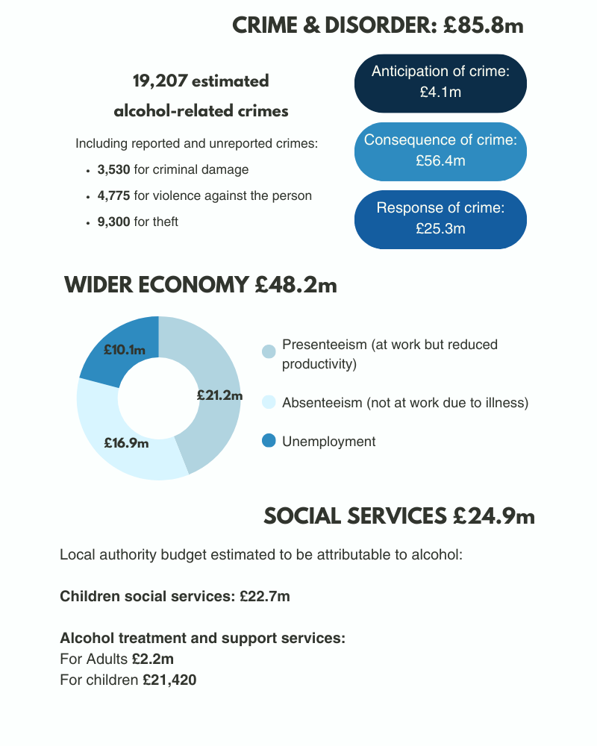

Slide 13
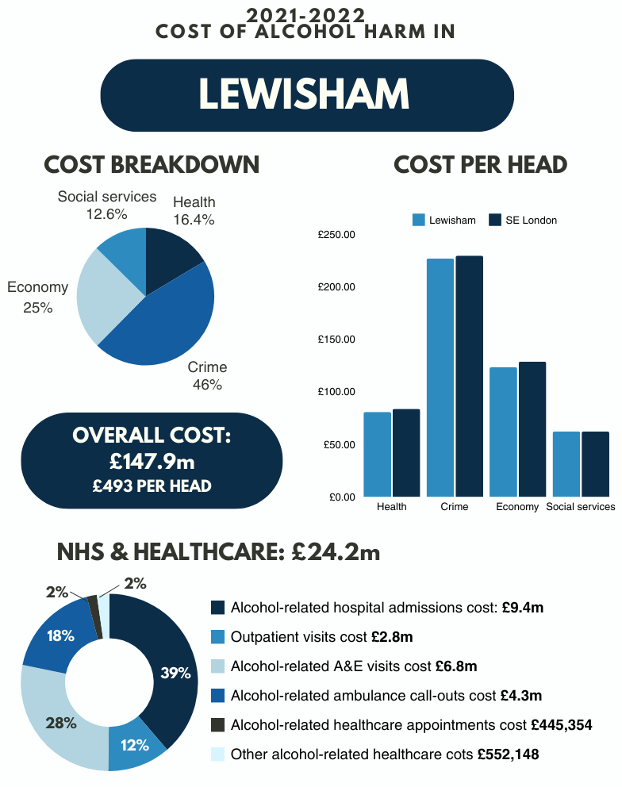
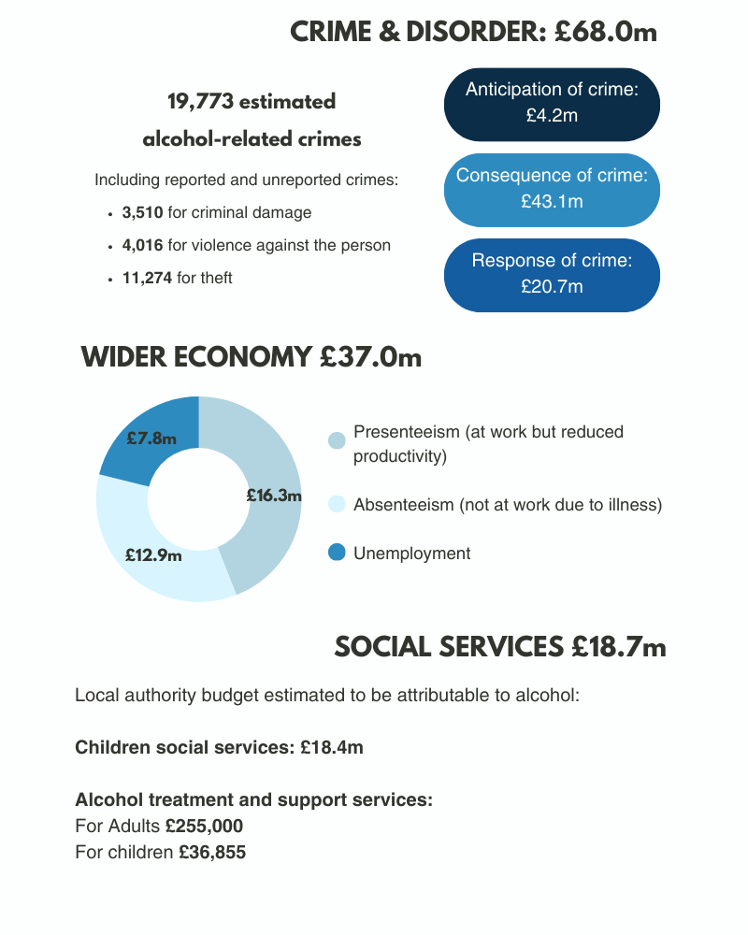

Slide 14
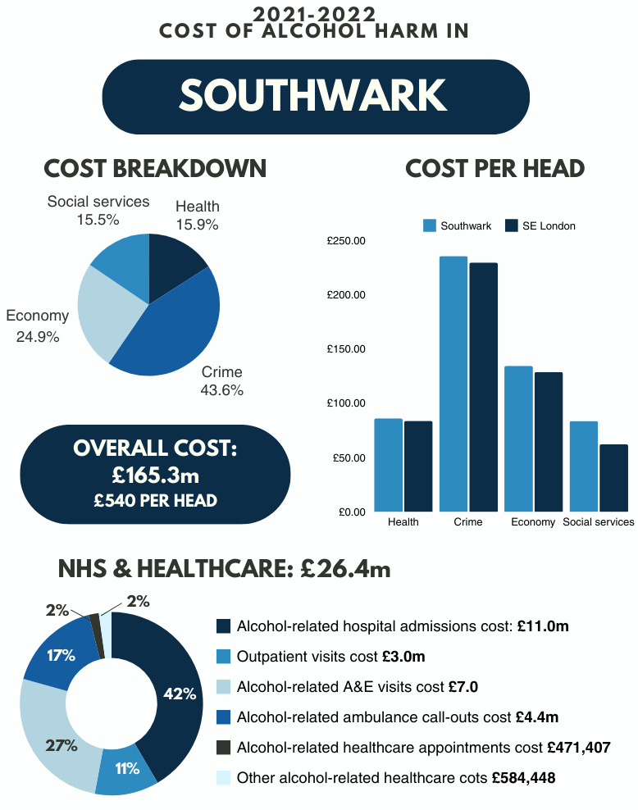
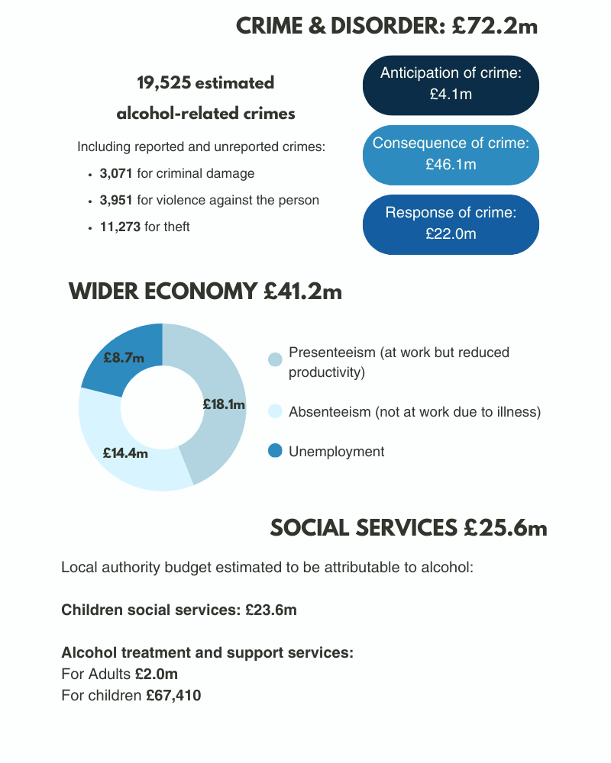

Slide 15
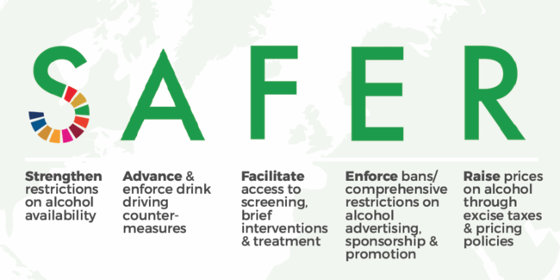

Evidence-based policies to tackle alcohol harm
WHO recommends governments adopt comprehensive strategies to reduce alcohol harm
Three high-impact, cost-effective policies identified are action on price, availability and marketing – known as their ‘best buy’ policies
For more information visit https://www.who.int/health-topics/alcohol#tab=tab_1

Slide 16
Calls for a national alcohol strategy in England
The Alcohol Health Alliance UK calls for the government to:
Commit to introducing evidence-based prevention policies – including reducing the availability, marketing and affordability of alcohol – to save lives and reduce pressure on the NHS
Introduce minimum unit pricing for alcohol in England, to prevent the sale of ultra-cheap high strength drinks that lead to high social costs
Ensure alcohol duty at least keeps pace with inflation and that all stronger products are always taxed at a higher rate than lower strength products.
Include ‘public health’ as a licensing objective in England and Wales so that licensing bodies have to consider local alcohol harm data when making their decisions
Include alcohol in the definition of ‘unhealthy products’ under the marketing regulations for products high in fat, sugar and salt
Give responsibility for ensuring alcohol marketing practices adhere to higher standards to an independent body with no links to the alcohol or advertising industries
Introduce mandatory alcohol product labelling that provides consumers with information relating to ingredients, calories, units, Chief Medical Officers’ guidelines, and health risks such as alcohol during pregnancy and cancer
Scale up and commit to long-term funding of proven and cost-effective early interventions and treatment across the UK, and deliver on better coordination between alcohol treatment and other services such as mental health, domestic abuse, and housing support
Bring forward an effective cross-government strategy to reduce health inequalities, recognising the key role that alcohol plays in driving these inequalities

Slide 17
Public support for action on alcohol harm
The UK public supports action on alcohol harm. The Alcohol Health Alliance opinion polling data in 2023 showed:
The majority (55%) of people who expressed an opinion did not think that the government is taking enough action on alcohol
70% of people wanted government policy to be protected from the influence of the alcohol industry and its representatives
76% of people thought the number of units in a product should be legally required on alcohol labels, with the majority of people supporting more and better labelling of alcoholic products overall
Over half of people would welcome improved marketing regulations, especially the introduction of health warnings on marketing materials and separate display areas for alcohol and its marketing in shops, and
There was demonstrable support amongst respondents from all political backgrounds for tackling the affordability of alcohol.
Decisionmakers can be confident that many of the high-impact policies to reduce alcohol harm often have the support of the public. Working with NGOs, campaigning and community groups can help to raise awareness of alcohol harm among the public and communicate key issues relating to evidence-based interventions to help build support for policy action. Data available at

Slide 18
Minimum Unit Pricing (MUP)
Sets a legal floor price per unit of alcohol
Currently implemented in Scotland and Wales at 50p per unit, although Scotland will increase to 65p from October 2024
Targets high-strength, cheap alcohol sold in shops and supermarkets, consumed by heaviest drinkers
In Scotland MUP associated with:
  13% reduction in alcohol deaths and
  4% reduction in hospital admissions
  Harms disproportionately reduced in lowest income groups
  For more information on evaluation of MUP in Scotland see Public Health Scotland evaluation report
  MUP proposed in England as part of 2012 Alcohol Strategy, but subsequently dropped after considerable industry lobbying (for more details see BMJ series Under the Influence)
In the absence of national action, Association of Greater Manchester Authorities and Cheshire and Merseyside Public Health Network called (unsuccessfully) for regional by-law to implement MUP
National legislation required via Licensing Act 2003 for national implementation or via the Sustainable Communities Act 2007 for optional implementation by local authorities as a mandatory licensing condition

Slide 19
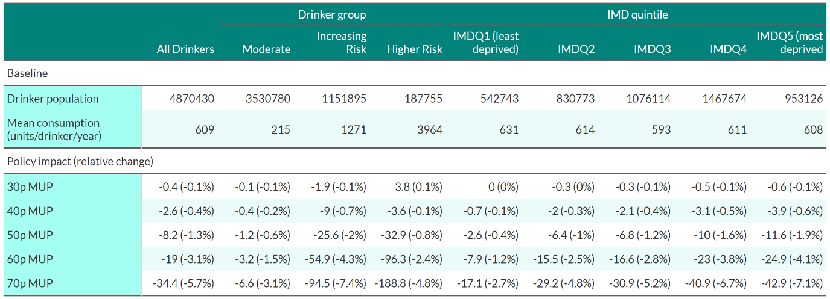
Estimated impact of MUP in London
Modelled impacts of MUP on alcohol consumption
50p MUP would reduce alcohol consumption by 1.3%
70p MUP would reduce alcohol consumption by 5.7%
Smaller impact on moderate drinkers and high income groups

Slide 20
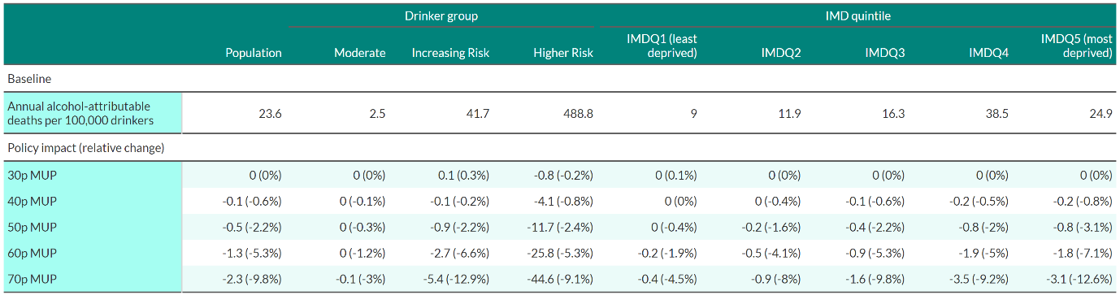
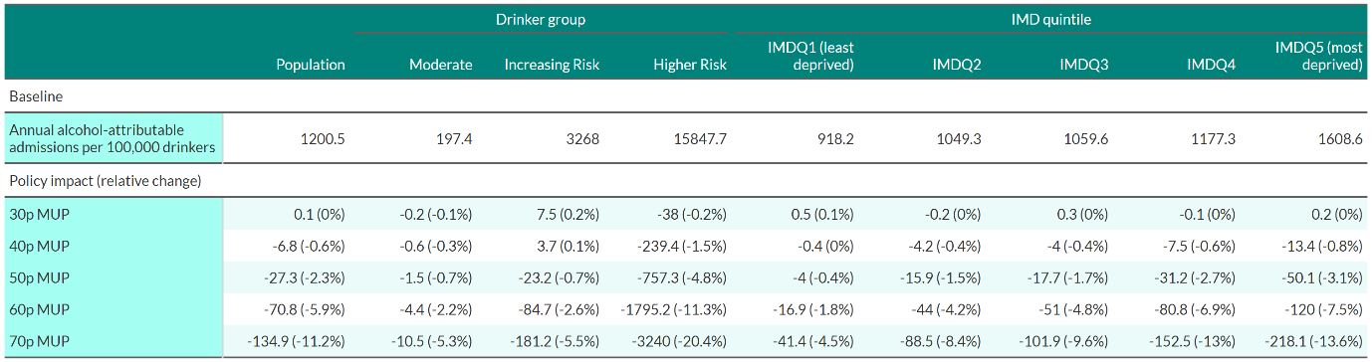
Estimated impact of MUP in London on health
50p MUP would:
reduce death rate by 0.3% among moderate drinkers and 2.4% among higher risk drinkers
Reduce hospital admission rate by 0.7% among moderate drinkers and 4.8% among higher risk drinkers
70p MUP would:
reduce death rate by 3% among moderate drinkers, 9.1% among higher risk drinkers
Reduce hospital admission rate by 5.3% among moderate drinkers and 20.4% among higher risk drinkers
Modelled impact of MUP on alcohol-attributable death rates
Modelled impact of MUP on rates of alcohol-attributable hospital admissions

Slide 21
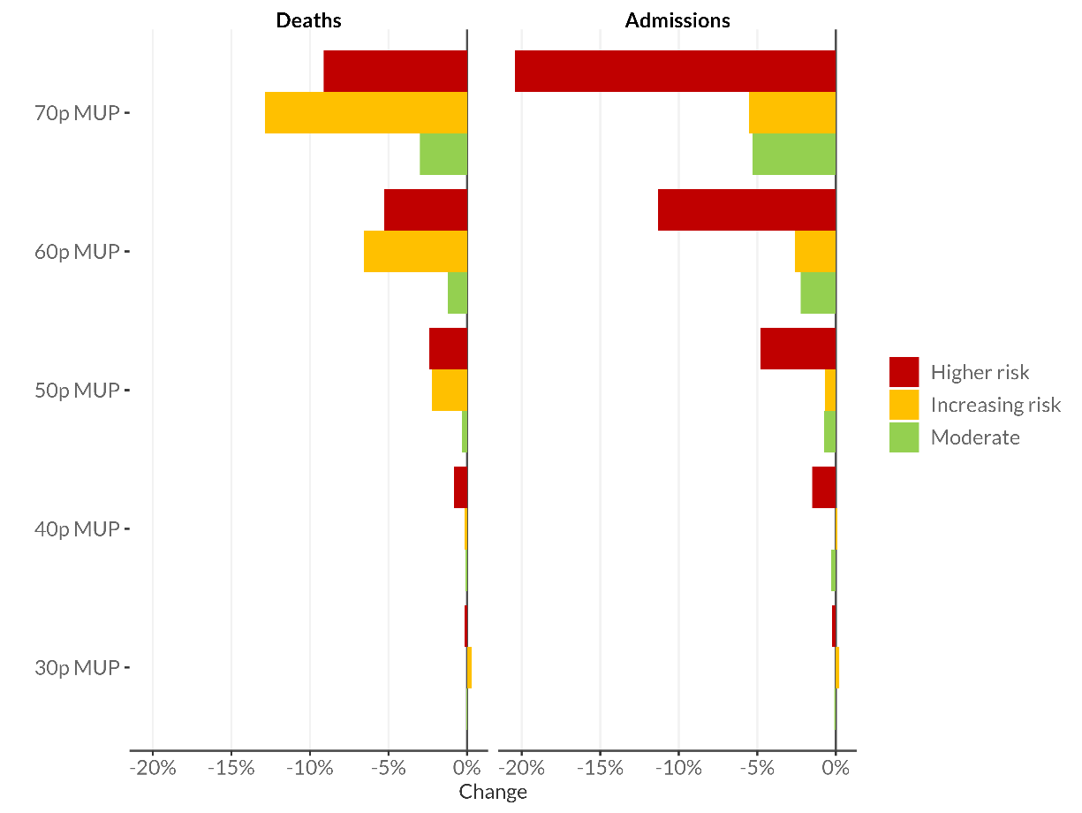
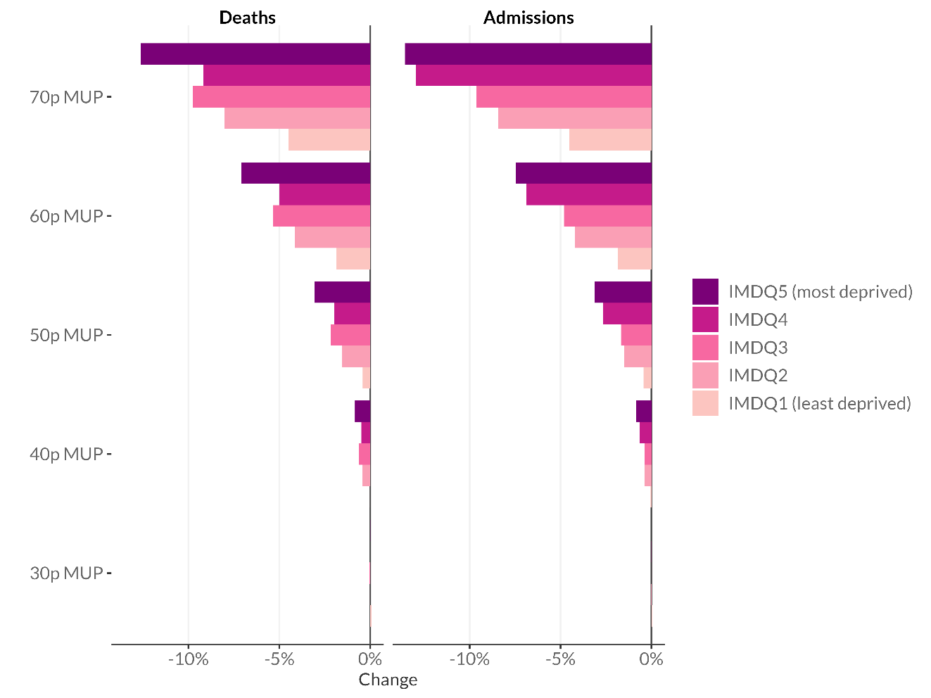
Health benefits of London MUP at all levels are greatest among heavier drinkers and most deprived groups
Modelled impacts of MUP on health outcomes by drinker group
Modelled impacts of MUP on health outcomes by IMD quintile

Slide 22
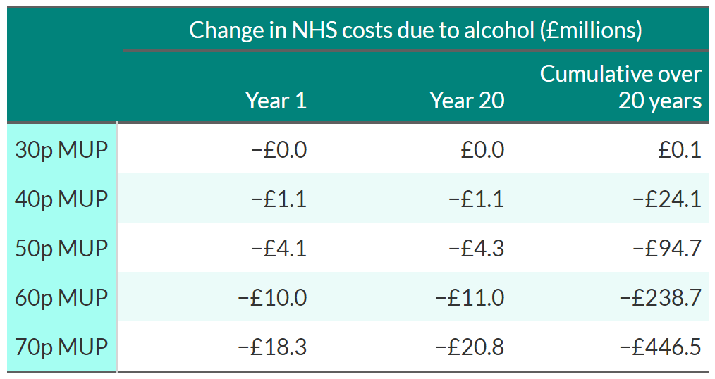
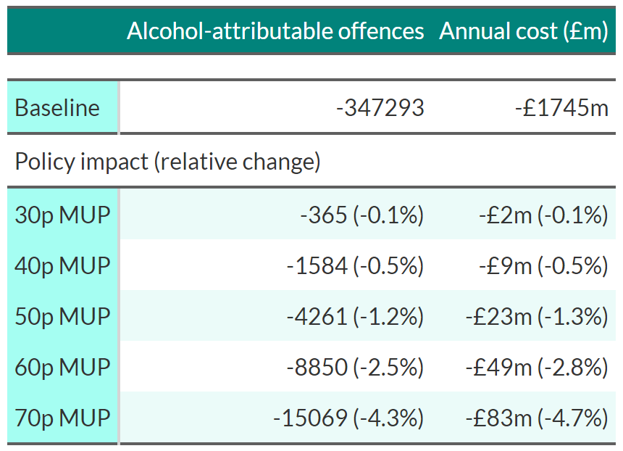
Cost savings linked to MUP in London
50p MUP would:
Reduce NHS costs by £4.1 million in first year after implementation and £94.7 million over following 20 years
Reduce alcohol attributable crimes by 1.2% and annual costs by £23 million
70p MUP would:
Reduce NHS costs by £18.3 million in first year after implementation and £446.5 million over following 20 years
Reduce alcohol attributable crimes by 4.3% and annual costs by £83 million
Modelled impacts of MUP on NHS costs attributable to alcohol
Modelled impacts of MUP on alcohol-attributable crime

Slide 23
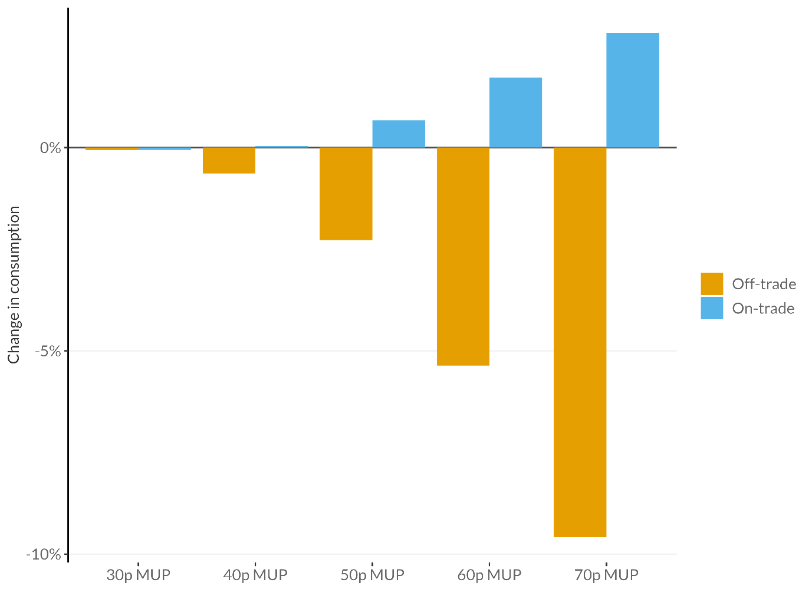
Estimated impact of MUP on purchase location
MUP impacts shop-bought alcohol (on-trade)
Higher prices in pubs, bars and restaurant means they are largely unaffected by MUP
Modelling suggests some consumers may shift to on-trade with higher off-trade prices
Estimated total changes in alcohol consumption by purchase location

Slide 24
MUP modelling – interpretation and context
These results illustrate that introducing a minimum unit price for alcohol would reduce alcohol consumption, improve population health, and reduce crime in London, saving the NHS and public services millions of pounds.
They also show that the policy would have the largest impact on heavier drinkers and those in the most deprived groups in society, leading to a reduction in health inequalities.
However, there are some important factors that should be considered when interpreting these results:
  London has lowest estimated reductions in consumption, alcohol-attributable deaths and hospital admissions of any region in England following the introduction of a 50p MUP
  Results are based on 2018 prices, so do not reflect significant inflationary increases
  Results do not reflect the changes to consumption during and after the COVID-19 pandemic

Slide 25
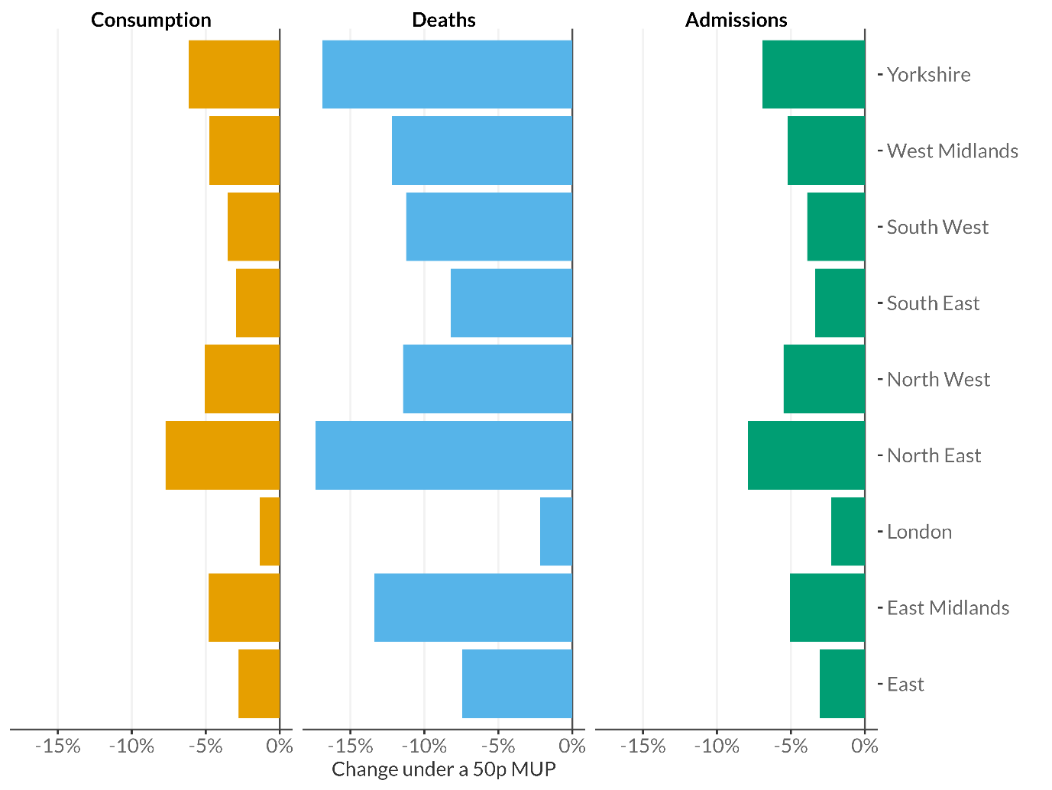
Impacts of MUP in London compared to other English regions
A comparison of modelled impacts of a 50p MUP between English regions
London has the lowest estimated impacts of any region in England following the introduction of a 50p MUP.
Due to a combination of several factors:
  London has higher rates of non-drinking than other regions,
  lower average alcohol consumption among drinkers,
  and lower rates of alcohol-attributable mortality.
  London has higher prices for alcohol on average than most other parts of the country, and
  a greater proportion of alcohol is bought in the on-trade, meaning that a smaller proportion of alcohol sales are affected by any MUP threshold.

Slide 26
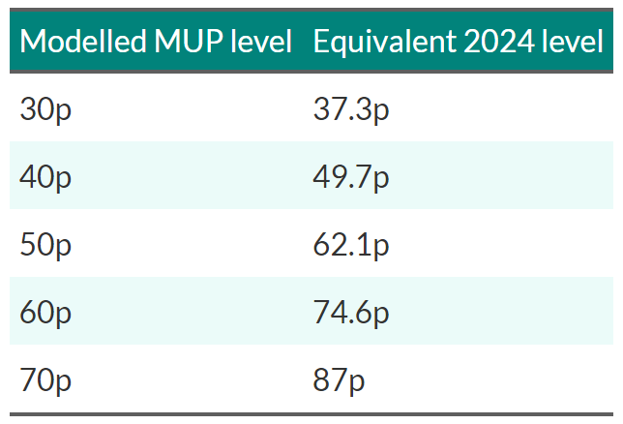
Inflation has eroded the impact of MUP
Data based on 2018 prices – inflation has since risen 24.3%
MUP thresholds would need to increase in line with inflation to achieve estimated impacts presented: 62.1p would be required to achieve impact of 50p
Scotland will uprate its MUP from 50p to 65p from October 2024
MUP levels after adjusting for inflation

Slide 27
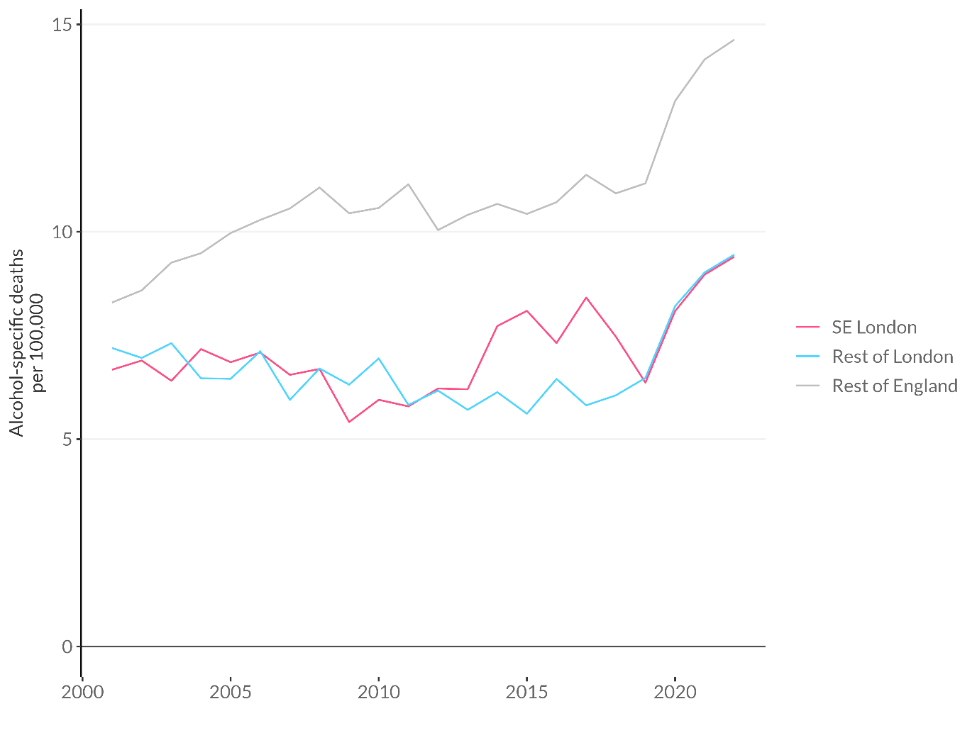
The impact of COVID-19
Trends in alcohol-specific death rates 2001-2022
There was a significant polarisation in drinking at the start of the pandemic, with moderate drinkers reducing their alcohol intake, or giving up alcohol entirely, while heavier drinkers increased their alcohol intake on average
This coincided with a sharp increase in alcohol-specific deaths in England, rising by 20% between 2019-2020. Figures have continued to rise in 2021 and 2022, with alcohol-specific deaths in 2022 being 35.9% higher than they were 2019
In SE London alcohol-specific deaths have been rising for over a decade, suggesting a greater need for effective policy action

Slide 28
Local interventions in South East London
Evidence suggests the following policy framework will lead to reductions in alcohol harm in SE London:
Advertising bans: prohibiting alcohol advertising on council-owned spaces and infrastructure
Regulating availability
Density of alcohol outlets: through Statements of Licensing Policy and Cumulative Impact Policies
Managing the drinking environment
Brief interventions and treatment
Multicomponent community programmes: such as 'Drink Less Enjoy More’ tested in NW England
Replacing glassware with safer alternatives: as in good practice licensing guidance
Voluntary removal of the sale of high strength alcohol: 'Reducing the Strength' initiatives
Policing and enforcement approaches: multi-agency Cardiff Model for violence prevention
Identification and brief advice (IBA) in primary healthcare: follow NICE guidance to routinely carry out alcohol screening as an integral part of practice
Regulating marketing
Hours and days of sale: through Statements of Licensing Policy, Late Night Levies, Early Morning Restriction Orders
Electronic IBA: follow NICE guidance to use as an adjunct to existing services
Psychosocial and psychological interventions: follow existing NICE guidance
Pharmacological interventions: follow existing NICE guidance
Advocacy for national action (on price, availability and marketing)

Slide 29

Guidance and resources for policy implementation

Slide 30
Local self-assessment: CLeaR
Public Health England developed the alcohol CLeaR (Challenge services, Leadership and Results) initiative to support local alcohol partnerships to assess the effectiveness of local systems and services
Helps partnerships develop action plans for improvement through its focus on 3 main areas:
  Challenge for the services that deliver interventions to prevent or reduce alcohol-related harm.
  Leadership for the alcohol agenda, which involves considering how local structures and governance arrangements can support collaborative action to reduce alcohol harm.
  Results achieved through recent activity to reduce alcohol harm, evidenced by national and local data sources.
Full details at CLeaR self-assessment tool
“The CLeaR approach asks partnerships to review progress against their priority alcohol objectives within the context of other plans to improve people’s health in the local area. CLeaR will have more impact if the partnership sees alcohol as part of the bigger local picture and understands how reducing alcohol harm can help to meet other local objectives. This can also help make the case for continued investment in alcohol harm reduction.” PHE

Slide 31
Key stakeholders with responsibility for addressing alcohol harm
Local politicians and senior decision-makers
Directors of public health
Local authority alcohol commissioners
Other local government officers from public health, trading standards, housing, children’s services and social care
NHS commissioners
NHS providers of primary, secondary and mental health care
Police and other organisations involved in community safety, offender management and crime reduction
Jobcentre Plus staff and representatives from local housing services
Local voluntary and community sector services
Service user and carer representatives

Slide 32
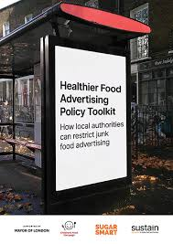
Prohibiting alcohol advertising on council-owned spaces and infrastructure
TFL restricts adverts that feature unhealthy foods and soft drinks and policy adopted by Haringey, Southwark and Greenwich
Sheffield City Council Advertising and Sponsorship Policy prohibits promotion of health harming products – including alcohol – on council-owned sites.
Sustain toolkit on Healthier Food Advertising Policy guides local decisionmakers through process of initiating, building support for, implementing and evaluating policies to restrict unhealthy food advertising.

Slide 33
Restricting availability
Licensing Act 2003 allows local decisionmakers to control availability of alcohol via:
  Density of alcohol outlets: through Statements of Licensing Policy and Cumulative Impact Policies
  Hours and days of sale: through Statements of Licensing Policy, Late Night Levies, Early Morning Restriction Orders
  See Home Office revised Guidance issued under section 182 of the Licensing Act 2003
Directors of Public Health are Responsible Authorities in licensing decisions – although absence of a licensing objective linked to health is a major challenge
Guidance exists on how health can contribute to licensing decisions within existing framework:
  Local Government Association, Public Health and the Licensing Act
  PHE, Alcohol licensing: a guide for public health teams

Slide 34
Multi-agency partnerships
Partnerships with health, police and enforcement bodies can be effective at reducing alcohol-related violence and disorder
Drink Less Enjoy More initiative in Cheshire and NW Merseyside linked to reduction in sales to ‘pseudo drunk’ actors, focused on:
  Community mobilization
  Responsible bar server training
  Strengthened police engagement

Slide 35
Reducing the Strength
Aims to tackle harms linked to high-strength low-cost alcohol products
Voluntary agreements with local retailers to remove items from sale (typically 6.5% ABV and over)
Introduced in Camden and Islington, via partnership with licensing teams, police and public health. Relatively high rates of compliance reported.
LGA Reducing the Strength: Guidance for councils considering setting up a scheme provides information on principles and design of a scheme, including legal considerations relating to competition law. Case studies are presented for Suffolk and Portsmouth

Slide 36
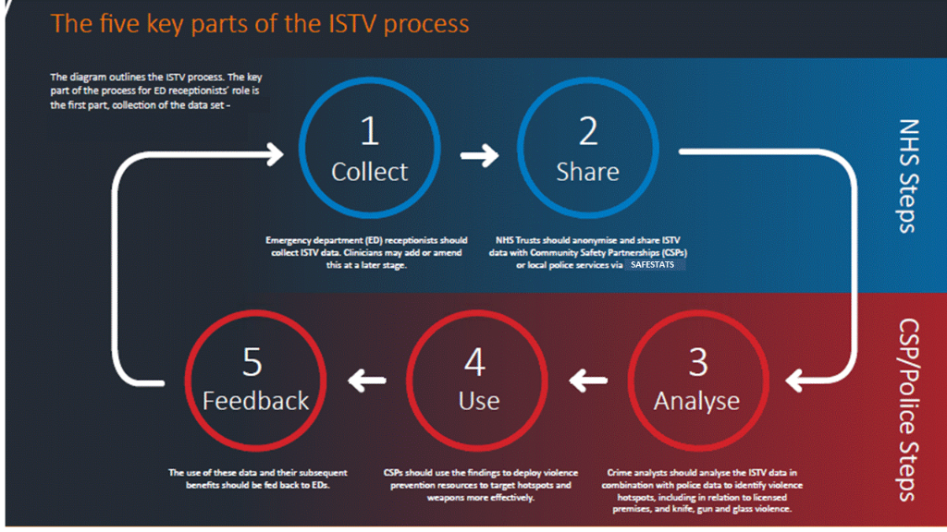
Cardiff model: Information sharing to tackle violence
Information Sharing to Tackle Violence (ISTV), aka the ‘Cardiff model’, involves collection of anonymised information by A&E departments that is shared with local Community Safety Partnerships.
The data covers all A&E attendances resulting from violent incidents, including the time, date and specific location of the incident and primary means of assault (for example a weapon or body part used).
Implementation can prevent alcohol-related violence by helping policy to identify hotspots, including specific licensed premises.
A multi-agency Violence Reduction Unit was established in London in 2018 to assess and take action on data collected via the Cardiff Model, which can also be used to tackle knife crime.
Guidance for London policymakers on the implementation of the Cardiff Model outlines resources available to health professionals, policy makers, researchers and analysts.

Slide 37
Alcohol identification and brief advice (IBA)
Preventative approach aimed at identifying and providing brief advice to increasing and higher-risk drinkers.
Delivered in a range of setting including health and social care, criminal justice, housing and youth.
The Health Innovation Network South London has produced a Toolkit for Commissioning Alcohol Identification and Brief Advice which includes:
  Guidance on commissioning across a range of different settings
  Framework for ensuring quality of delivery
  Guidance on workforce development
  How to calculate return on investment
Health Education England also provides a range of comprehensive e-learning courses on alcohol identification and brief advice
The 5 alcohol-use screening tests, known as the alcohol use disorders identification test (AUDIT) tools, help healthcare professionals to assess a patient’s level of risk to alcohol harm.

